Slide 1
SemiMonthly Payroll
What You Need to Know
Office of Human Resources Business Office

Slide 2
Key Focus Areas for transition to Semimonthly payroll
What is semimonthly payroll?
TRANSITION PERIOD & PAY SCHEDULE
Taxation and other deductions
EXEMPT VS NON-EXEMPT EMPLOYEES
BENEFITS ADMINISTRATION

Slide 3
What is semimonthly payroll?
It is a pay cycle in which employees are paid twice a month, on the 15th and the last business day of the month.
Employees will receive 24 paychecks in a year. Non-exempt employees will be paid for actual hours worked per pay period.
If either the 15th or the last business day of the month falls on a weekend or holiday, the pay date will be on the preceding business day.

Slide 4
Who is affected by this change?
All college employees. Hourly part-time employees are already in a semimonthly payroll.
Monthly payroll will no longer be offered. Effective January 1, 2025, all employees will be paid semi-monthly.
Can I opt out of this change? NO

Slide 5
Why is south Texas college converting to semimonthly?
Pay Frequency: employees are paid more frequently, twice monthly, rather than once a month.
Consistent cash flow: employees can schedule personal finances and other payments based on the dates employees receive their paycheck each month.
Actuals: Non-exempt employees are paid for actual hours worked rather than estimated hours and are compensated for overtime hours closer to the time they worked rather than waiting for the following month.
Best Practice: Semimonthly payroll ensures more accurate processing and is a widely preferred payroll schedule.

Slide 6
Exempt vs. Non-Exempt Employees
Exempt Employees
Do not clock in and out
Do not receive overtime pay
Are paid on an annual salary basis
Non-Exempt Employees
Are required to clock in and out
Are eligible for overtime pay
Are paid on an hourly basis

Slide 7
Exempt Employees (Faculty and Staff)
Annual pay will be divided into 24 equal payments
Gross payments for all 24 semimonthly pay dates will be the same
Non-Exempt Employees (Staff)
Employees will be compensated based on the number of hours worked during each pay period
Number of hours per pay period multiplied by the hourly rate
Gross payment amounts may fluctuate depending on the number of days and hours worked within each pay cycle

Slide 8
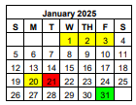
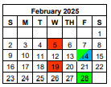
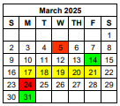
Non-Exempt Employees – Assuming a standard 8-hour per day work schedule
Pay period: 1/1/2025 – 1/15/2025, pay date 1/31/2025
11 business days X 8 hours per day = 88 total hours
Pay Period: 1/16/2025 – 1/31/2025, pay date 2/14/2025
12 business days X 8 hours per day = 96 total hours
Pay period: 2/1/2025 – 2/15/2025, pay date 2/28/2025
10 business days X 8 hours per day = 80 total hours
Pay Period: 2/16/2025 – 2/28/2025, pay date 3/14/2025
10 business days X 8 hours per day = 80 total hours
Pay period: 3/1/2025 – 3/15/2025, pay date 3/31/2025
10 business days X 8 hours per day = 80 total hours
Pay Period: 3/16/2025 – 3/31/2025, pay date 4/15/2025
11 business days X 8 hours per day = 88 total hours

Slide 9
Non-Exempt Employees –Overtime Hours and Pay
Overtime hours will be compensated closer to the time the hours were worked
All regular hours and overtime hours will be paid according to the semimonthly pay schedule
Ex: Regular and overtime hours worked 2/1/2025 – 2/15/2025, will be paid on 2/28/2025
For the one-time transition, all overtime hours worked in December 2024 will be paid on January 15, 2025
Please review and approve all your weeks in TCP in December as soon as possible to ensure accurate payment

Slide 10
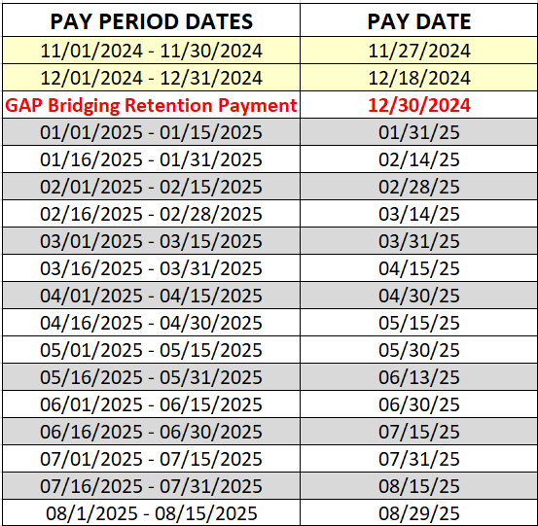
TRANSITION PERIOD AND PAY SCHEDULE
Effective January 1, 2025, all employees will transition from monthly to semi-monthly payroll.

Slide 11
TRANSITION PERIOD AND PAY SCHEDULE
(one-time) Gap Bridging Retention Payment
As the first semimonthly pay date on January 31, 2025, covers only the period from January 1 – 15, resulting in a paycheck of roughly half of the monthly amount, a Gap Bridging Retention Payment will be provided to all eligible full-time employees. The payment will equal half the monthly base pay (Primary Position) and will be paid on Monday, December 30, 2024. This additional payment does not need to be repaid.

Slide 12
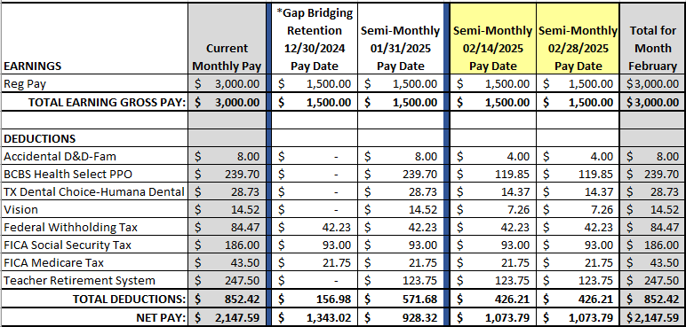
MONTHLY VS. SEMIMONTHLY
*Gap retention payment is not a true representation of what your semi-monthly wages.

Slide 13
$3,000 Monthly to Semimonthly Earnings
02/14/2025 Semimonthly Payroll $1,500
02/28/2025 Semimonthly Payroll $1,500
Grand Total of $3,000 ** at the end of the month
Benefit Deductions per pay cycle
04/15/2025 Semimonthly Payroll $1,500
04/30/2025 Semimonthly Payroll $1,500
Grand Total of $3,000 ** at the end of the month
Benefit Deductions per pay cycle
12/30/2024 GAP Retention Payment to cover for the first two weeks of Jan. 2025 $1,500**
Dec. 2024
Jan. 2025
Feb. 2025
Mar. 2025
Apr. 2025
12/18/2024 Monthly Payroll $3,000 **
01/31/2025 – First Semimonthly Payroll $1,500
Grand Total of $3,000 ** at the end of the month
One time monthly Benefit Deductions on 01/31/2025
03/14/2025 Semimonthly Payroll $1,500
03/31/2025 Semimonthly Payroll $1,500
Grand Total of $3,000 ** at the end of the month
Benefit Deductions per pay cycle
**Non-exempt employee: gross payment amounts may fluctuate depending on the number of days and hours worked within each pay cycle

Slide 14
EMPLOYEE PAY OVERVIEW
NO IMPACT
Your annual salary and/or hourly rate.
Benefits coverage.
How much you pay for benefits.
Your annual earned leave.
When you use your leave.
Fair Labor Standards Act (FLSA) designation.
Required Teacher’s Retirement System (TRS) and Optional Retirement Plan (ORP) contributions.

Slide 15
Payroll Taxation
How will this change affect my tax withholdings (IRS Form W-4)?
The system will calculate and deduct taxes based on the IRS Tax Tables applicable to the payroll frequency.
However, if you have elected to make additional tax withholdings, you may want to consider making necessary updates by completing a new W-4 form.

Slide 16
WAGE GARNISHMENTS
Child Support
Student Loans
Tax Levies
Bankruptcy

Slide 17
REVIEW: Your Payroll Contributions & Personal Finances
Direct Deposits into multiple accounts.
You may want to make changes if you have multiple accounts receiving direct deposit payments or if you have specific dollar amounts arranged. For example, if you have setup for $100 to be put into a secondary account each month, you will want to change the amount to $50, since it is applied each pay period.
Automatic Payments

Slide 18
VOLUNTARY CONTRIBUTIONS & WITHHOLDINGS
Texa$aver 457
Scholarship Donations
403b Annuity
United Way

Slide 19
BENEFITS ADMINISTRATION
Paying for Insurance Premiums from 12 to 24 pay checks
VISION
LIFE
Disability Insurance
HEALTH
DENTAL
TexFlex

Slide 20
Tips for employees
Review your expenses and due dates
Plan what expenses will be paid with each paycheck
Coordinate and discuss with debtors any necessary adjustments to the payment due dates
Consider utilizing the Gap Bridging Retention Payment to negotiate and secure adjustments to the payment due date
Visit our website: About Semimonthly Payroll | South Texas College
About Semimonthly Payroll
Gap Bridging Retention Payment
Frequently Asked Questions
Calculator
Resources
Personal Finance

Slide 21
Additional Resources

Slide 22
Additional Resources
Employee Assistance Program (EAP): https://www.uth.edu/uteap/
-Login with your EAP credentials to access helpful webinars:
Talking to Your Partner About Money
Meet in the Middle
Avoid These 10 Common Money Mistakes
What is a Budget?
A budget allows you to plan your income and your expenses over some time. Review these resources from consumer.gov for information about budgeting.
Making a Budget
Budget Worksheet

Slide 23
Additional Resources
DatDate | Name | Workshop # | Zoom Link
Wednesday, November 13th, 2024 | Maximize Your EAP Benefits: Financial and Legal Resources for a Smooth Semimonthly Transition (11/13/24) | #344868 | https://southtexascollege.zoom.us/j/96240347469
Thursday, November 14th, 2024 | Aproveche al máximo sus beneficios de EAP: Recursos financieros y legales para una transición suave a pagos semimensuales (11/14/24) | #344871 | https://southtexascollege.zoom.us/j/99824375310
Friday, November 15th, 2024 | Maximize Your EAP Benefits: Financial and Legal Resources for a Smooth Semimonthly Transition (11/15/24) | #344870 | https://southtexascollege.zoom.us/j/96100745476

Slide 24
communications
Email notification to each individual employee from Office of Human Resources - October 1, 2024
Announcement and Informational Table at Fall Convocation – September 27, 2024
Message from the Office of the Vice President of Finance and Administrative Services – September 26, 2024
Social Media Post - September 19, 2024
Collegewide Alert Notice sent by Business Office - August 26, 2024
Message from the Office of the Vice President of Finance and Administrative Services - June 6, 2024
Message from the President - May 30, 2024
May 2024 Spotlight - May 30, 2024

Slide 25
Questions
?
Thank you!

