Slide 1
ERP Project Kick-off
October 19, 2023

Slide 2
Welcome and Opening Remarks

Slide 3
Project Vision
ERP Project is focus on:
Modernizing and automating business processes and systems to take advantage of emerging technologies.
Increasing effectiveness in business process areas and lowering operating costs.
Improving the student, faculty, and employee experience.

Slide 4
Market Analysis Timeline

Slide 5
We are ready to …

Slide 6
Partners
Workday
PTG
Peak Performance

Slide 7
The Workday Language
Tenant
Workday Community
Human Capital Management
HCM (Human Resources (HR))
FDM (Financial Data Market Chart of Accounts)
TAGs (FOAPAL)
Cloud – based
FTS
Smartsheets and Workbooks
National ID (SSN#)

Slide 8
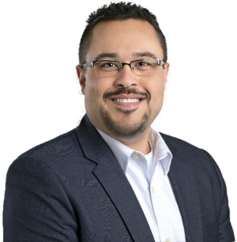
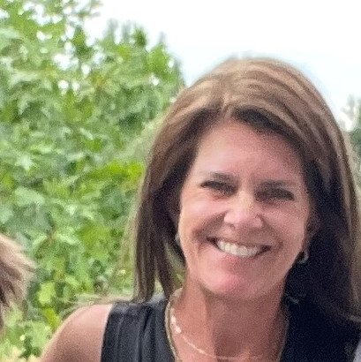
Workday
Roman Cortes
Holly Hall-Perry
Engagement Manager

Slide 9
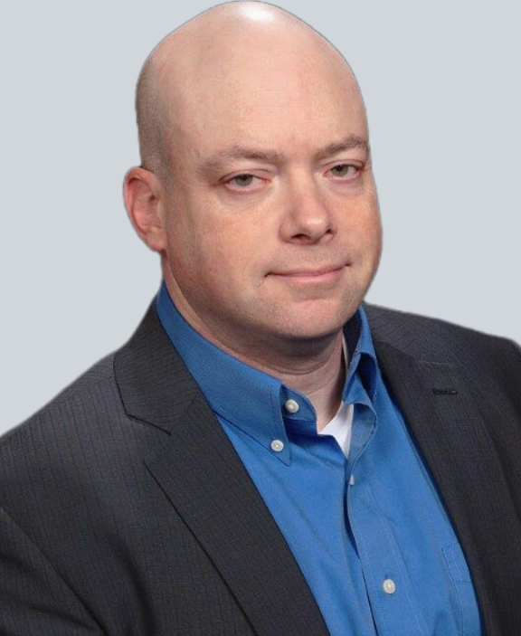
Precision Task Group (PTG) Introductions
PTG Exec Project
Sponsor
PTG Exec Project
Sponsor
Dave Meyers
Director, Workday Delivery & Operations
Jessica Rios
Account Executive
Higher Education

Slide 10
Overview of Precision Task Group (PTG)
Founded in 1980
Headquarters in Houston, TX
20 years of ERP experience
A TEXAS Workday implementation partner, advisory partner, AMS partner, and license reseller
Supported Collin College, Dallas College, Austin Community College, and Texas State Technical on their Workday implantation.
Privately-held, Minority-owned business

Slide 11
Peak Introductions
Rob Cardelli
President of Peak Performance Technologies
29 years of ERP experience
245+ colleges and universities
Program Management and Change Management Expert
9 Workday clients
Community College Expertise
Christian Heneghan
25+ years of education and government consulting
ERP/SIS transformation expertise
Community college expertise
Program Management, Change Management and Risk Management expertise
Workday Certified Program Manager
Anderson University (Workday Consulting)
Bucks Community College (Workday Consulting)
Mercer University (Accenture)
Meharry Medical College (Accenture)

Slide 12
Peak’s Role in Governance Model
Help create internal governance structure and align it with Workday consulting
Document stakeholder’s goals/objectives/measures of success and track them throughout deployment
Serve as executive advisor to leadership team to help drive transformation
Serve as internal program manager and mentor client throughout deployment
Serve as internal change management lead and help drive change activities
Proactively seek out risks and help mitigate them
Help keep client team ahead of schedule
Help facilitate design workshops
Help align STC strategic plan with multiyear Workday deployment

Slide 13
Help Create Project Management Structure
Educate STC leadership on the role and importance of a formal PMO
You MUST keep the platform current and build a culture of continuous process optimization
Help create PMO framework including the following:
Strategy
Rules of Engagement
Staffing
Templates
Resource utilization
Help breakdown operational barriers and “fiefdoms”
Help STC leadership align departments and staff to optimize project governance

Slide 14
Extended Market Analysis
May 2021-April 2023
Assembled a team of functional and technical business experts to help with analysis
Began documenting pain points and opportunities to improve
Documented requirements
Created questionnaires to send to vendors to gather company and product information
Conducted multiple rounds of product demonstrations
Gathered procurement/contracting options
Gathered high level pricing data and began setting aside funds
Conducted multiple reference calls
Hired a consulting firm in spring 2023 to assist with final analysis and strategic planning

Slide 15
Departments Involved in Analysis
Admissions
College Connections
Financial Aid
Bursar/Student Accounts
Accounts Receivable
Student Records
Faculty/Deans
Learning Outcomes
Registration & Recruiting
Curriculum Management
Advising
Dual Programs
Workforce and Continuing Education
Distance Learning
Students
Vice Presidents
Recruiting and Onboarding
Performance Management
Succession Planning
Core HR
Benefits
Payroll
Time and Attendance
Core Financials
Core Accounting
Accounts Payable and Purchasing
Grants Management
Capital Projects
Business Assets
Travel and Expense Management
Financial Planning
I/T
College President

Slide 16
Example of Areas of Analysis
What people do
How they do it
Why they do it
Most common processes
Who is involved
Staffing considerations
Quality of service
Opportunities to improve
Systems Accessed
Data Management
Ease of Use
Workflow/Processes
Training
Impact on student or others
Pain points
Risks
Touch points with other systems
Current State & Future State
Analysis
Usage of
Technology
How projects are identified
How projects are estimated
How projects get staffed
Staffing levels
How projects are funded
How projects are managed
How projects get tracked
How project success is measured
Policies
User Procedures
Stakeholder analysis
Communication plans
Training
Documentation
Impact of Change
Culture and Willingness to Change
Impact on mission/culture
Project
Governance
Change
Management
Considerations

Slide 17
Why Education Customers are Transforming

Slide 18
Aligning with Generation Z
Baby Boomer Generation
Born 1946-1964
Ages 77-59
Predates PC’s & Mobility
PMC: Personal Conversation
Decades of Industry
Experience, Wisdom, Market Makers & Pioneers
Believes in Tenure
Generation X (Baby Bust)
Born 1965-1979
Ages 58-44
Always had PC, Predates Mobility & Internet
PMC: Email
Rising Stars
Loyal, Requires Career Path Growth
Xennials &
Millennials
Born 1975-1985,
1980-94
Ages 48-38, 43-29
Always had PC, Mobility & Internet
PMC: Text
Fresh Perspectives, Uninhibited & Impatient with Low Tech
iGen /
Generation Z
Born 1995-2012
Ages 28-11
Tablet, Smart Phone & Perpetual Connection
PMC: Social
Super Social, Obsessively Connected, Unconstrained, Non-Tolerant

Slide 19
Agility Is Necessary to Address “Generation Alpha” (Students born 2010-2025)
2.8 million Gen Alphas are born globally each week
Generation Alpha will be the most educated generation in history
Technology will be expected to be seamless throughout their lives
Aligning with the high schools will be more important than ever
Artificial Intelligence will be part of this generation’s learning model
Alphas are used to the immediate accessibility of information. As such, highly personalized and targeted learning experiences are critical
65% of Gen Alphas will work in jobs that don’t exist today
Half of Gen Alphas are expected to earn a university degree
Programs/courses/curriculum may need to be aligned with the workforce of tomorrow
Faculty will need to be trained/retooled
Facilities may need retooling for labs (virtual reality, augmented reality, new technology)
Expertise managing state and federal grants will be necessary to remain competitive
The latest industrial revolution (4.0) - the trend toward interconnectivity, automation, machine learning, and real-time data - will continue to transform the workplace, including changes in employability. This demands a response from higher education institutions

Slide 20
Summary of Challenges
Critical college platforms have atrophied to the point they have become a liability for many departments (HR, Payroll, Finance predominantly)
Many users lack the modern tools needed to remain competitive with peers
Limited ability to audit system - track data changes or updates (fields)
Many users are not getting data needed to get their jobs done
Need shadow systems (Excel) to validate, update, and manage data – leading to lack of consistency in reporting
Most departments are fragmented/siloed due to manual nature of work and volume
Many job functions are heavily manual and repetitive due to lack of system integration
I/T department has focused most support efforts on the SIS platform leaving the HR and Finance teams without adequate technical support for their critical applications
Key vacancy in I/T leadership and several open I/T and Business positions

Slide 21
Challenges with Existing Banner Platform
Banner is almost 3 decades old and has antiquated technology, inefficient tools, and ineffective processes to advance the College to the next level
Many job functions and processes are heavily paper-based
Faculty, staff, and students have to consolidate data from multiple systems
Dozens of critical systems that do not ‘talk’ to each other well
Fragmented technology and processes directly hinder service to faculty and students
Student System users have heavy reliance on IT to support day-to-day operations. They are not self sufficient. HR, Finance and Facilities have reverted to purchasing cloud-based 3rd party tools to solve problems. These are managed by the department’s functional teams without additional positions being added.
Current technology platform enables and supports organizational “silos” that hinder support to other departments, students, and alumni
The current platform has limited tools for automation
Business users struggle to obtain timely and accurate data to make critical decisions

Slide 22
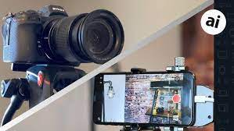
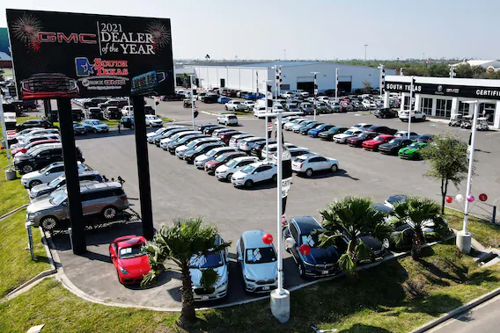
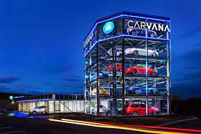
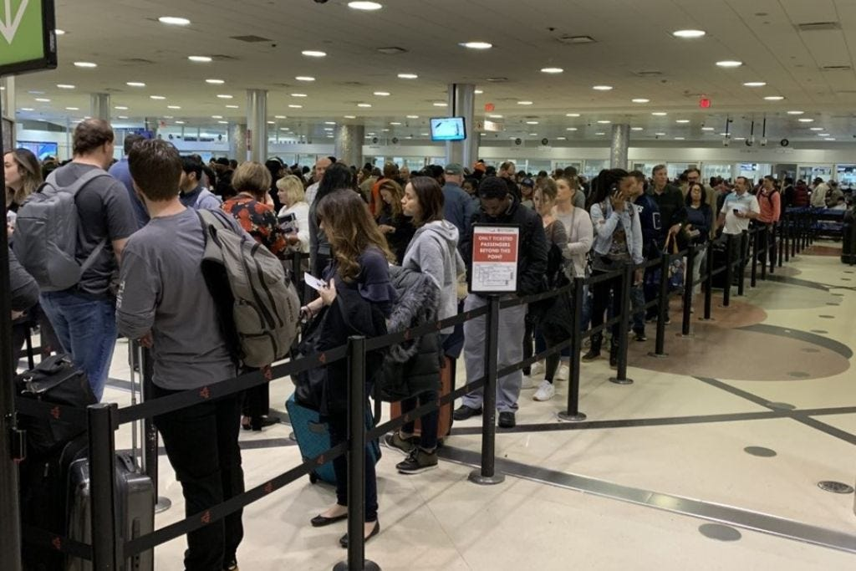
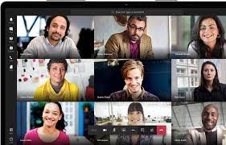
Colleges Must Evolve to Survive?

Slide 23
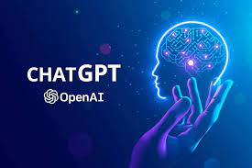
Technology is Evolving Rapidly
Netscape Navigator
Google LLC Formed
First Phone
STC Implemented
Banner
1994
1997
2005-2006
2007
2011
2017
2019
2022

Slide 24
STC Lacks Agility to Evolve
The fragmented nature of the current technology and processes makes it hard to add or modify programs to adapt to the changing needs of students and employers. A single, integrated platform will help better manage processes and data.
The underlying technical ecosystem is overly complex and requires elongated timelines to make changes
Current environment will make it difficult to address the needs and expectations of Generation Alpha, adult learner’s unique requirements and the rapidly evolving needs of the workforce
College leadership lack the tools and technology to model new programs to assess viability before investing in new offerings. The marketplace is evolving rapidly, and the pace of innovation will continue to evolve as the 4th industrial revolution expands throughout corporate America
Ellucian Banner’s current technical platform lacks the agility College requires to innovate in a timely manner to meet the changing expectations of students and workforce customers

Slide 25
What is Workday?
Workday Platform:
Finance, HR, and Payroll activities Go-live: Jan. 2025+
Followed by Rolling Adoption
Workday Student: Academic & Student activities Planned Go-live: 2027 and 2028
Workday is a cloud-based, Enterprise Resource Planning system which will help modernize digital operations.
The primary focus for now and through early 2025 will be Workday Platform.

Slide 26
Modern Enterprise Architecture
Hosted in the cloud and accessible from anywhere
Sustainable investment will ensure tools and technology stay “current
Reporting/Analytics/Dashboards/Query
Accounting/Finance
General Ledger
Accounts Payable & Purchasing
Accounts Receivable/Billing
Travel/Expenses
Asset Management
Budgeting/Planning
Projects/Contracts/Grants
Student
Recruiting/Admissions
Student Records/Advising
Student Success & Engagement
Student Financials
Financial Aid
Alumni Management
HCM
Recruiting/Onboarding
HR Transactions
Benefits Administration
Payroll/Time and Attendance
Performance Management
Employee Self Service
Collaboration Tools
Self Service, Mobile, Chat Bots, Simplified User Interface, Electronic Forms/Signature
Business Process Framework
Integrated Help Desk/Tutoring/Training Tools
Access Management
Workflow
Automation
Modernized
Security
Disaster
Recovery
Reporting
Analytics
Integration
API Tools
Simplified
Data Model

Slide 27
Workday Had Proven Banner Conversions
Workday has been rapidly growing the higher education marketplace
130+ clients with almost 40 live on full HCM, Finance and SIS
Robust product roadmap that has a proven track
Many Banner to Workday clients including
Collin College
Ivy Tech Community College
Owens Community College
Meharry Medical College
St. Norbert College
Bowdoin College
Bucknell University
Emerson College
Fairfield University
Florida Atlantic University
Florida Gulf Coast University
Florida Institute of Technology
Grand Valley State University
Guilford College
Miami University
Northeastern Illinois University
Rhodes College
Southern Oregon University
Saint Louis University
University of North Florida
University of Richmond
Vassar College
Wellesley College
William Paterson University
Wofford College
Montgomery College
Wake Forest University
Northwest Arkansas Community College
Smith College
Aims Community College
University of the Cumberland's

Slide 28
Additional Workday Higher Education Clients
State University of NY-Erie Campus
Syracuse University
New York University
Bucks County Community College
North Hampton Community College
Anderson University
Pensacola State College
American University
Calvin University
Barnard College
Washington and Lee University
University of the Cumberland's
Jolliet College
University of Maryland
University of Missouri System
Medical University of SC
Aims Community College
Grand Valley State College
Century College
Montgomery College
University of Akron
Furman University
Wake Forest Medical College
Mercer University
Depauw
Wofford College
Collin County Community College
Worchester Poly Tech
Bowdoin University
LSU
St. Anslem College
Hinds Community College
Arizona State University
Florida Gulf Coast University
Embry-Riddle
Austin Community College
Wellesley College
Broward College
Howard University
University of Miss. Medical College
Rhodes College
Kansas City Medical University
University of Virginia Medical Center
WVU School of Medicine
VCU Health
University of Central Florida
Minnesota State College System (20+ colleges)
Vanderbilt Health
Stanford School of Medicine
State University NY-SUNY
College of Lake County
Meharry Medical College

Slide 29
Multiple Texas Colleges Moving To Workday
Workday has multiple implementations with Texas colleges and universities going on
HR and Finance are live today and the Student Information System is being implemented at multiple colleges
Collin Community College
Austin Community Colleges
Texas State Technical Colleges
University of Texas-Austin live on HCM
Texas A&M System
Trinity University
Dallas College
Multiple colleges will be LIVE before we even begin
All Texas State reports will be in place and proven before we begin

Slide 30
Project Guiding Principles
Respect for Staff’s Day Jobs
Business driven transformation and not just another I/T project
Adopt Workday best business practices
Follow the Workday LDP (Lifecycle Deployment Program) methodology
Break down operational silos and drive consistency across all business areas
Build governance model that enables continuous process optimization
Just because the system can do something doesn’t mean it should
Focus on the core activities not the exceptions: (80/20)
Eliminate paper and leverage workflow and automation
Position based training
Intentional focus on documentation of user procedures

Slide 31
What areas are changing?
Phase 1- October 2023 - January 2025
Finance
Banking & Settlement
Budgets
Business Assets
Customers / Billings
Expenses
Endowments
Financial Accounting
Foundation Data Model (FDM)
Projects, Contracts and Grants
Procurement
Supplier Accounts / Accounts Payable
Human Resources
Absence
Benefits
Compensation
Human Capital Management (HCM)
Payroll
Recruiting and Onboarding
Talent Management
Time Tracking
Employee Self Service
Manager Self Service
There may also be changes related to data management, reports, and security.

Slide 32
What areas are changing?
Phase 2- Fall 2025 – Fall 2028
Student Information System
Recruiting & Admissions
Alignment with Dual Enrollment
Student Records
Academic Advising
Student Billing
Financial Aid
Workforce Development
Student Success/Retention
Institutional Reporting
Student Portal
Mobile
Chatbots/Artificial Intelligence

Slide 33
Primary HCM Goals and Objectives
Consolidate HR systems and functions into a single integrated platform
Eliminate manual processes and duplication of data entry
Implement a modern talent management system
Deploy workflow and automation tools throughout the organization
Simplify data model to enable real time reporting and analytics
Enhance the support model to improve customer service to employees
Improve timeliness and accuracy of payroll operations
Simplify compliance and regulatory reporting requirements
Align HR and Finance data models to expand reporting capabilities
Departments
Positions Control/FTE Position Budgeting
Chart of Accounts

Slide 34
Primary Finance Goals and Objectives
Implement and utilize state-of-the-art technology that will benefit the students, employees, vendors, and the community
Modernize chart of accounts and align with academic structure to enable more robust budgeting/planning and forecasting
Modernize accounts payable and purchasing processes and leverage electronic forms, workflow and duplicate checking capabilities to keep vendor file clean
Simplify management of travel and expenses
Leverage project costing and grants to increase accuracy of compliance reporting
Better management of student billing including fee management and delinquent accounts
Enhanced integration capabilities to connect 3rd party systems and simplify reporting
Reduce number of 3rd party systems by utilizing a single/robust finance platform
Enable staff to be data driven leaders by providing real time access to data
Tighten integration between HR, Finance and SIS platforms to create frictionless processes
Finance team is lean and has limited I/T support in regard to the Banner tools

Slide 35
Primary Student System Goals and Objectives
Simplify processes for staff, faculty and students
Expand automation and simplify communication to all stakeholders
Align HR, Finance and SIS platforms into a single data model to enable robust reporting
Provide modern tools for portal, mobile and self service
Provide more intuitive student billing capabilities
Provide a platform that seamlessly aligns recruiting and admissions tools with the SIS
Provide an agile platform to build and deploy new programs of study
Provide tools to strengthen advising capabilities
Provide tools and technology to expand tracking and management of student success
Deploy a platform that enables continuous process optimization
Provide reporting tools that allow business users to manage reporting and analytics with little to no involvement from I/T personnel

Slide 36
Project Governance Structure

Slide 37
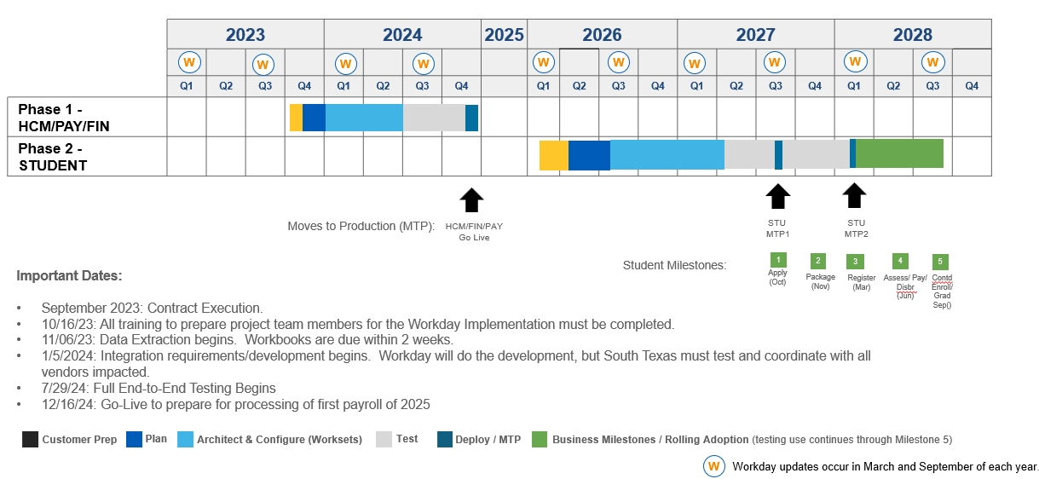
Current Workday Deployment Timeline

Slide 38
Formula For Successful Transformation
Project Management
Future State
Process
Reimagining
Successful
Transformation
Organizational
Change
Management
Data
Governance

Slide 39
Align project governance for transformation
Project
Managers
PMO Capabilities
Change
Management
Business Transformation Resources
Portfolio
Mgmt.
Tools
Create Prioritized
List of Projects
Business Driven Leadership
Realign Governance
Accountability
and Trust
Executive Sponsorship
Measures of
Success
Manage until expected outcomes achieved
Broad Stakeholder
Representation
Business Transformation Committee
This is required before any transformation initiatives begin!

Slide 40
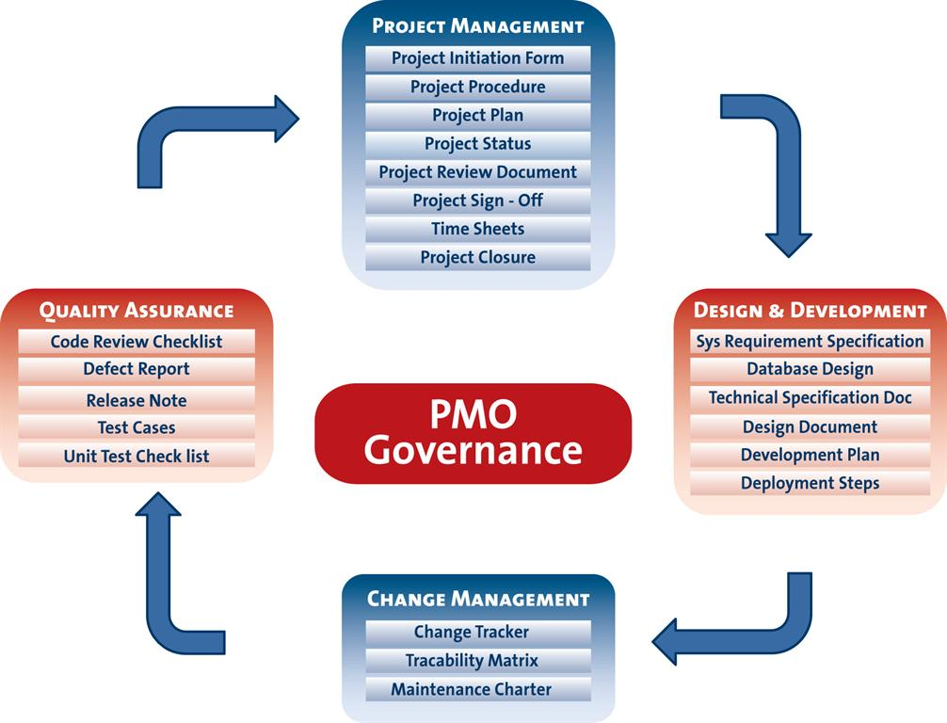
Project Management Consistency

Slide 41
Simplified Data Governance
Standard data inputs
Common
Tools
Common Processes
Role
Based
Access
Create Common Data Definitions
Audit and cleanse data and update data model
Train staff and instill accountability
Conduct Regular Cleanliness Audits to maintain data integrity
Accurate Data
41

Slide 42
Change Management Drives Transformation
Stakeholder analysis
Communication plans
BPR and Business Process Standardization and Modernization
Cultural alignment
Modernizing segregation of duties
Digital transformation (eForms with signature, workflow, mobile, dashboards, chatbots)
Usability analysis
Role-based testing and role-based training
Creation of user procedures or training videos that are position based
Creation of future state production support model

Slide 43
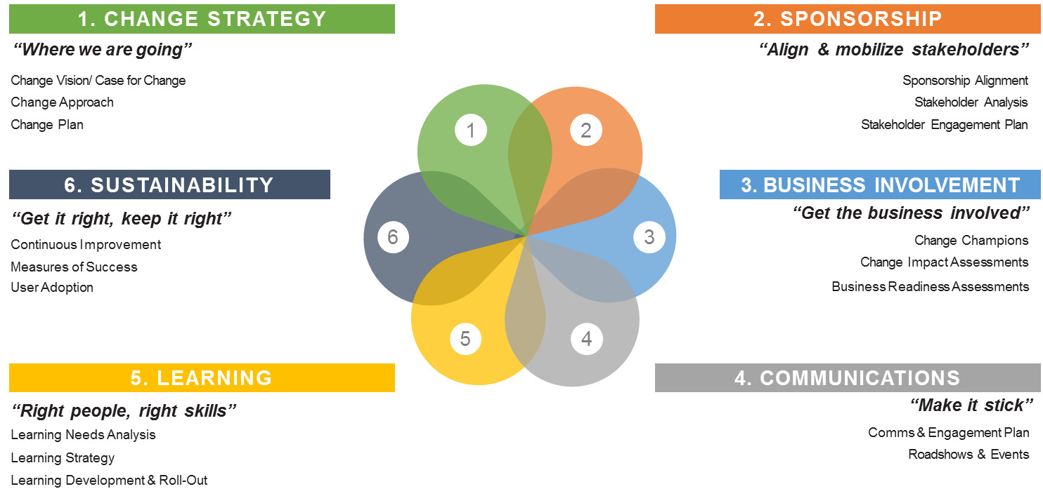
Change Management Framework

Slide 44
Change Management Training
Educate the STC team on the value of organizational change management
Familiarize the team with terminology and concepts
Help train team to maintain a model of continuous process optimization

Slide 45
Change Activities By Phase (Example)

Slide 46
The Value of Change Management

Slide 47
Project Life Cycle People Emotions
What Else Can it Do?
This is Taking a Lot of Time!
I Like Doing it the Old Way!
This Thing Works!
Happy Team Member
WOW! This is Cool!
Reimaging the Future
I am Doing 2 Full-Time Jobs!
Change to Make Things Better!
Nothing is Working Like we Expected
That is a Little Better – But Not MUCH!
Irritated Team Member
Why are We Leaving Banner?
I Can’t Do My STC Day Job
Project Kickoff Planning
I Wonder if I am Eligible for Early Retirement

Slide 48
Gartner’s Top Reasons Projects Fail
Governance is not business transformation focused
I/T driving the project versus business
Lack of consistent executive sponsorship
Inaccurate vendor selection/product match with requirements & culture
Lack of focus on organizational change management
Poorly defined measures of success
Communication
BPR/BPO
Segregation of duties
Poorly structured project teams
Resources don’t have the right skills or knowledge
Resources aren’t adequately committed to project (day jobs)
Unrealistic schedule

Slide 49
Gartner’s Top Reasons Projects Fail
Inaccurate and/or incomplete requirements definition
Data integrity/conversion/validation
Scope creep and poor change control
Poorly executed user testing and validation of future platform
Ineffective user documentation
Poorly trained staff
Big bang vs compartmentalized deployment
Future state support model not well thought-out

Slide 50
Focus On Workbooks and Initial Data Mapping

Slide 51
Working on

Slide 52
We are ready to …

