Slide 1
Position Control Budget Tips
Nora Cantu
Budget/Position Control Accountant

Slide 2
Common errors in FORM BO-3700 - DELAYS
Missing signatures as required see “Required Signatures for Approval” on top left corner of the form.
Missing details under “ JUSTIFICATION”
Combining Grant, Auxiliary, and Bond positions in one form. Transfers can only be done within same Fund type.
Not reviewing totals at the bottom and right columns for accuracy of transfer amounts.
Round to 2 decimal points, do not use infinite numbers ☺
Can add lines to include more positions or signatures, but please do not change the overall physical appearance of the form

Slide 3
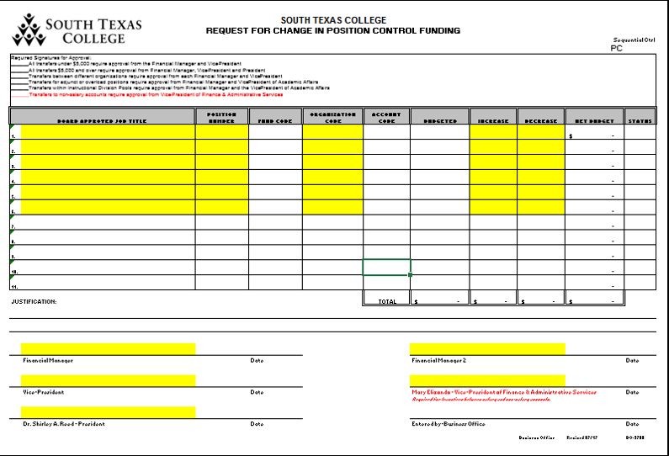
BO-3700 POSITION CONTROL FORM
Use for changes to Positions Budgets
Link-P

Slide 4
SALARY SAVINGS REPORT
Distributed to VPs
Monthly

Slide 5
QUESTIONS “?”

Slide 6
THANK YOU !
Nora Cantu
Budget/Position Control Accountant

