Slide 1
Business Office
Banner 9 Finance Pages & Navigation

Slide 2
Banner 8 vs Banner 9 Comparison
Login
Filters and Wildcards
Data Extraction
Banner 8 forms vs Banner 9 pages
Shortcuts

Slide 3
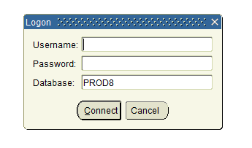
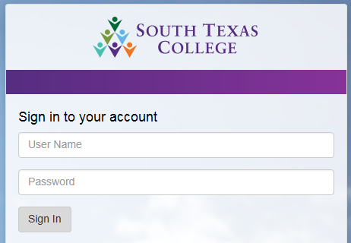
Login Changes
Banner 8 used to have it’s unique authentication
Banner 8
Banner 9 authentication has been changed to your email username and password
Banner 9

Slide 4
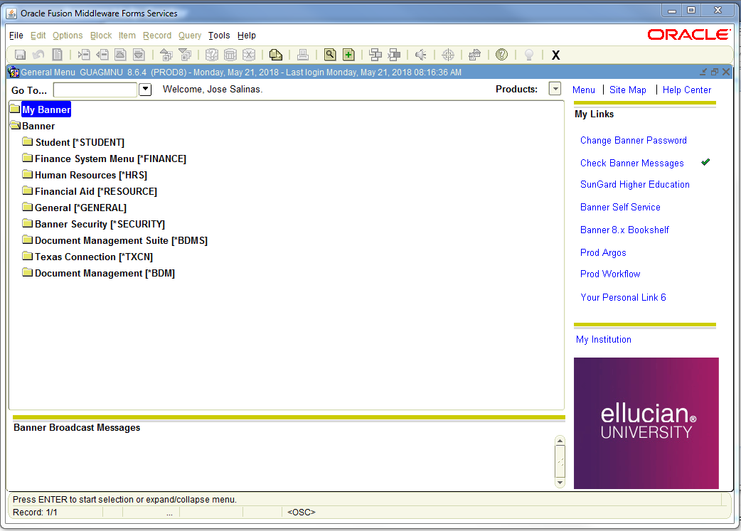
Landing Page Overview
Banner 8
Banner 9
Able to search by page name, description or any keyword. It will auto search and show options as a list under the search bar.

Slide 5
Banner 8
Query and Wildcards
Query-Retrieve information based on criteria
Accessible through the Query Menu or through the query buttons on the toolbar
Query Menu | Toolbar | Action
Query; Enter |  | Begins the query process
Query; Execute |  | Performs the query based on the criteria entered
Query; Cancel |  | Cancels the query

Slide 6
Banner 9
Filters and Wildcards
Filter-Retrieve information based on criteria
Accessible through the Sub-Menu on every page when applicable or through the shortcuts below.
Filter Shortcuts |  | Action
(F7) |  | Brings up the filter screen
(F8) |  | Performs the query based on the criteria entered
ESC or Ctrl + Q |  | Cancels the query

Slide 7
Query/Filter and Wildcards
Banner 8 & 9
Wildcards-Used to represent characters within a query
“%” can be used to represent any character
“_” can be used to represent one character
Query Criteria | Action
71% | Query for all operating records
73% | Query for all travel records
74% | Query for all capital records
%JAN% | Query for all January records
%2018 | Query for all 2018 records
_m% | Query for all records that have “m” as the second letter

Slide 8
Banner 8
Extracting Data to Excel
Extracts parameter information from top of form
Does not extract parameter information from top of form
Click “OK”
Click “Save As”
Name file, keep the extension as “csv”
Open file in Excel and save in Excel format
Delete “csv” file

Slide 9
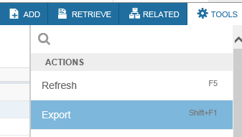
Banner 9
Extracting Data to Excel
Click on “TOOLS”
Click on “Export”
Either save or open file as prompted
Or simply use the shortcut key “Shift+F1” then save or open file

Slide 10
Forms Overview
Banner 8 & 9
Form | Description
FGIBAVL | Use the Budget Availability Status Form to view an online query of the budget availability for a selected fund, organization, account, and program combination.
FGIBDST | Use the Organization Budget Status Form to view an online query of the budget availability by organization code.
FGITRND | Use the Detail Transaction Activity Form to display an online view of detailed transaction activity for operating ledger accounts.
FOIAPPH | The Document Approval History Form provides an online display of the approval history for a specified document.
FTMORGN | Use the Organization Code Maintenance Form to establish organization codes representing functions and departments within your site.
FTMFUND | The Fund Code Maintenance Form enables you to establish fund codes for a specific chart of accounts
FOIDOCH | The Document History Form displays the processing history of purchasing and payment documents. It identifies and provides the status of all documents in the processing path for the document you select.

Slide 11
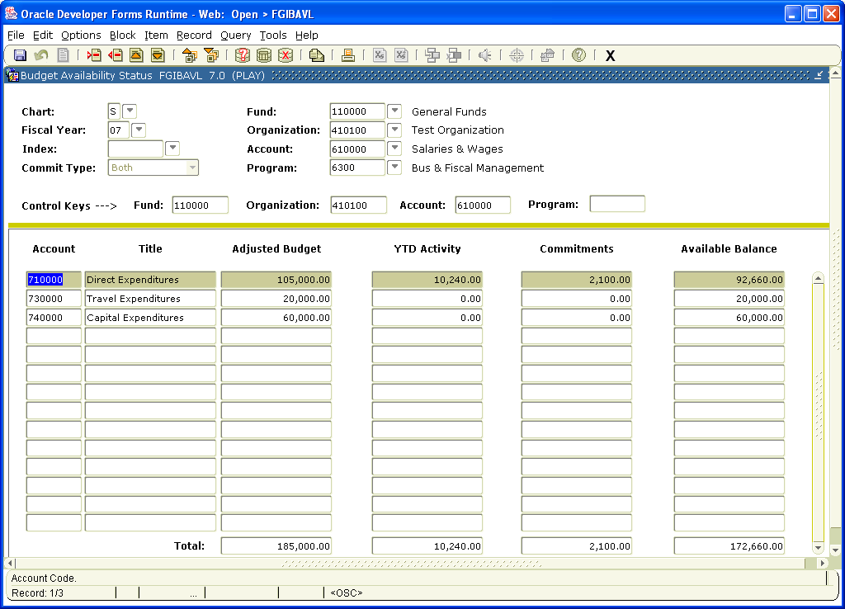
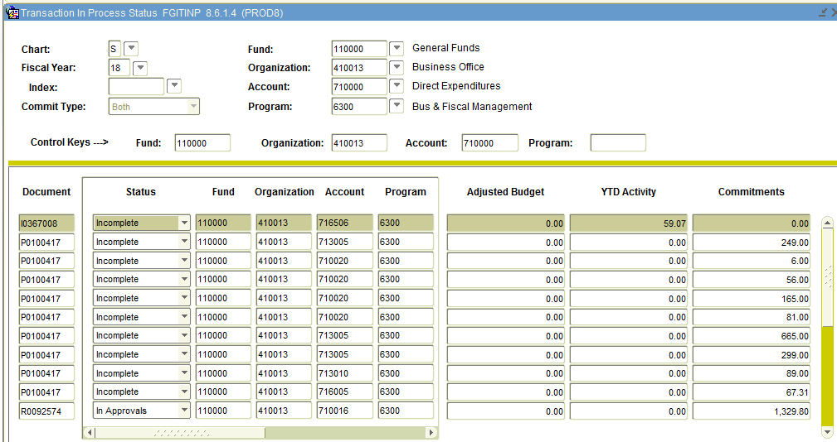
Banner 8
Review Budget Status on FGIBAVL and pending documents in FGITINP
FGIBAVL is the form Banner uses to check Non-Sufficient Funds (NSF)
Pending documents can be reviewed by going to Options-> Pending Documents [FGITINP]
The available balance on FGIBAVL is reduced by complete, incomplete, suspended, and unapproved transactions (requisitions, POs, invoices and journal entries)

Slide 12
Banner 9
Review Budget Status on FGIBAVL and pending documents in FGITINP
Enter your search criteria and press “Go” when ready
This will bring up the summary for your search criteria
*Note – FGIBAVL is the form Banner uses to check Non-Sufficient Funds (NSF), also the available balance in FGIBAVL is reduced by complete, incomplete, suspended and unapproved transactions (requisitions, PO’s, invoices and journal entries).

Slide 13
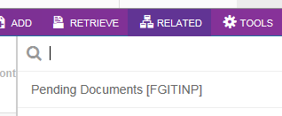
Banner 9
Pending documents in FGITINP
Pending documents can be reviewed from Related -> Pending Documents [FGITINP]
This should bring up the list of any pending document

Slide 14
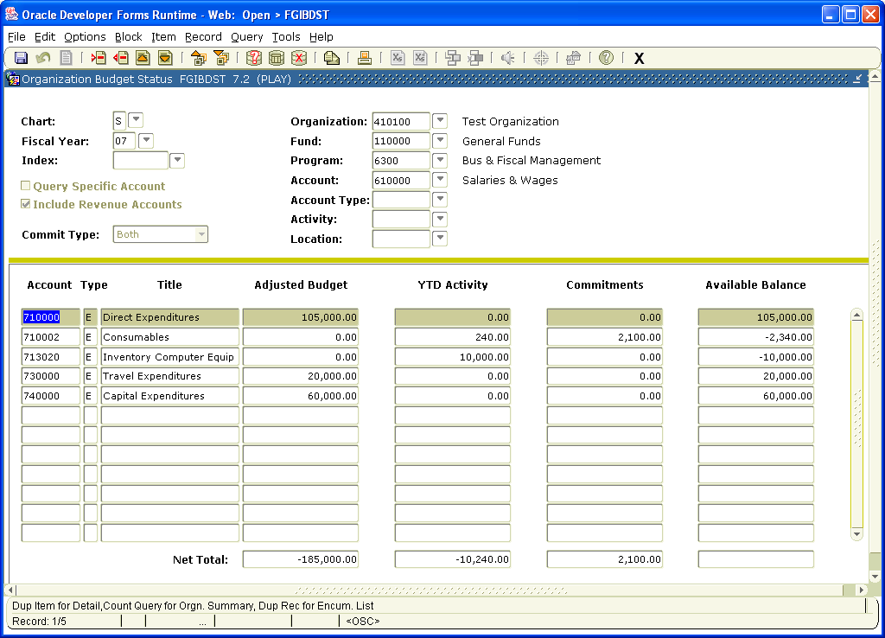
Banner 8
Review Budget Status on FGIBDST
Unlike FGIBAVL, only complete and fully approved documents post to FGIBDST
FGIBDST also provides a more detailed summary by account code while FGIBAVL shows a summary by account pool.

Slide 15
Banner 9
Review Budget Status on FGIBDST
Enter your search criteria and press “Go” when ready
This will bring up the summary for your search criteria
*Note – FGIBDST unlike FGIBAVL, only complete and fully approved documents post to FGIBDST. Also FGIBDST provides a more detailed summary by account code while FGIBAVL shows a summary by account pool.

Slide 16
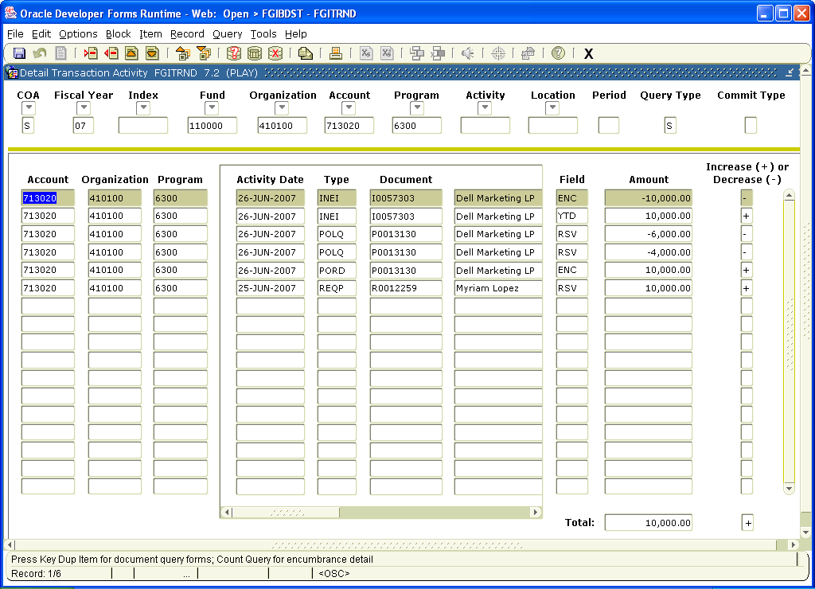
Banner 8
Transaction Detail - FGITRND
The field column can help you determine the type of transaction.
OBD – Budget transaction
RSV – Encumbrance transaction from requisition
ENC – Encumbrance transaction from PO
YTD – Expense transaction from invoice, journal entry or feeds from other system (Student, HR)
- “I” documents are Invoices, “J” documents are Journal Entries, and “F” documents are feed transactions

Slide 17
Banner 9
Transaction Detail - FGITRND
Enter your search criteria and press “Go” when ready
This will bring up the filter screen in case you need to narrow down your search if no additional filters needed press “Go”. This should bring up the summary for your search criteria.
*Note – FGIBDST unlike FGIBAVL, only complete and fully approved documents post to FGIBDST. Also FGIBDST provides a more detailed summary by account code while FGIBAVL shows a summary by account pool.

Slide 18
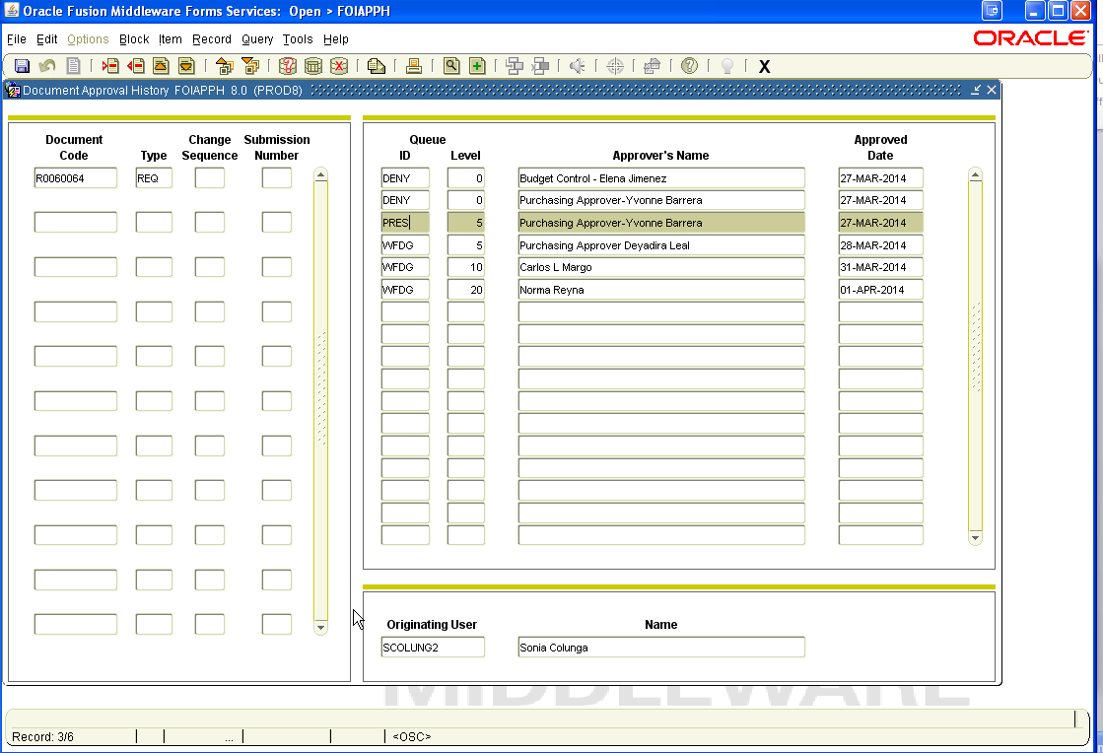
Document Approval History - FOIAPPH
Banner 8
Approval queues level for non-grants
Level 5 – Purchasing
Level 10 – Budget Control
Level 20 – Financial Manager
Level 30 – Purchasing Director
Grants queues levels
Level 5 – Purchasing
Level 10 – Financial Manager
Level 20 – Grants Office
Level 30 – Purchasing Director
People that have approved or denied.
Requisition requestor

Slide 19
Document Approval History - FOIAPPH
Banner 9
When navigating to FOIAPPH, filter screen is displayed. Select your search criteria then press “Go” to continue.
This should bring up the approval history of the document in question.
Non-grants approval queue
Level 5 | Purchasing
Level 10 | Budget Control
Level 20 | Financial Manager
Level 30 | Purchasing Director
Grants approval queues
Level 5 | Purchasing
Level 10 | Financial Manager
Level 20 | Grants Office
Level 30 | Purchasing Director

Slide 20
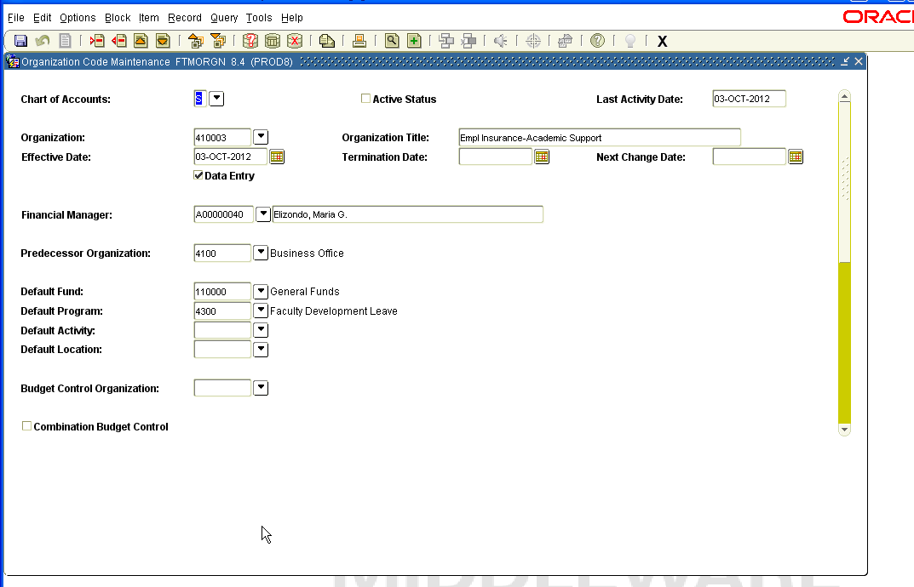
Banner 8
Organization Code Maintenance - FTMORGN

Slide 21
Organization Code Maintenance - FTMORGN
Banner 9
Use shortcut key “F7” or click on Filter to enter query mode. Select your filter choices and press “Go” when ready.
This will bring up the current record for your search criteria.

Slide 22
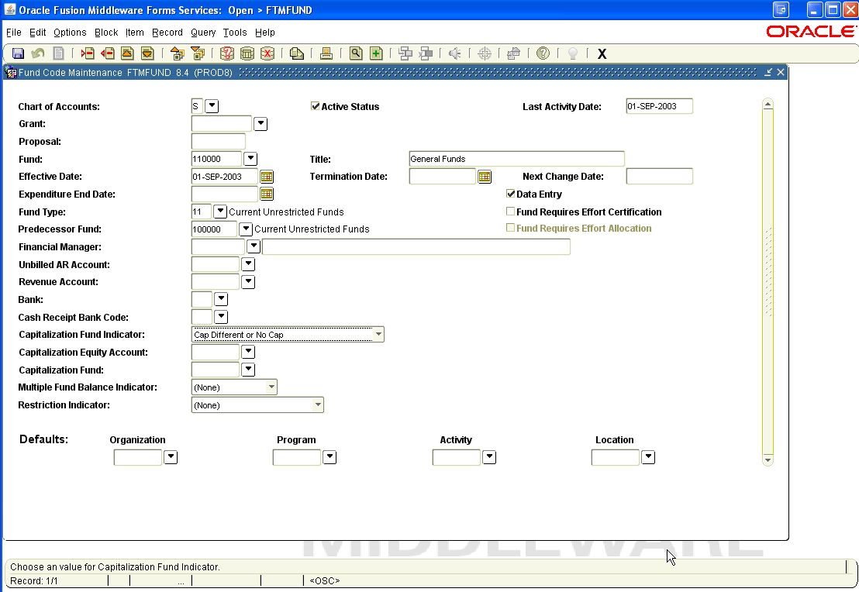
Banner 8
Fund Code Maintenance - FTMFUND

Slide 23
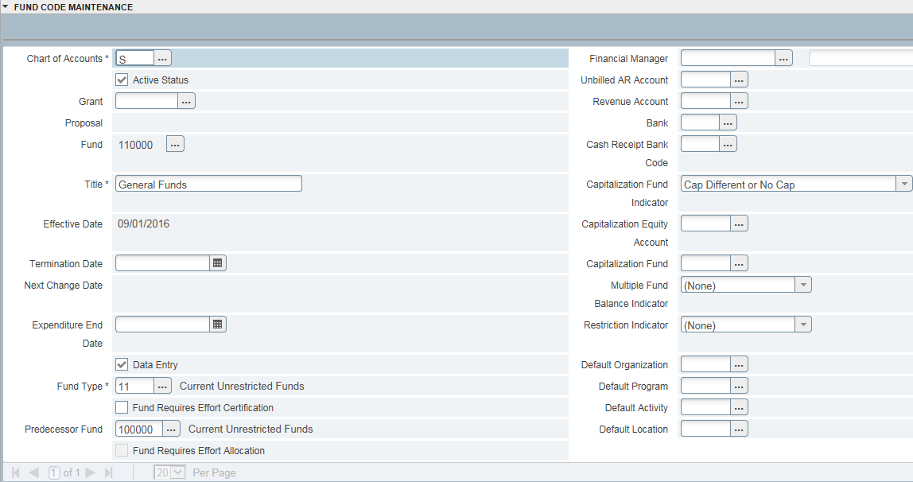
Fund Code Maintenance - FTMFUND
Banner 9
Use shortcut key “F7” or click on Filter to enter query mode. Select your filter choices and press “Go” when ready.
This will bring up the current record for your search criteria.

Slide 24
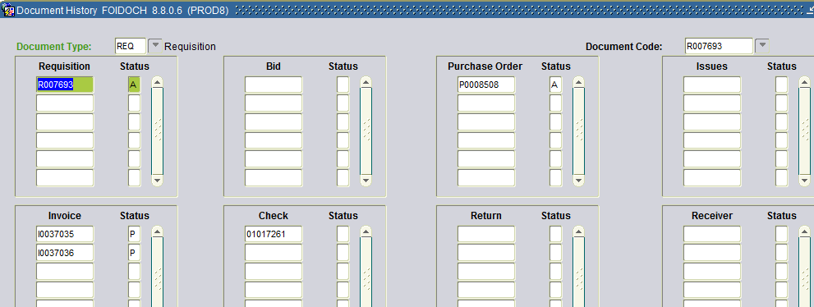
Banner 8
Document Review FOIDOCH
View FOIDOCH (Document History)
Lists all documents associated to a specific document based on the document number
Requisition number, P.O. number, Invoice number, Check number
Details about each document can be viewed through the Options menu

Slide 25
Banner 9
Document Review FOIDOCH
View FOIDOCH (Document History)
Lists all documents associated to a specific document based on the document number
Requisition number, P.O. number, Invoice number, Check number
Details about each document can be viewed through the Options menu
Document Code | Description
REQ | Requisition
PO | Purchase Order
INV | Invoice

Slide 26
AP Forms Overview
Banner 8 & 9
Form | Description
FTMVEND | Use the Vendor Maintenance Form to view vendor default information, text, and addresses.
FAIVNDH | Use the Vendor Detail History Form to view invoice status and payment history.
FGIENCD | Use the Detail Encumbrance Activity Form to view available balance on POs and travel encumbrances.

Slide 27
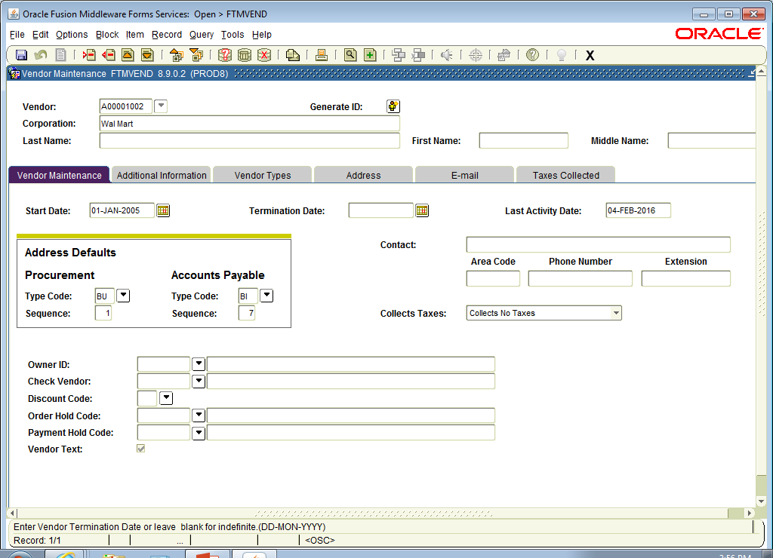
Banner 8
Vendor Maintenance FTMVEND

Slide 28
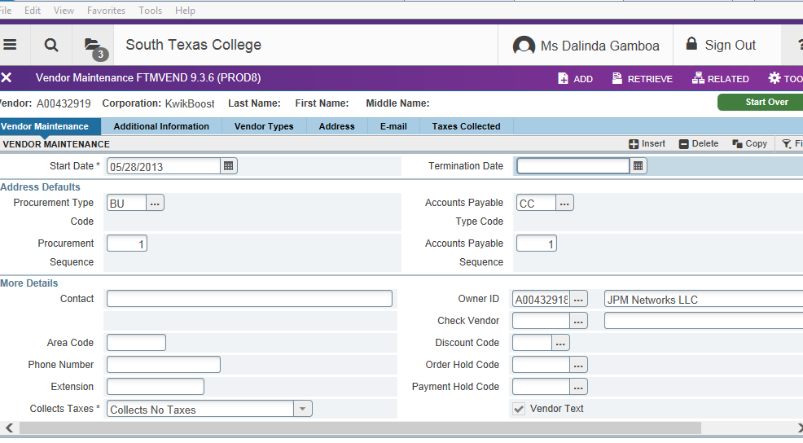
Banner 9
Vendor Maintenance FTMVEND
Vendor Maint Tab – view vendor defaults and text Address Tabs – view all address types

Slide 29
Banner 9
Vendor Maintenance FTMVEND – View Text
1. Select Related Option 2. Select Text

Slide 30
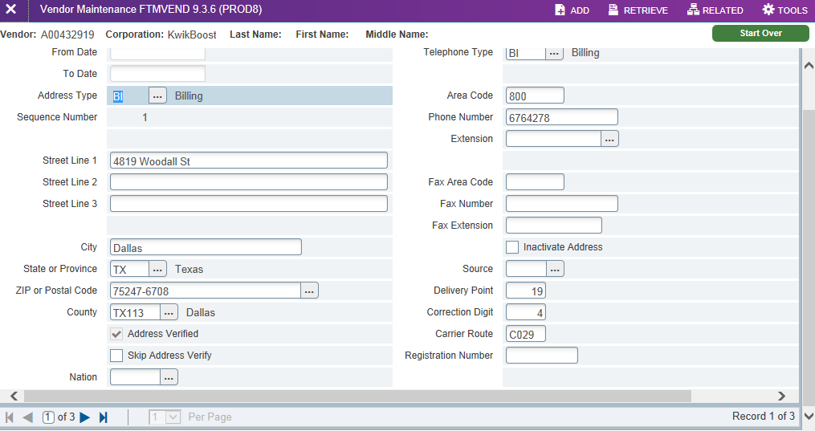
Banner 9
Vendor Maintenance FTMVEND –
View Addresses

Slide 31
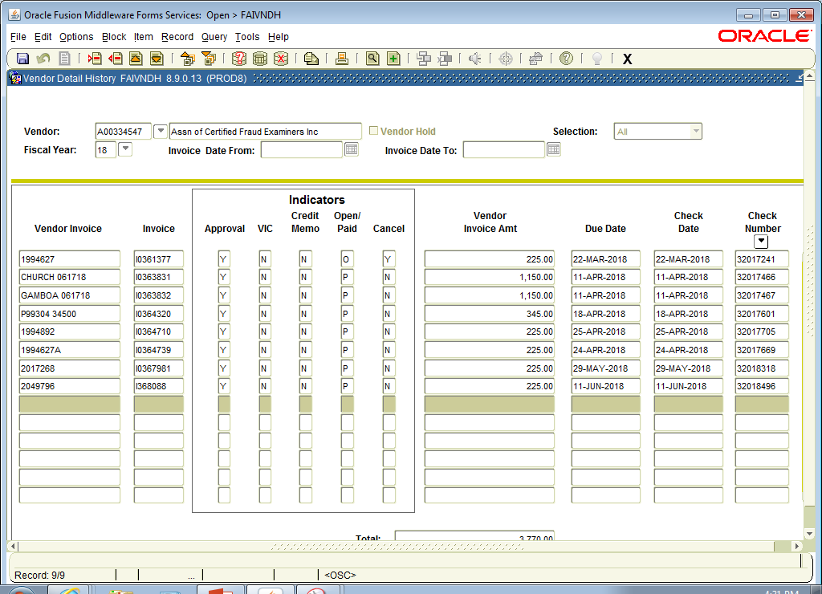
Banner 8
Vendor Detail History FAIVNDH

Slide 32
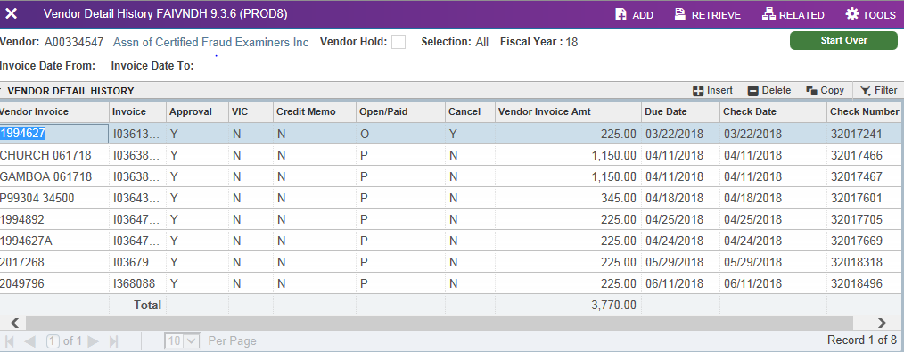
Banner 9
Vendor Detail History FAIVNDH

Slide 33
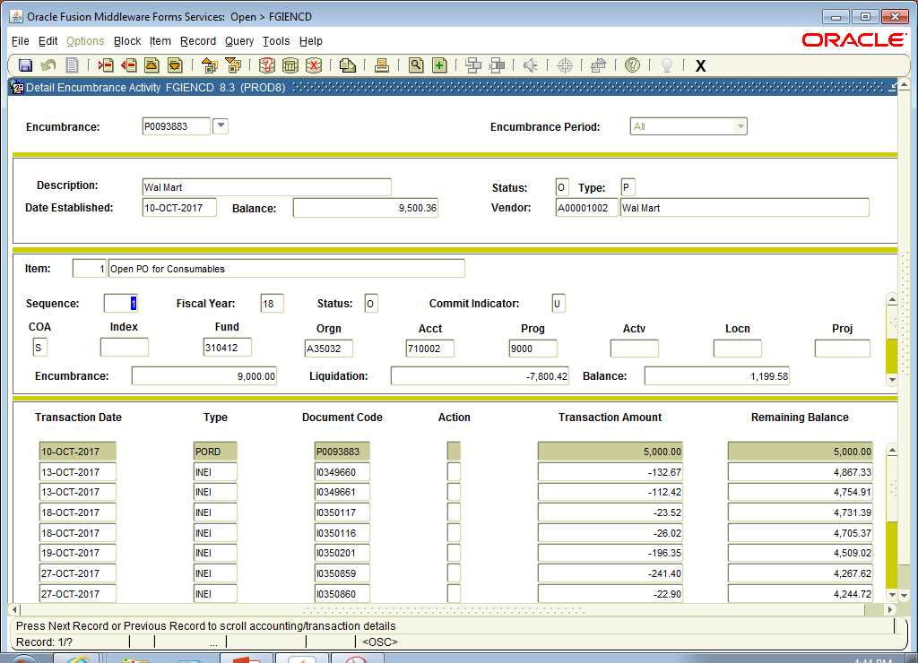
Banner 8
Detail Encumbrance Activity FGIENCD

Slide 34
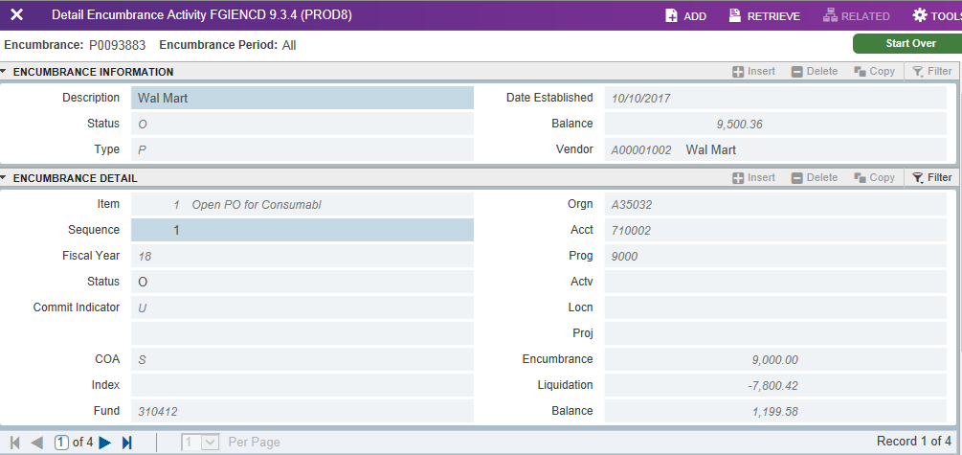
Banner 9
Detail Encumbrance Activity FGIENCD

Slide 35
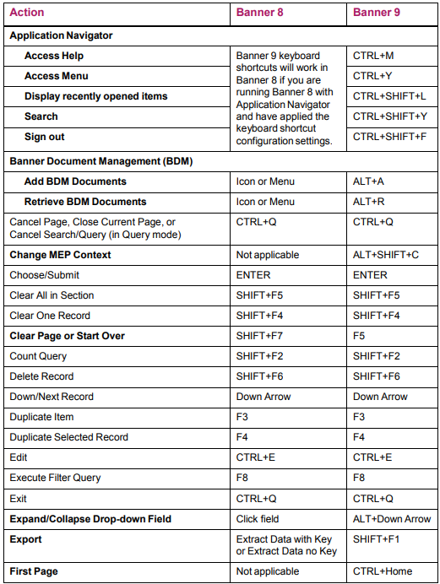
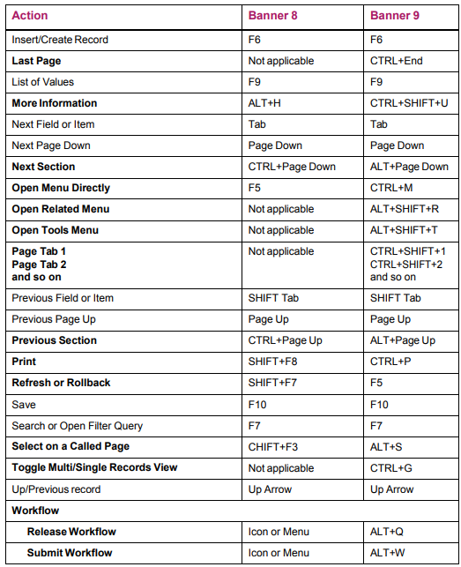
Shortcuts
Banner 8 & 9

Slide 36
Transaction Questions
Transaction | Department | Phone Number
Encumbrances (Requisitions or Purchase Orders) | Purchasing | 872-4681
Payments (Invoices) | Accounts Payable | 872-4609
Journal Entries | General Accounting | 872-4638 or 872-4650
Budget Availability | Budget | 872-4620
Finance Access | FAS – Business System Analyst | 872-4663

Slide 37
Banner Finance Overview
Q&A Section

