Slide 1
Departmental Cash Handling
Presenters: Connie Lira & Tiki Vela
Cashiers Department
AA Roundup
July 27, 2017

Slide 2
Cash Handling Training
Cash Handling Certification is Available!
South Texas College full-time employees may request training.
Purpose: To train & certify staff prior to handling cash
Training is provided by the Business Office-Cashiers Department:
Collection of cash
Custody & safeguarding cash
Reporting of cash
Accountability
Internal controls
Petty cash funds
Cash disbursements
Sussy Palomo
MDPALOMO1@SOUTHTEXASCOLLEGE.EDU
(956) 872-6451
Notes:
Because cash is on of the college’s most sensitive asset, we do this training, the objective of this training is to assist college departments with the cash handling procedures.

Slide 3
Did You Know?
Business Office approval is required
to Collect Payments:
Board Policy # 5110 – Comptroller Function:
Collection, Deposit, And Disbursements
Board Policy # 5630 - Establishment and
Control of Petty Cash Funds
Board Policies are online:
https://admin.southtexascollege.edu/president/policies/

Slide 4
Guidelines
Collection sites
Approved by the Business Office.
Comply with guidelines and procedures.
Financial Manager
Cash collector
Certified for “Cash Handling” by the Business Office-Cashiers
Must be a full-time, permanent employee
Maintain a single collection point

Slide 5
Practice Internal Controls
Proper segregation of duties – different individual
Receiving of cash
Depositing of cash
Reconciliation
Safeguard of cash
Secure at all times
Safe, locked desk or cabinet in a locked office

Slide 6
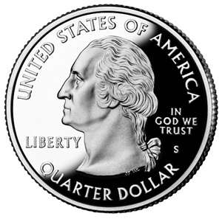
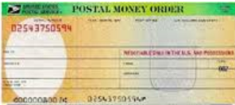
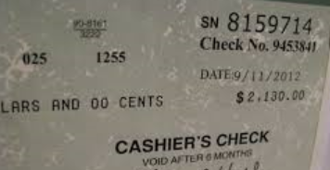
What is considered cash?
Cash are: coins, paper currency, checks, money orders, cashier checks and credit cards.
Check payments must be directed to:
South Texas College
P.O. Box 9701
McAllen, TX 78502-9701
Credit card payments: in-person or by phone at the Cashiers Office only. American Express is not accepted!

Slide 7
Collected Cash
Checks
Made payable to South Texas College
Endorsed
Should not be cashed
Transactions must be logged.
Departmental Deposit Worksheet
Spreadsheet
List
Receipts
Issue a receipt in sequential number.
South Texas College Payment Receipt Booklets are available:
At the Business Office
To a full-time employee
Return used payment receipt booklets to the Business Office.
Voids
Sequential order
Approved by a supervisor
Explanation

Slide 8
End of Day – Deposits
Daily Balancing of Collections
Total the daily collections
Collection amount = to deposit amount
Deposit Support Forms
Departmental Deposit Worksheet
Depositing at cashiers
Bag or envelopes
Cashier will issue a “Banner Receipt”
Keep the receipt for your records

Slide 9
Timeliness of Deposits
Depositing Cash Bank
Within 7 days - Education Code §51.003-(b)
Cashier’s Office
The following day
Collections under $20.00
Once per week
At month end

Slide 10
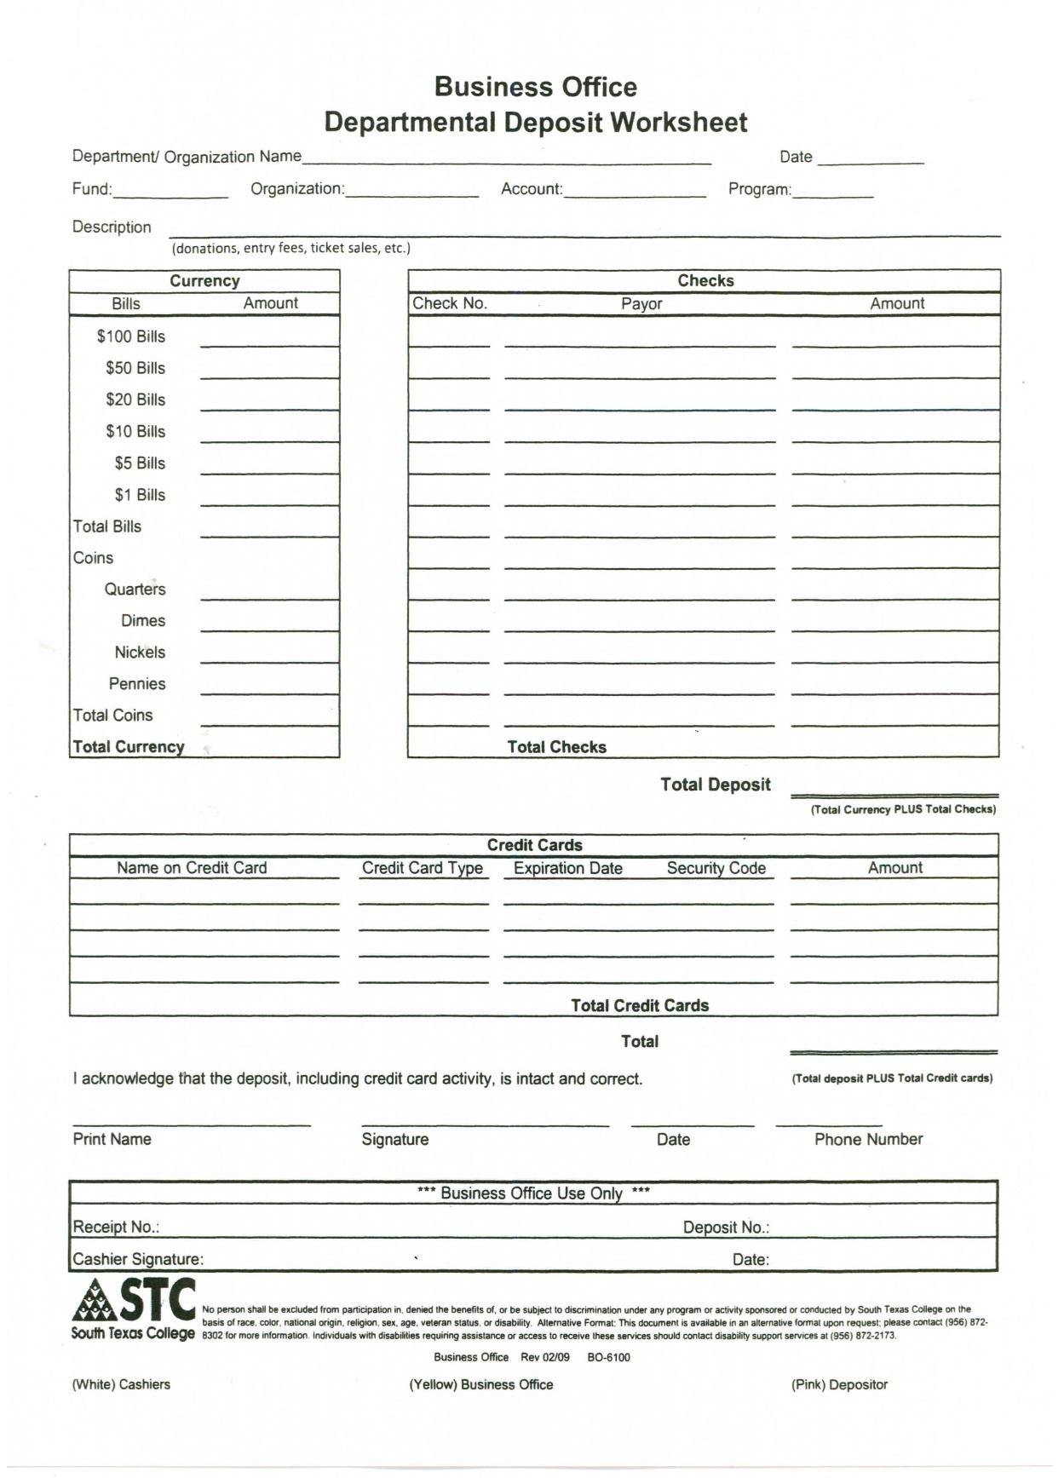
1.- Name of Department/Organization the deposit is made for.
2.- Date when deposit is turned in to cashiers.
3.- Enter the FOAP as provided by the Business Office. Make sure this information is correct.
4.- Deposit description ex: BBQ tickets, tickets sales, fundraiser.
5.- Enter the currency turned in to cashiers, bills on top according to denominations, coins in the bottom according to denominations. Include total currency in the bottom.
6.- Enter any checks received, include student ID if applicable. If more space is needed than provide a list and just enter “see list” and enter the total of checks in the space provided in the bottom.
7.- Enter the total of currency plus checks.
8.- Enter credit card payments if applicable
9.- This should be the total of currency plus checks plus credit cards.
10.- Information for the person submitting the deposit.
1
2
4
3
5
6
Once the deposit is made the cashier will provide the pink copy for your records.
7
8
9
10

Slide 11
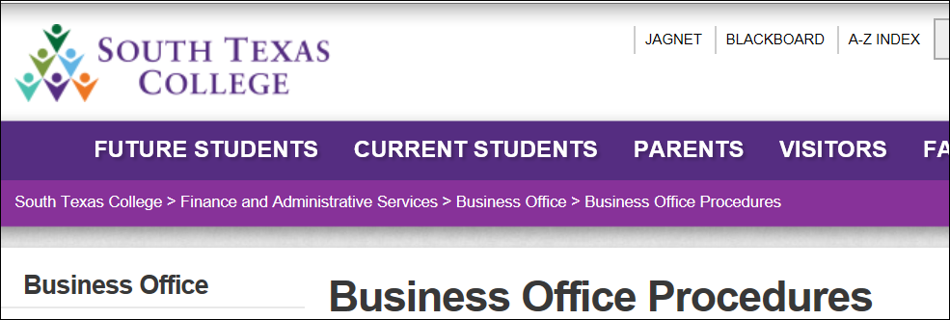
Cash Handling Procedure
Cash Handling Procedure is online at the Business Office website:
https://finance.southtexascollege.edu/businessoffice/index.html

Slide 12
Get Certified!
Cash Handling Training Requests:
Sussy Palomo
MDPALOMO1@SOUTHTEXASCOLLEGE.EDU
(956) 872-6451

Slide 13
Template Provided By
www.animationfactory.com
500,000 Downloadable PowerPoint Templates, Animated Clip Art, Backgrounds and Videos

