Slide 1
INTERDEPARTMENTAL TRANSFERS
(IDTs)

Slide 2
WHAT IS THE PURPOSE OF AN IDT?
The Interdepartmental Transfer (IDT) form should be used only between College departments when a department providing services (provider) needs to bill the department receiving the services or materials (customer)
These IDT forms are used by the Business Office as journal entries (IDT transactions) between the provider department and the customer department to record services or materials provided

Slide 3
WHAT IS THE PURPOSE OF AN IDT?
(Cont’d)
The provider department is responsible for following up on unpaid journal entries (IDT transactions).
The provider and customer departments are responsible for keeping copies of all IDT forms submitted and reconciling them against their departmental monthly transaction reports.
There are four types of IDTs:
Expenditure
Revenue
Food Service
Student Organization Food Service

Slide 4
Expenditure IDTs
Examples: Xerox Copies (copier), Business Cards, Letterhead Paper & Envelopes, Postage, Name Plates, Exxon Card (Fuel)
PROCESS
Department
providing
services obtains
IDT form from STC
Business Office
web page.
(BO-5300)
Provider department
prepares and completes
IDT form after good(s)
and/or service(s) are
provided to
Customer Department.
Provider Department Must Disclose IDT Form:
Description of good(s) and/or service(s)
Proper justification of IDT
Type of services / goods provided
PO # where goods were paid from
Price, Invoice #, Vendor Name
Include back up documentation
Total amounts
Provider signatures by FM
Provider FOAP Codes
(Fund, Organization, Account, and Program Code)
Customer FOAP Codes
(Fund, Organization, Account, and Program Code)
Customer Department
submits IDT form to
Business Office –
General
Accounting within
3 days
that goods/services
were
received and provided.
Provider Dept. must
then route IDT to
Customer Dept. for
Financial Manager
signatures/approvals.

Slide 5
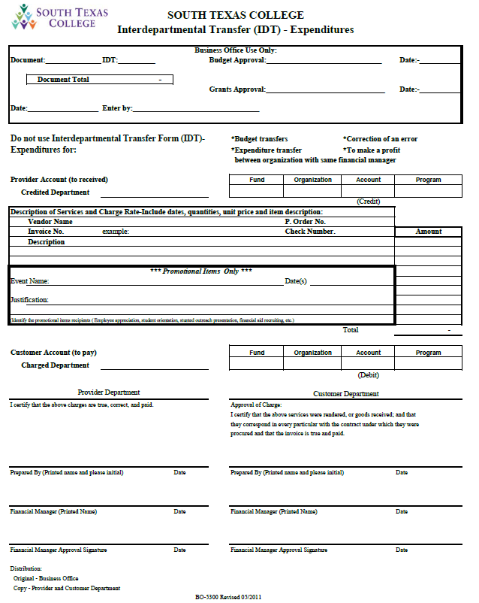
EXPENDITURE IDT FORM
BO-5300

Slide 6
Revenue IDTs
Examples: Conference Registration Fees
PROCESS
Provider Department Must Provide
on IDT Form:
Name of Conference to be held
Justification of IDT
Date, time, and place
Name of employee(s) attending
event/conference
Registration fee per employee
Total amounts
Provider signatures by FM
Backup documentation
(ex. flyer of event, brochure)
Provider FOAP Codes
(Fund, Organization, Account, and Program Code)
Customer FOAP
(Fund, Organization, Account, and Program Code)
Department providing
services obtains
IDT form from STC
Business Office
web page.
(BO-5320)
Provider department
prepares and completes
IDT form at least three (3)
days before conference is
held, and submits to
Customer Department.
Customer Department
submits IDT form to
Business Office General
Accounting within 3 days
before conference is
held.
Provider Dept. must
then route IDT to
Customer Dept. for
Financial Manager
signatures/approvals.

Slide 7
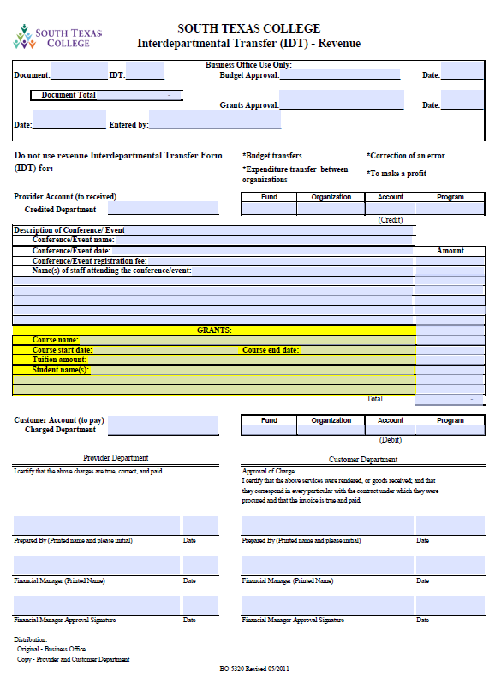
REVENUE IDT FORM
BO-5320

Slide 8
Food Service IDTs &
Food Quotes
PROCESS
The VP-FAS Office prepares a Food Quote
Form by providing the following
Information:
Contact person
Invoice number
Event date & time
Event Place
Menu – in detail
Cost of meal(s)
The VP-FAS Office
emails Food Quote
to Customer Dept.
The Customer Department
(the one needing services)
emails Maria Christina Garcia
at VP-FAS Office to request a
Food Quote. Please email
(mgarcia_0535@south...) and
CC Nancy Cantu Ozuna
and/or Victoria Lopez.
Contact Phone:
(956) 872-3558
The Customer Department
MUST complete the purpose
and justification information,
and then return Food Quote
to VP-FAS Office
After completed Food
Quote is ACCEPTED,
the VP-FAS Office
will email Food Quote
to Business Office
By returning the completed Food
Quote form to VP-FAS Office
it implies ACCEPTANCE to
perform and provide the stated services
If there are problems with the Justification
and Purpose, Business Office will inform all
Departments involved via email.
Note – Allowable Expenditures Procedures for
Food Purchases are available (see JAGNET online account)
Business Office will
APPROVE the
Purpose & Justification
(Alma Church)

Slide 9
Food Service IDTs
PROCESS (cont’d)
The Customer Department
prepares the IDT within
three (3) days of services
rendered.
(Form BO-5310)
The Customer Department provides
the following information on the IDT:
Department Name & Organization Number
Contact Person
Phone & Fax Number
Event Name
Justification AND Purpose
Event Date, Time & Location
The Customer
Department MUST
also provide the
following information
on the IDT:
Fund Code
Organization Code
Account Code
Program Code
Invoice Number
Total Amounts
Attach Original
Food Quote
After the VP-FAS Office approves
original IDT and Food Quote
and forwards to the
Business Office
General Accounting Dept.
for recording
The Customer Department Financial
Manager approves IDT, then the
IDT and Food Quote are
forwarded to the Vice-President
for FAS Office for approval,
invoice number, and logging.

Slide 10
Food Service IDTs
Justification:
Must clearly state why the attendees are required to attend.
Why it is impractical for attendees to obtain the meal on their own time.
Explanation of why such services must be provided and why event must
be held.
Example:
Meeting to discuss possible partnerships for students articulation
agreements between STC and Texas A&M College of Nursing.
Incorrect Justification Example:
To provide breakfast…, to provide lunch for employees…, etc.

Slide 11
Food Service IDTs
Purpose:
1. Purpose must clearly state how meeting/event is beneficial to the
individual.
2. Purpose must also clearly state how meeting/event is beneficial to
the college.
Example:
Faculty/Staff will be obtaining a certificate on Managing Conflict in
the Workplace (Training).
NOTE:
The justification and purpose cannot be the same explanation.
The purpose or justification cannot be to provide meals or refreshments
to the employees, students and/or guests attending the meeting/event.
Other information that must be included with the IDT is:
A formal written agenda identifying the topics to be discussed.
A listing of the attendees and their respective department.
The expected total cost of the meal.

Slide 12
FOOD SERVICE IDTs
(Cont’d)
FOOD PURCHASES
With the exception of food purchased for travel, educational or laboratory purposes, the only funds which may be expended for food and/or beverages shall be from the Auxiliary Fund (ex. A50007 – I&SP Focus Group).
Each campus has their own auxiliary organization. Please make sure the IDT contains the correct code.
Pecan – A40101
Technology – A40102
Mid-Valley – A40103
Starr – A40104
Expenditures of these funds for such purposes must serve a legitimate public purpose or further the educational function of the College.
Expense must be kept to a minimum.
Preference must be given to College services.

Slide 13
FOOD SERVICE IDTs
(Cont’d)
UNALLOWABLE FOOD PURCHASES:
Food celebrating employees personal events.
(e.g. birthdays, weddings, graduations, showers, welcome/farewell parties)
Non college-wide meals or refreshments for holiday celebrations.
(e.g. Thanksgiving, Christmas)
Meals or refreshments for department/division parties or entertainment.
Meals or refreshments for department/division employee appreciation events.
(see JagNet online account for )
Further information can be located in the Business Office website under:
Procedures & Forms –AA/FM Roundup – Allowable Expenditures
http://finance.southtexascollege.edu/businessoffice/aa_roundup.html

Slide 14
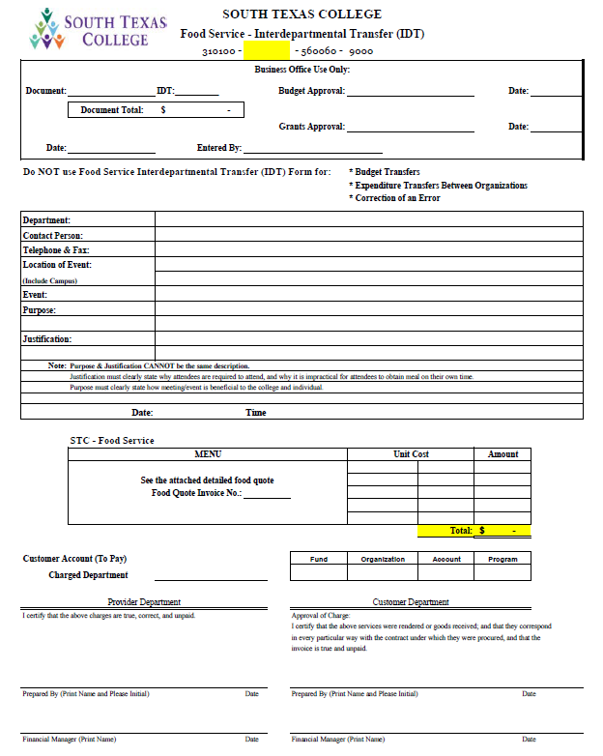
FOOD SERVICE IDT FORM
BO-5310

Slide 15
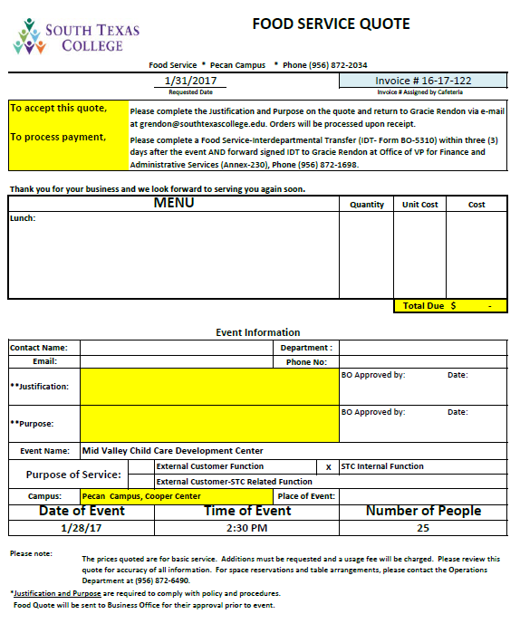
FOOD SERVICE FOOD QUOTE

Slide 16
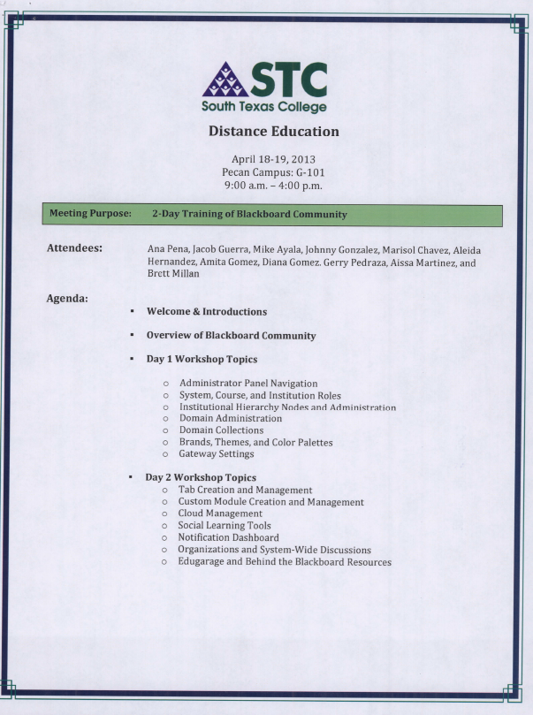
FOOD SERVICE IDTs
Example of detailed
agenda attached
with IDT.

Slide 17
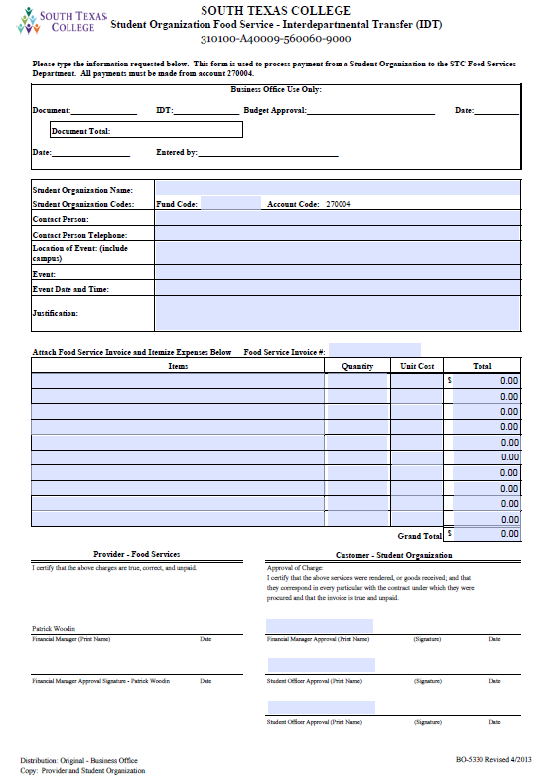
STUDENT ORGANIZATION
FOOD SERVICE IDT FORM
BO-5330

Slide 18
Uses For Interdepartmental Transfer Form (IDTs)
DO’S
Food Services
Fuel Expenses
Printing Services
Postage / Overnight Mail
Equipment Use (copier machines)
Revenue for In-House Conferences
(ex. Bi-National Innovation
Conference)
DONT’S
Budget Transfers
(use Budget Transfer Form)
Correction of an Error
(Memo for Journal Entry)
To Make a Profit
To Increase Budget
Expenditure Transfers between Organizations
(use Expenditure Transfer Form)

Slide 19
Questions?
Contact:
Alex Cespedes, Accountant
Email: acespedes_5228@southtexascollege
Phone: (956) 872-4665
Anabel Garza, Accounting Specialist
Email: magarza1@southtexascollege
Phone: (956) 872-4662
Alma Church, Accounting Group Manager
Email: achurch@southtexascollege
Phone: (956) 872-4616

