Slide 1
Banner Reconciliation Concepts

Slide 2
Access to Banner Finance
Access to Banner Finance is needed if you:
Need to review budget status for organizations under your department
Need to input online requisitions for your department
To request access, complete Banner Finance Access Request Form.
Form is available to download on the Business Office website http://www.southtexascollege.edu/businessoffice/index.html

Slide 3
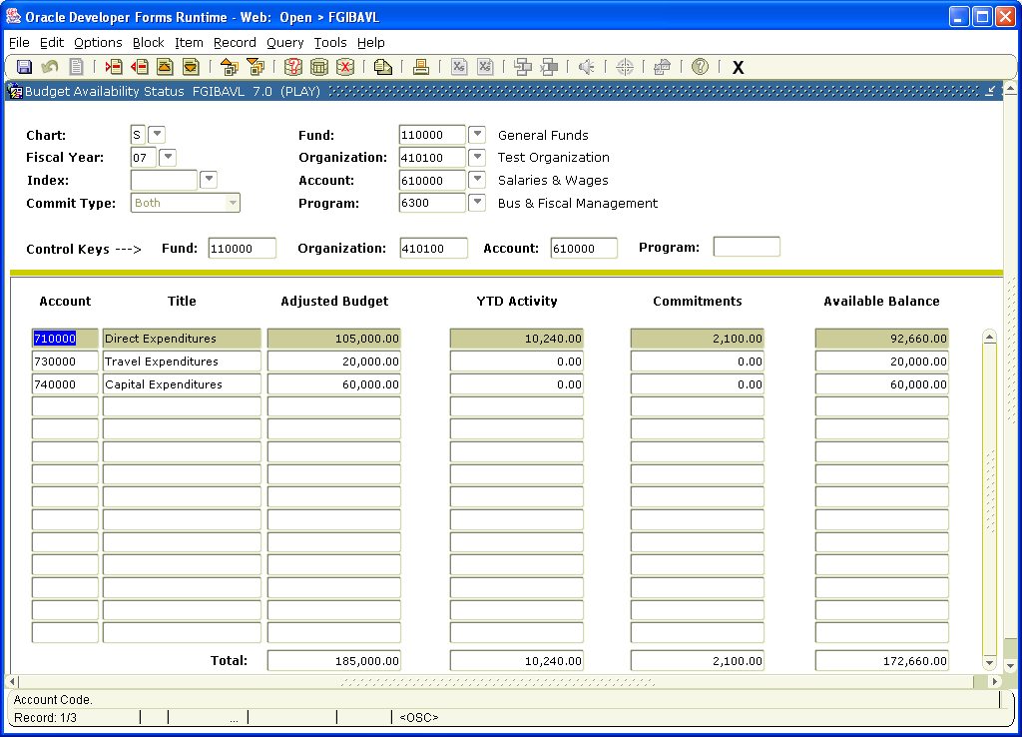
Review Budget Status on FGIBAVL
FGIBAVL is the form Banner uses to check Non-Sufficient Funds (NSF)
The available balance on FGIBAVL is reduced by complete, incomplete, suspense and unapproved transactions (requisitions, POs, invoices and journal entries)

Slide 4
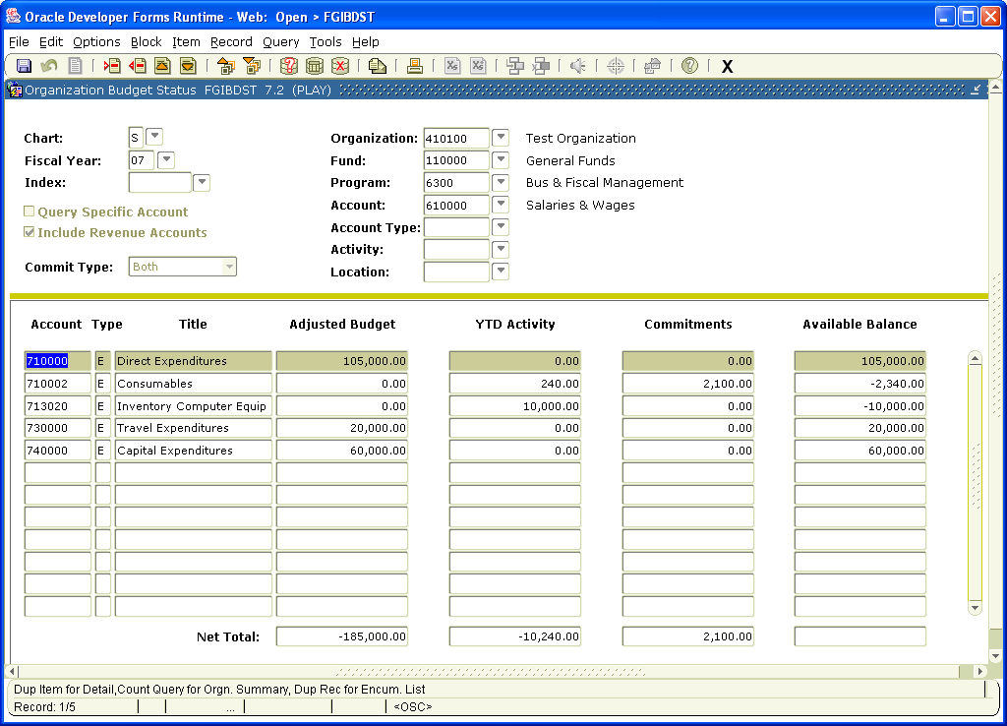
Review Budget Status on FGIBDST
Unlike FGIBAVL, only complete and fully approved documents post to FGIBDST
FGIBDST also provides a more detailed summary by account code while FGIBAVL shows a summary by account pool.

Slide 5
Available Balance Calculation on FGIBAVL and FGIBDST
Adjusted Budget
- Year-to-Date (YTD) Activity
- Commitments (Encumbrances)
= Available Budget Balance

Slide 6
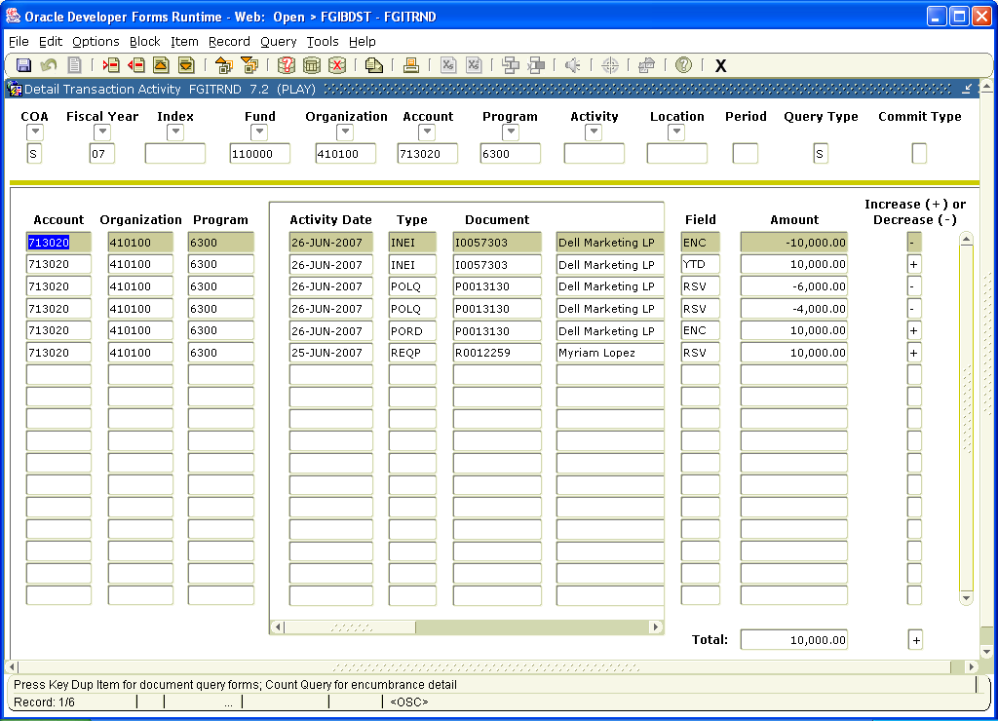
Transaction Detail - FGITRND
The field column can help you determine the type of transaction.
OBD – Budget transaction (original budget)
ABD – Budget transaction (adjusted budget-budget transfers)
RSV – Encumbrance transaction from requisition
ENC – Encumbrance transaction from PO
YTD – Expense transaction from invoice, journal entry or feeds from other system
“I” documents are Invoices,
“J” documents are Journal Entries,
“F” documents are feed transactions

Slide 7
Transaction Cycle

Slide 8
Document Inquiry Forms
FPIREQN – Requisition Query Form
FPIPURR – Purchase Order Query Form
FAIINVE – Invoice Query Form
FGIDOCR – Document Retrieval Inquiry

Slide 9
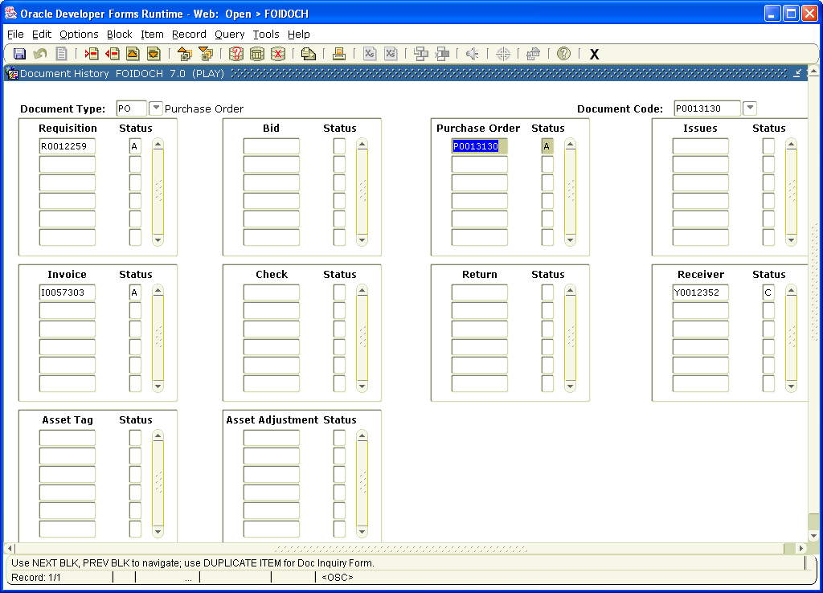
FOIDOCH - Associated Documents
REQ – Requisition
PO – Purchase Order
INV – Invoice
Enter document number

Slide 10
Banner Data Extracts
Banner data can be extracted on various forms.
FGIBDST – Report of Summary by Account
FGITRND – Report of Detail Transactions
To extract data, go to form and click on
Help / Data Extract / Extract Data No Key

Slide 11
Reconciliation Tips
Reconcile the account pools separately.
Extract detail transactions from FGITRND for each account pool separately.
71% - Operating Transactions
73% - Travel Transactions
74% - Capital Transactions

Slide 12
Reconciliation Tips
On Reconciliation Worksheet, associate related documents based on the requisition. For example, the PO(s) and Invoice(s) related to the same requisition.
Use FOIDOCH to find associated documents.

Slide 13
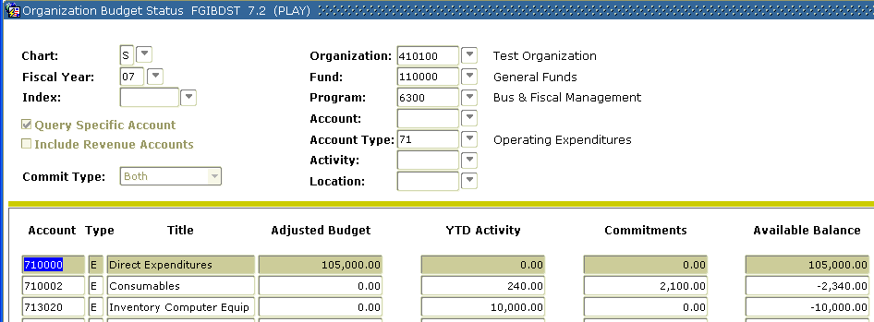
Reconciliation Tips
Make sure totals for Budget, Commitments and YTD Activity tie to FGIBDST for each pool.
Uncheck “Include Revenue Accounts” to get net totals
71 – Operating Transactions
73 – Travel Transactions
74 – Capital Transactions

Slide 14
Reconciliation Worksheet
Should tie to FGIBDST Net Totals
Check Figure to make sure Available Balance ties to FGIBDST

Slide 15
Update Reconciliation
Update Reconciliation Worksheet as new requisitions are created and with transactions posted after last reconciliation update
Print Banner screens as backup documentation

Slide 16
Thank you! Questions?

