Slide 1
TimeClock Plus
Full Time Employees

Slide 2
Biggest Changes:
For biometric clock, no longer last SS#’s, now numbers in Employee A#, without the letter A and without the leading zero’s, just numbers
Biometric clock will accept 2 fingerprints. No need to use both, just one.
For logging into Web access using computer, use same credentials as computer login. Linked to one user one password.
All punches are immediately posted in system.
Select proper action such as IN and OUT, not just enter as with TimeForce.
No paper forms for submitting leave requests for Sick, Vacation, Funeral, and Educational Activities. For FMLA, Military Leave, and other extended leaves will still require documentation submitted to HR.
Exempt employees will use Timekeeping system for submitting Leave requests.
The new clocks allow employees to request leaves, read messages from supervisors, and review and verify hours.

Slide 3
Contents
Clocking in and out operations – using the Timeclock
Missed punches – using the Timeclock
Messages – using the Timeclock
Requesting Leave – using the Timeclock
Verifying Time – using the Timeclock
Clocking in and out operations – using the computer (webclock)
Missed punches – using the computer (webclock)
Requesting/approving leave using the computer (webclock)
Exempt Employees Only
Time Adjustment Request Form
Correct/Revise Punch
Verifying Time – using computer (webclock)
Best Practices

Slide 4
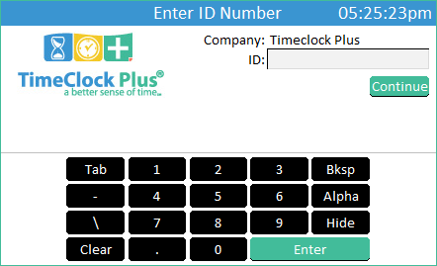
Clocking in and Clocking Out Operations
Using the touchscreen keypad, enter your Employee A#, not including the leading zeros.
Press

Slide 5
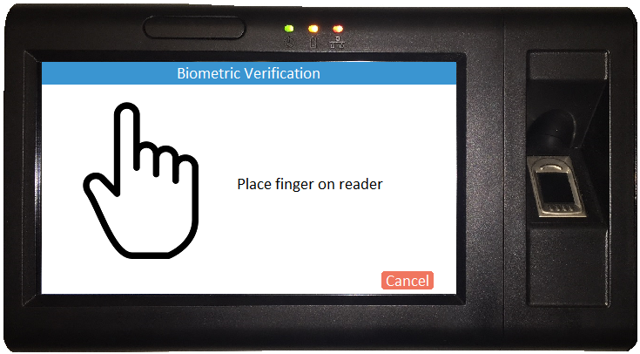
Clocking in and Clocking Out Operations
Place your finger on the fingerprint scanner.

Slide 6
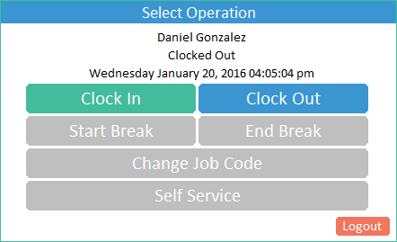
Clocking in and Clocking Out Operations
To Clock In:
Select
To Clock Out:
Select
Only use the Clock In and Clock Out options.
Do not clock out for breaks.
DO NOT USE Logout tab on bottom right corner for Clocking Out.
This will completely log you out of the system.

Slide 7
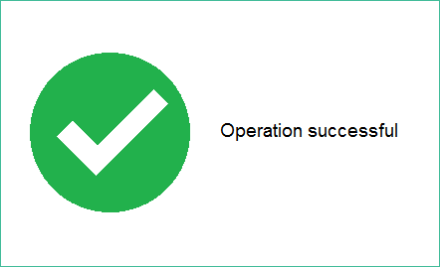
Clocking in and Clocking Out(Biometric Reader)
When you see this screen, you have successfully clocked in/out.

Slide 8
Missed Punch – Enter Record
System is letting you know that there is a missed punch
Press
Notes:
Now what happens if you’re trying to punch in but you didn’t punch out? The system will ask you if you missed a missed a punch and if you want to punch out manually, correct the punch. Press continue.

Slide 9
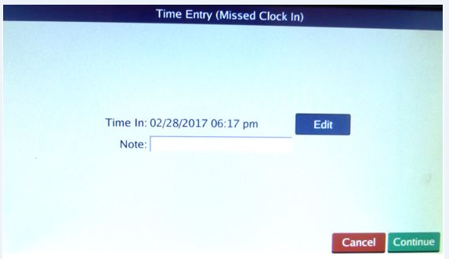
Missed Punch – Enter Record
This will allow you to correct the missing punch
Press
Notes:
Now what happens if you’re trying to punch in but you didn’t punch out? The system will ask you if you missed a missed a punch and if you want to punch out manually, correct the punch. Press edit.

Slide 10
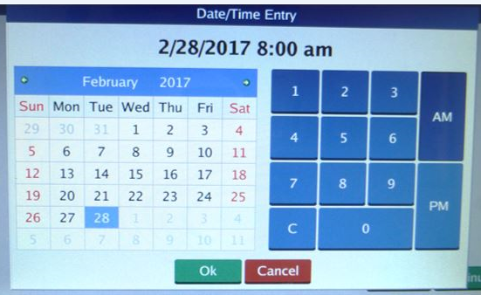
Missed Punch – Enter Record
Enter the correct date and time for your missed punch.
Press

Slide 11
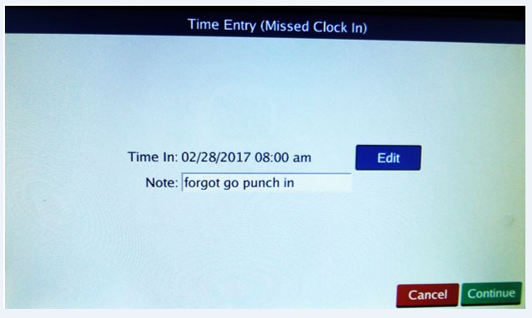
Missed Punch – Enter Record
Enter an explanation of the missed punch. Then click Continue

Slide 12
Missed Punch – Enter Record
The correct IN and OUT punches for the day should be displayed.
Press

Slide 13
Missed Punch-Enter Record
When you see this screen, you have successfully clocked in/out.

Slide 14
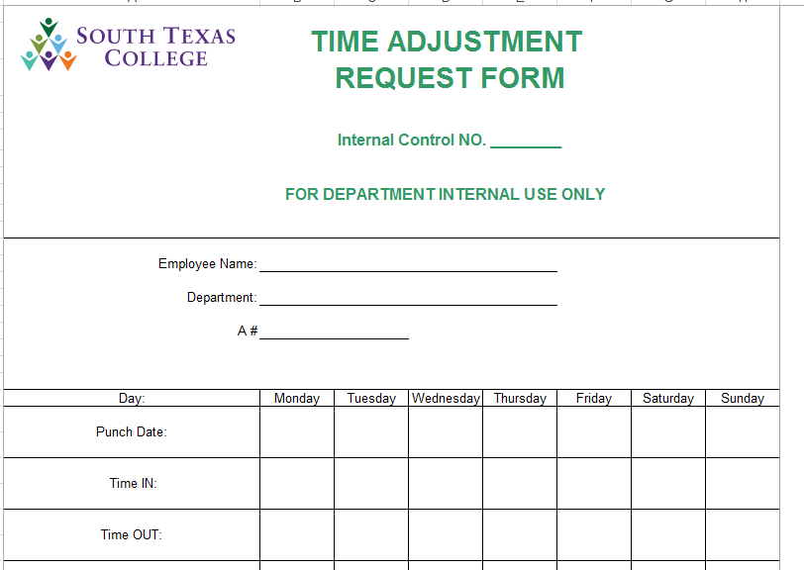
Correct/Revise Punch-Enter Record
We will continue using the Time Adjustment Request Form (TARF) for Correcting/Revising a punch.
The use of this paper form should be decreased significantly as missed punches should be corrected as we previously reviewed.
There should by very limited corrections/revisions to punches in the new system.
Process will remain the same.
Employee completes paper form submits to supervisor
Supervisor corrects punch in system
Original form must be kept for 10 years

Slide 15
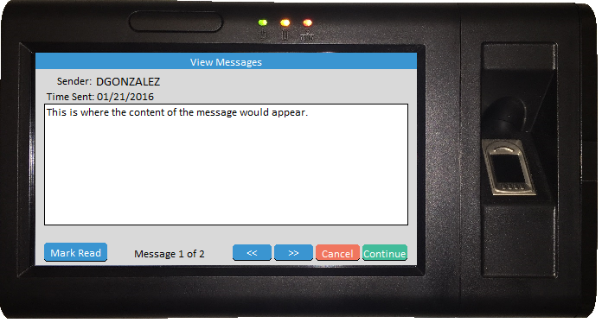
Employee Message
The buttons are used to scroll through the messages but will only appear if there are multiple messages available to view.
The button alerts the sender that you have viewed the message. Upon marking a message as read, it will immediately advance to the next message. The sender may not require the alert in which case the button may not appear.
You must press to finish clocking in or out.
Notes:
Timeclock plus has the ability for supervisors to send messages to their employees. If you receive a message upon logging into the system, read message, click Mark Reach, and continue.

Slide 16
Requesting Leave
From the “Select Operation” screen, press
Do not use any function outside of punching in/out/resolving missed punch, on the clock during the hours of:
7:45 – 8:15 am and 4:45-5:15 pm.
This is to avoid delaying others during the hours of peak timeclock use.

Slide 17
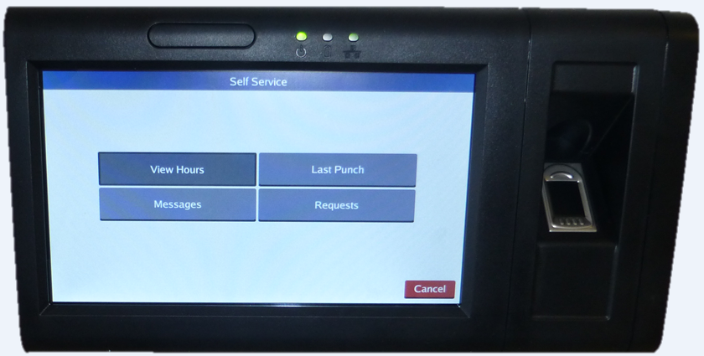
Requesting Leave
Click on Requests.

Slide 18
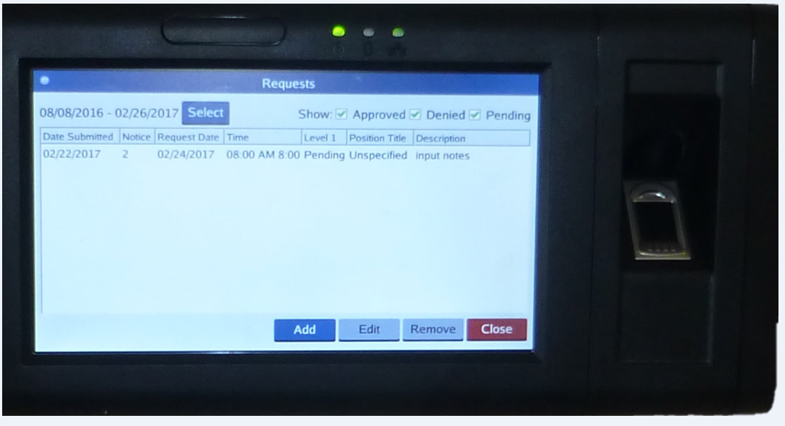
Requesting Leave
Click on blue Add button.

Slide 19
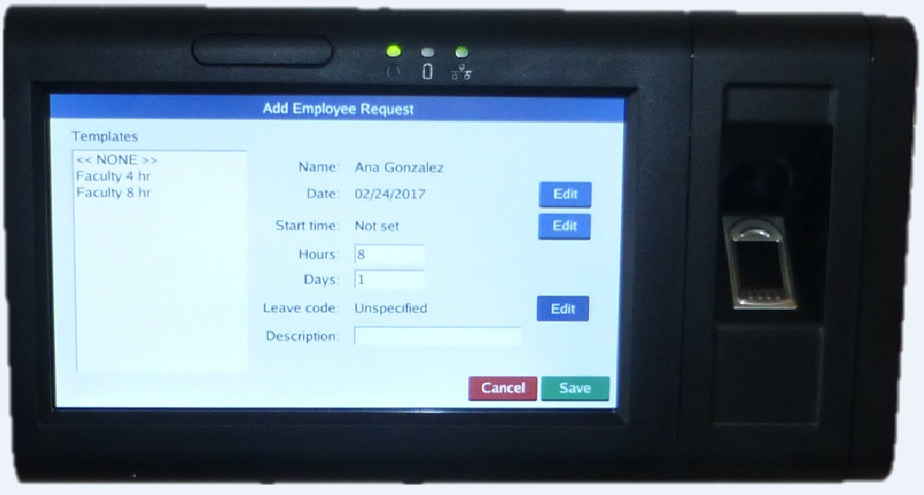
Requesting Leave
Using blue Edit button, enter date for leave requested, start time, and number of hours, or days.
Enter brief description, ex. Vacation day.
Then for Leave code line, click on blue Edit button.

Slide 20
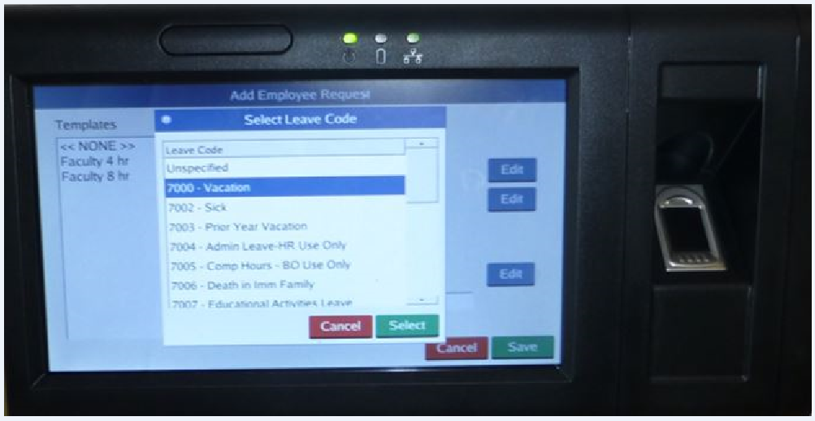
Requesting Leave
Choose the Leave you are requesting. Be sure to choose the correct one, as you are responsible for your leave requests.
Then click Select.
Then click save on next screen, Employee Request screen.

Slide 21
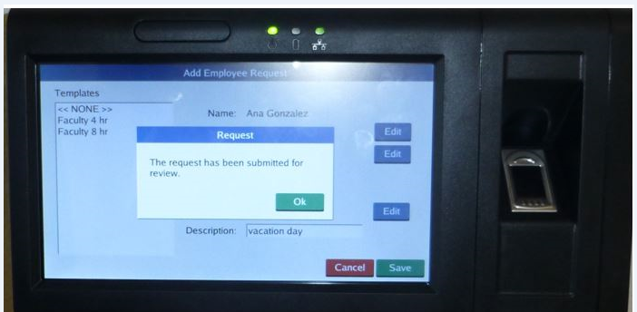
Requesting Leave
You should receive this message indicating this request is now with your supervisor for review and approval.

Slide 22
Verifying Time
Log into the clock. This will take you to the “Select Operation” screen.
From the “Select Operation” screen, press

Slide 23
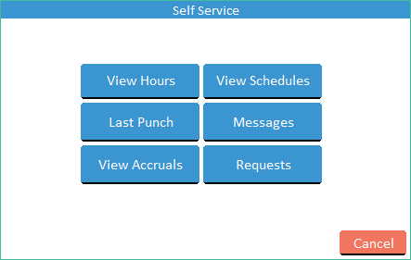
Verifying Time
On the “Self Service” screen, press

Slide 24
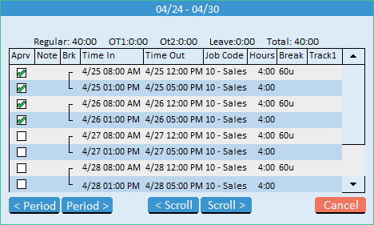
Verifying Time
Examine the time information. If everything is correct, press the Checkbox in the Aprv column next to the segment.

Slide 25
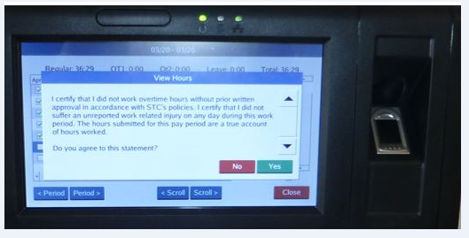
Verifying Time-Certification
Every time you approve your hours, you will receive this notice. It is the same certification as in our previous timekeeping system.
If you agree to this statement, click on Yes.

Slide 26
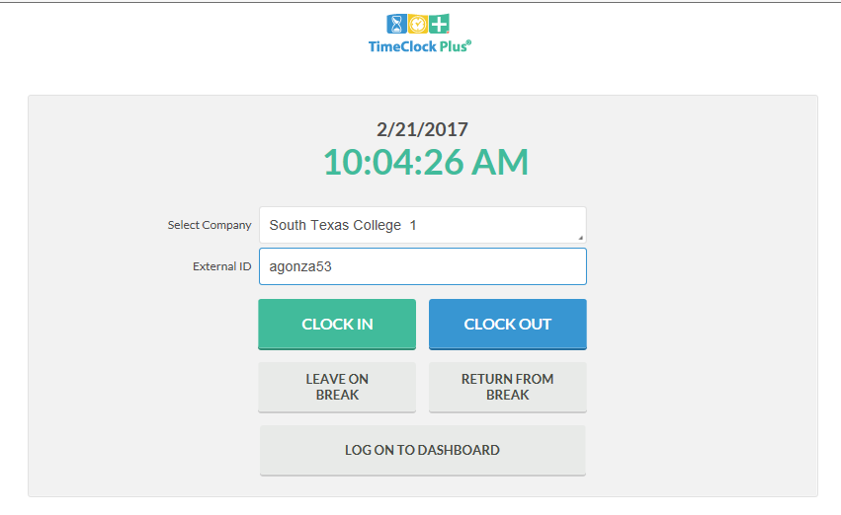
Clock in and Out using Computer
Go to TimeClock link. Login using your computer credentials. Click CLOCK IN or CLOCK OUT.
https://finance.southtexascollege.edu/businessoffice/timeclock.html

Slide 27
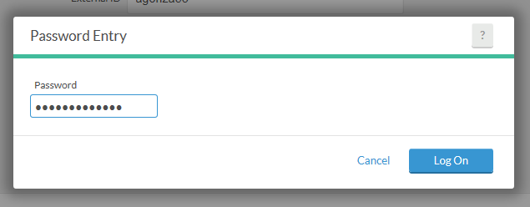
Clock in and Out using Computer
Enter your Password. Same password as computer credentials. Click Log On.

Slide 28
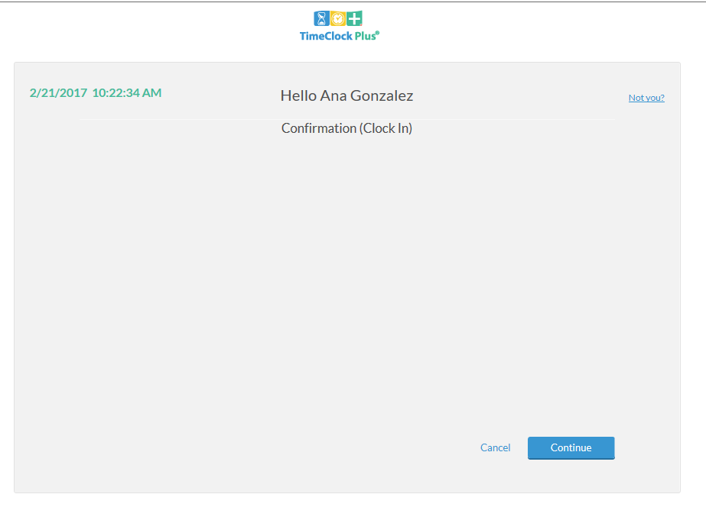
Clock in and Out using Computer
This is confirming that you are clocking in. Click on Continue.

Slide 29
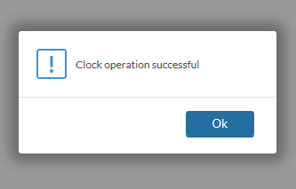
Clock in and Out using Computer
You will see the message indicating that the clock operation was successful.
Click on Ok.

Slide 30
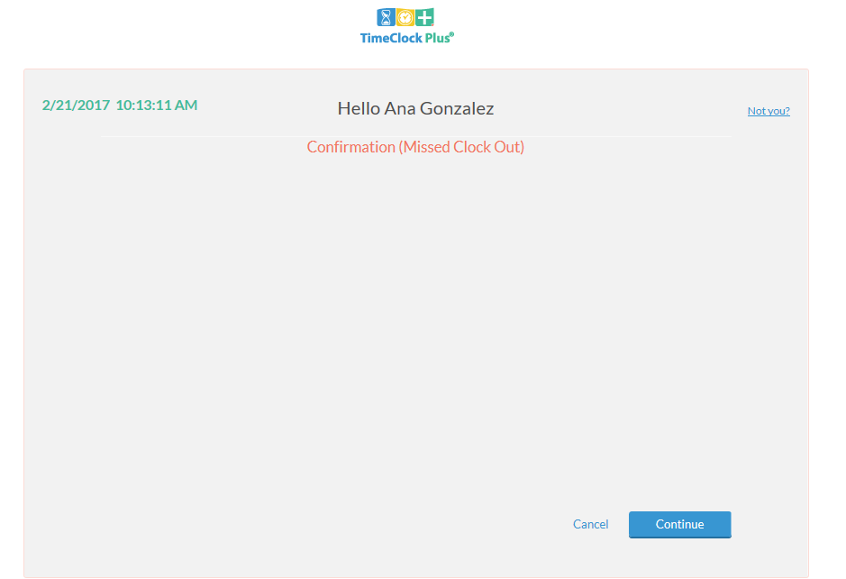
Correcting/Missing punches using Computer
If you get this message, this means you missed a punch and you cannot perform any other actions until it is corrected.
Click Continue.

Slide 31
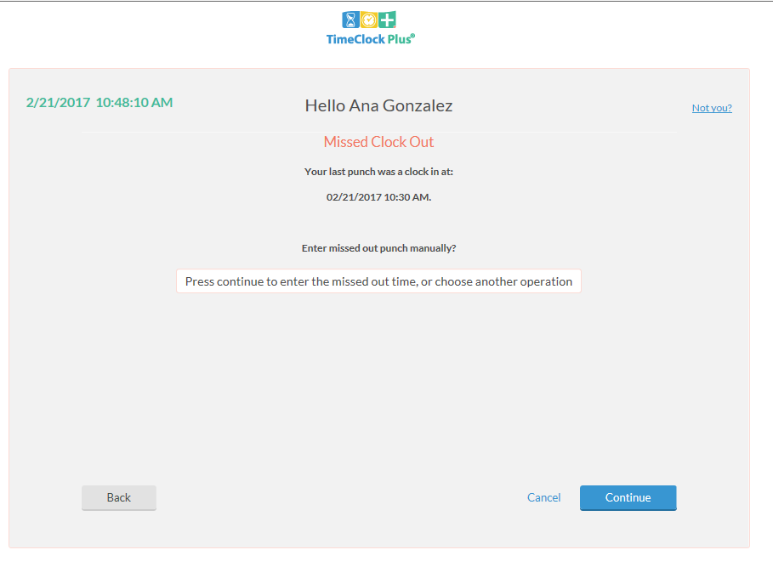
Correcting/Missing punches using Computer
The screen is asking if you want to enter missed out punch manually.
Click Continue.

Slide 32
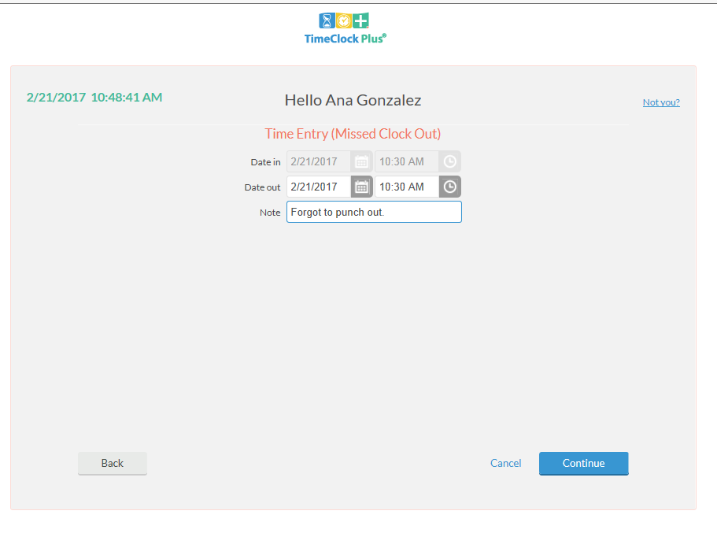
Correcting/Missing punches using Computer
Verify or enter date and time of missed punch. Enter a Note, this is required.

Slide 33
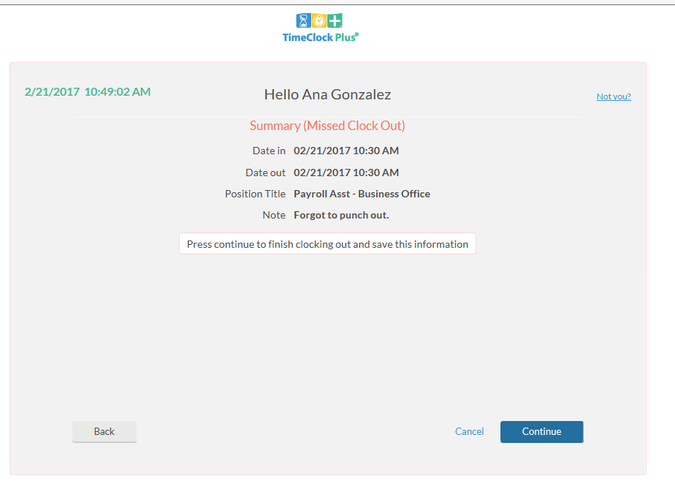
Correcting/Missing punches using Computer
Summary screen.
Verify date, time, and action.
If correct, click Continue.

Slide 34
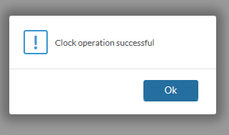
Correcting/Missing punches using Computer
You should get Clock operation successful message which means you were able to both correct the missing out punch and clock yourself in with this operation.

Slide 35
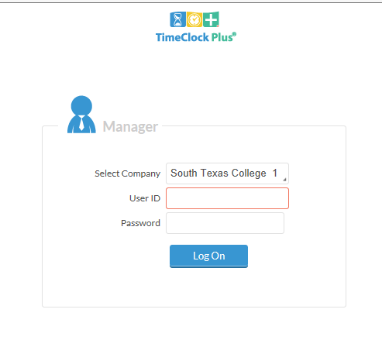
Correcting/Missing punches using Computer – Supervisor Role
Now, you’re supervisor will log in and view leave requests pending approval.
Supervisors use a different log in than employees use, for viewing employee information.
Supervisors will log in using same credentials as computer credentials.
https://timeclock.southtexascollege.edu/app/manager/#/ManagerLogOn

Slide 36
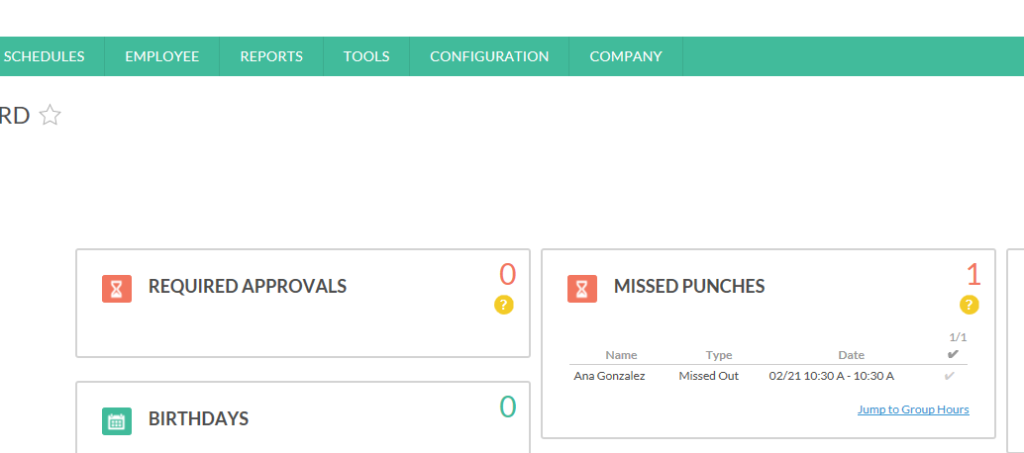
Correcting/Missing punches using Computer – Supervisor Role
When supervisors log in, they will arrive at “My Dashboard”.
Under MISSED PUNCHES, they will see all revised/missing punches that need review and approval.
Click on Jump to Group Hours.

Slide 37
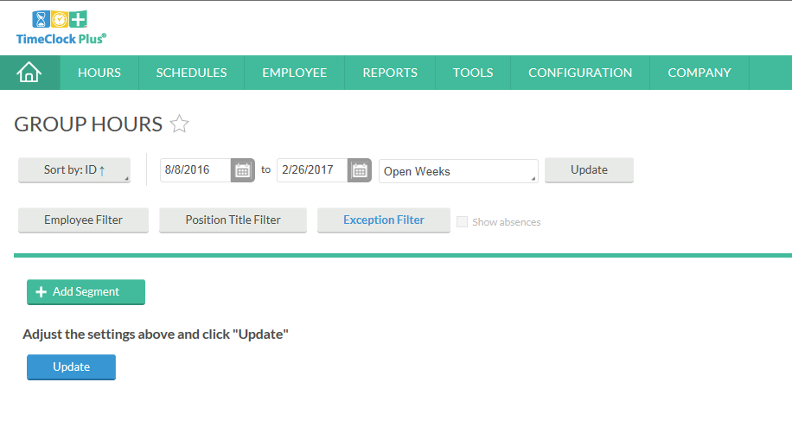
Correcting/Missing punches using Computer – Supervisor Role
Click on the Exception Filter
Notes:
Different ways to maneuver around this screen, for this example, we will use the Exception Filter to isolate

Slide 38
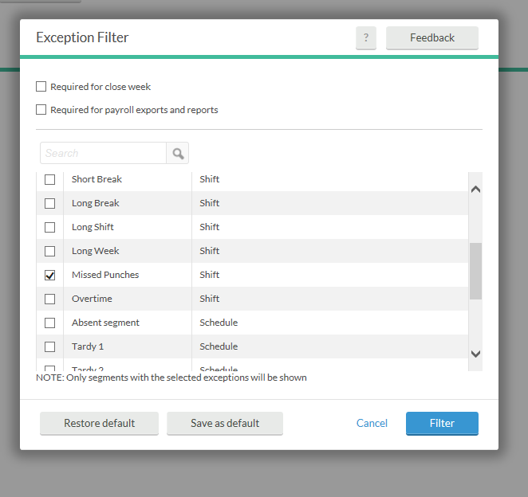
Correcting/Missing punches using Computer – Supervisor Role
There are many Exceptions for filtering.
For this example, we are isolating Missed Punches.
Click Filter.

Slide 39
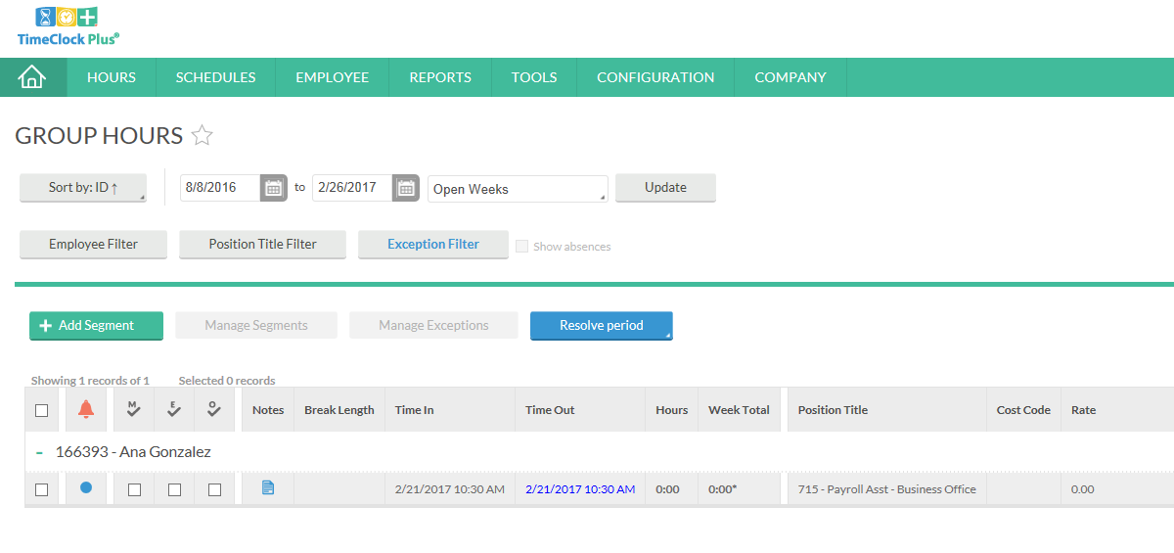
Correcting/Missing punches using Computer – Supervisor Role
The punch that was just added by employee is showing.

Slide 40
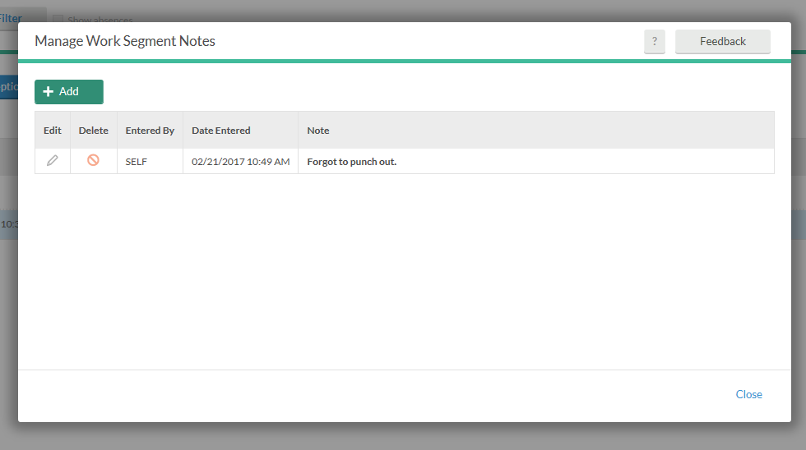
Correcting/Missing punches using Computer – Supervisor Role
Click on Notes for more detail on this occurrence.

Slide 41
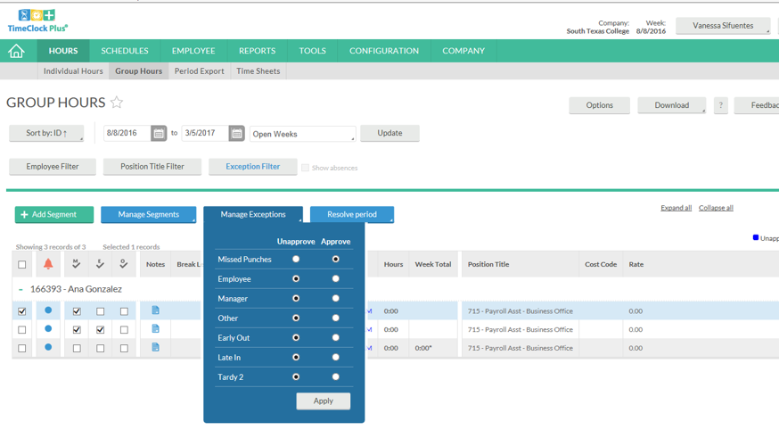
Correcting/Missing punches using Computer – Supervisor Role
If approved, click on the left box to isolate that activity. Click on Manage Exceptions, click under Approve column for Missed Punches.
Then click Apply.
If not approved, review with employee and have correct information in the system for approval.

Slide 42
Correcting/Missing punches using Computer – Supervisor Role
When supervisor returns to Home Page, the Missed Punches have been resolved. Nothing pending for review and approval.

Slide 43
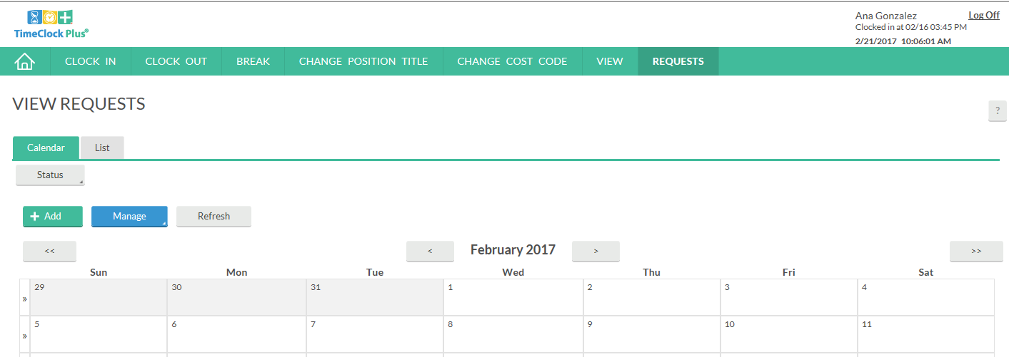
Request Leave using Computer-Employee
Click on Requests, calendar will appear. You can either double click the day you want to request leave for or click on green +Add.

Slide 44
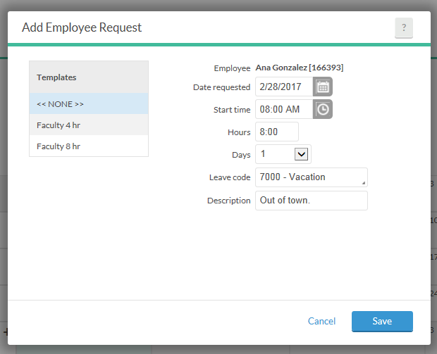
Request Leave using Computer-Employee
Enter date of requested leave, start time (typically 8 am if full day), number of hours for leave, (typically 8 if full day), number of days, then choose a leave code from drop down. Enter a brief description.
Be sure to choose the correct leave code, as you are responsible for your leave requests.

Slide 45
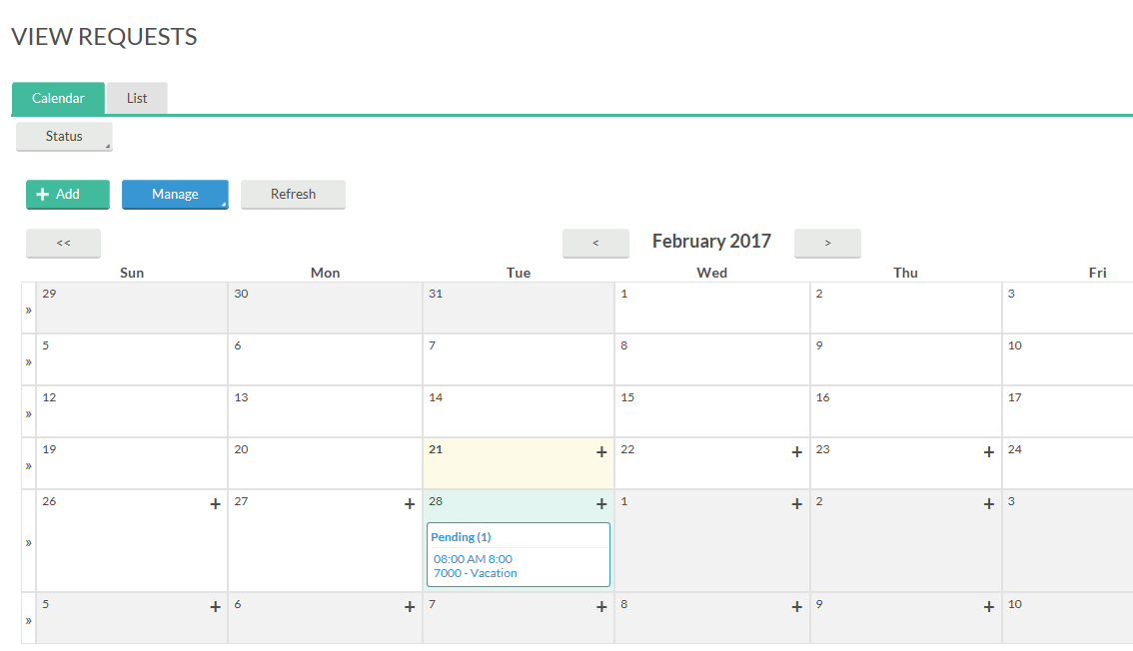
Request Leave using Computer-Employee

Slide 46
Request Future Leave-Employee
Example: In month of February, an employee wants to request Vacation Leave for June. However, they haven’t accrued enough leave as of February to request the amount of vacation they want to take in June. Since TCP is linked to Banner, employees are unable to request leave based on future leave earnings.
The employee will notify the supervisor that they are requesting leave in June, the supervisor will input into TCP and have those days locked for them as vacation.

Slide 47
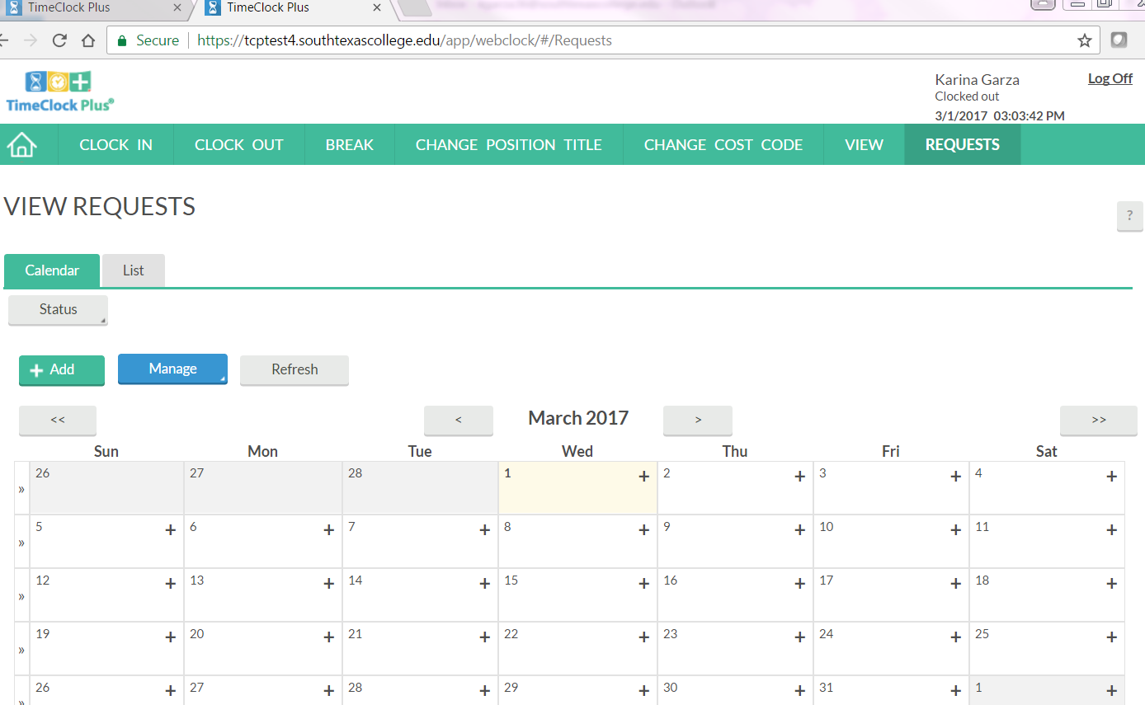
Exempt Employees ONLY
If you are an EXEMPT employee and if you are out of the office for a PARTIAL DAY- (Less than 8 hours)
Report the absence using the Exempt-Paid Leave code
Select the REQUEST Tab

Slide 48
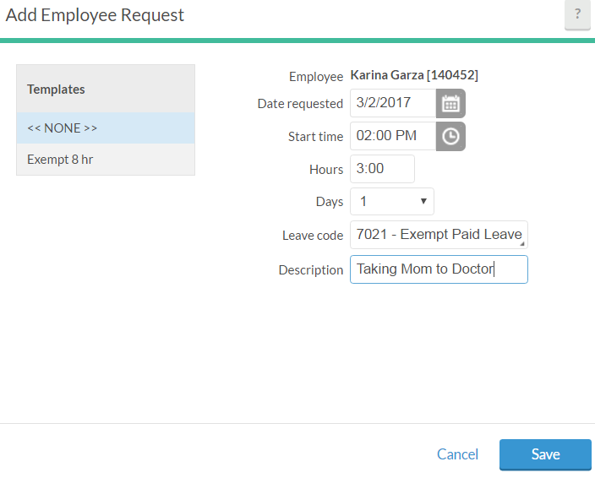
Exempt Employees ONLY
Click on the day you want to request partial leave, enter the start time and the number of hours and use the leave code: EXEMPT-Paid Leave and enter a brief description and save.
**Keep in mind this will not be reduced from your leave its just for reporting purposes.**

Slide 49
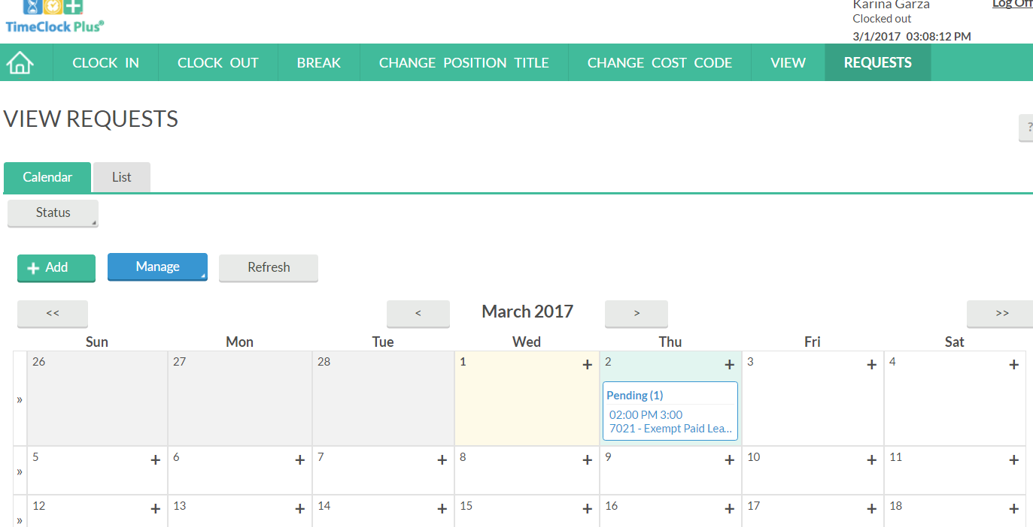
Exempt Employees ONLY
Your absence request is now reflecting in your timecard and will be forwarded to your supervisor for approval.

Slide 50
Request Leave using Computer-Supervisor Role
Now, you’re supervisor will log in and view leave requests pending approval.
**Remember to log into the supervisor link to review your employees requests.**

Slide 51
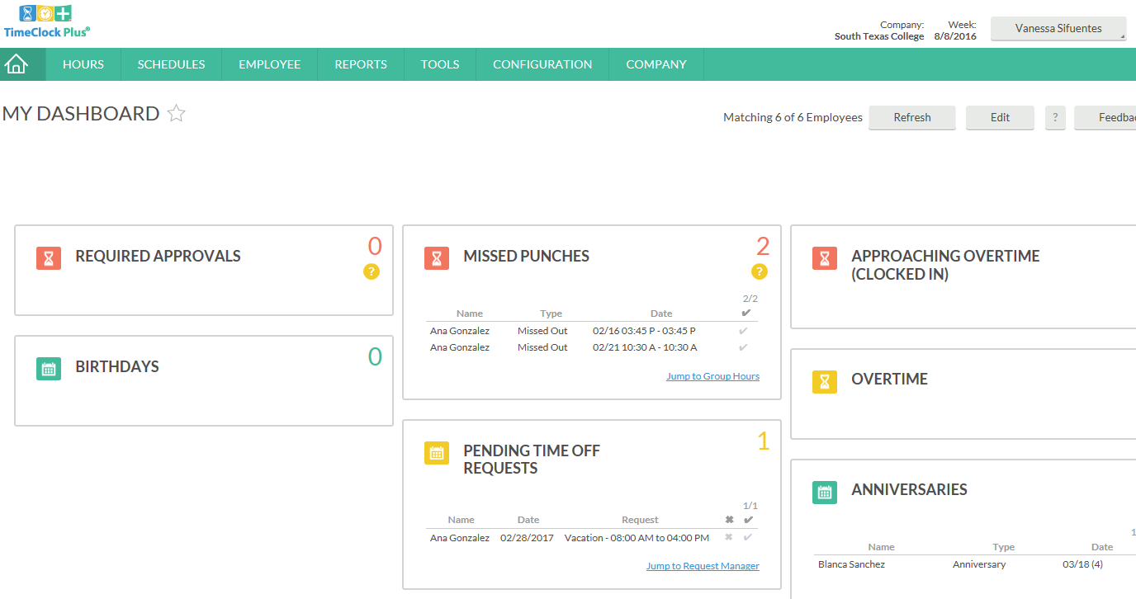
Request Leave using Computer-Supervisor Role
When supervisors log in, they will arrive at “My Dashboard”.
Under Pending Time Off Requests, they will see all pending requests. Then they will go to Request Manager.

Slide 52
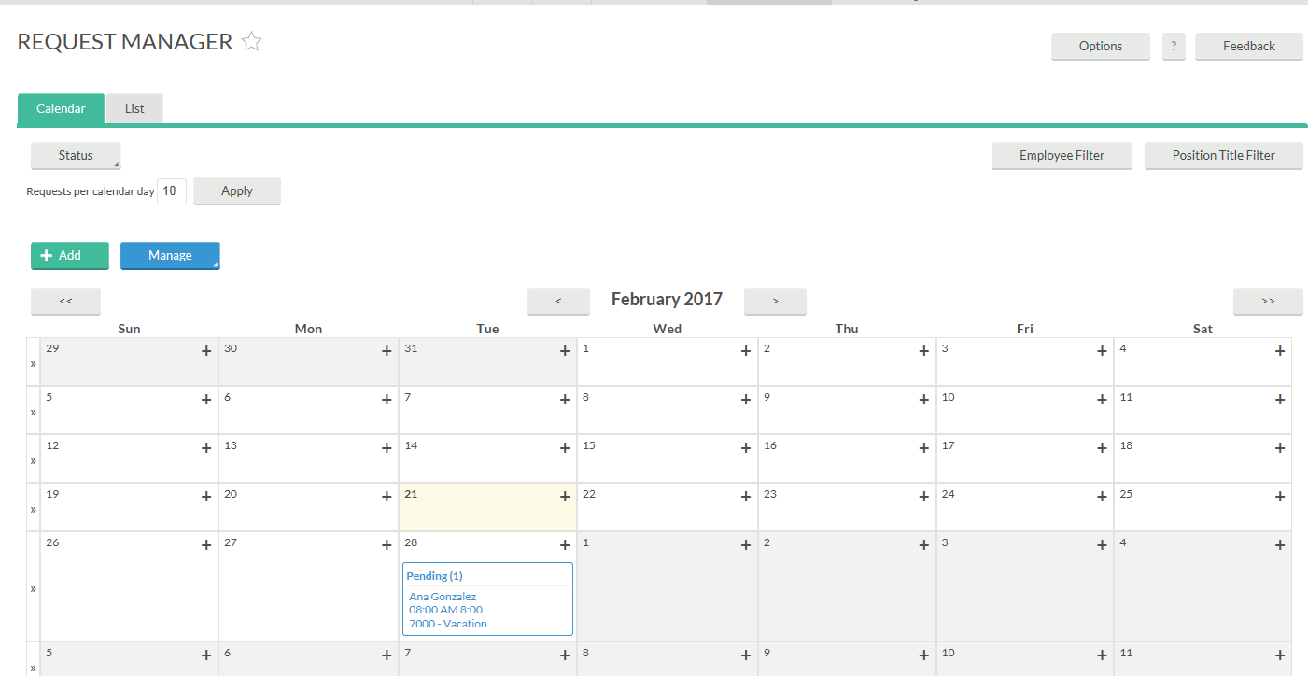
Request Leave using Computer-Supervisor Role

Slide 53
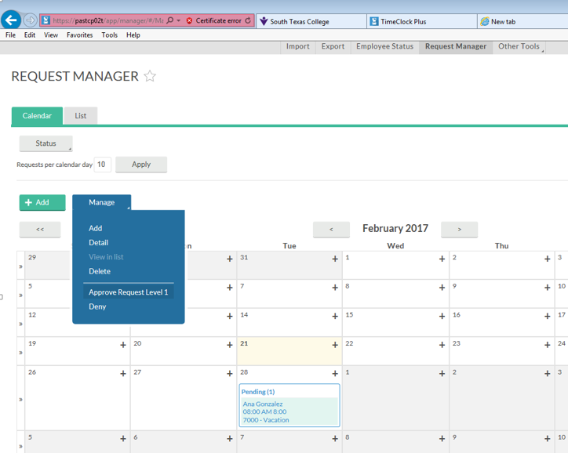
Request Leave using Computer
If leave request is approved, click on blue Manage button. Then click on Approve Request.

Slide 54
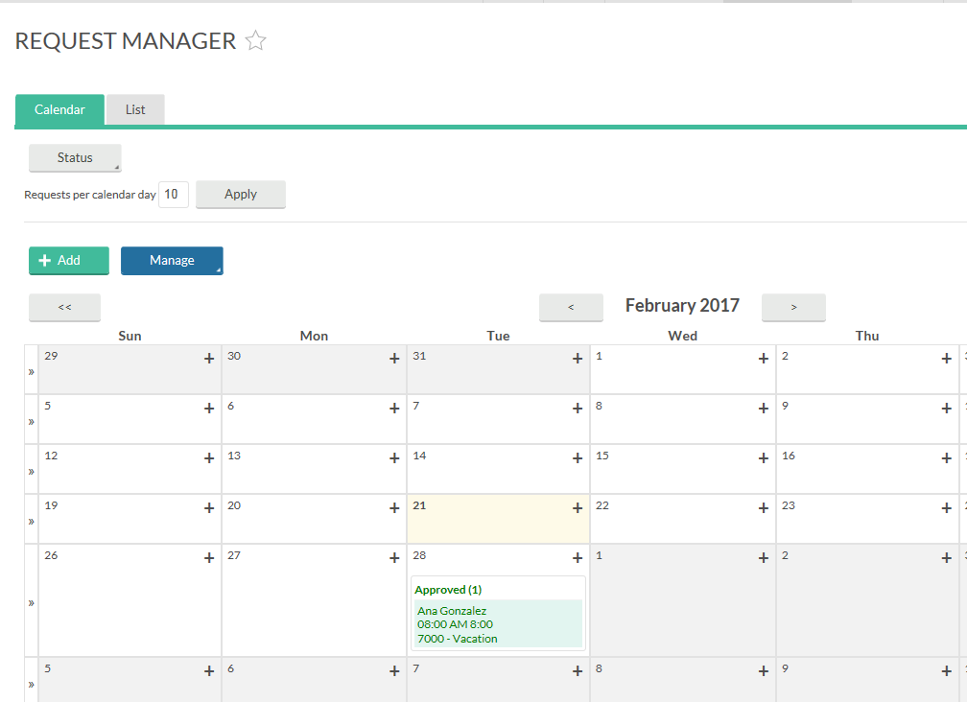
Request Leave using Computer
Once approved, the status will change from Pending to Approved.

Slide 55
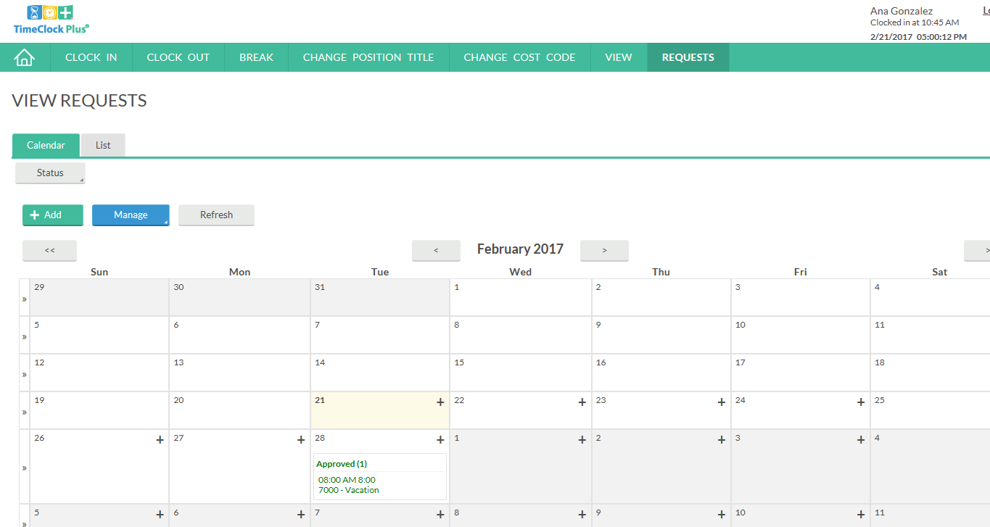
Request Leave using Computer
Now when the employee logs in and views requests, they will see that the request has been updated from Pending to Approved.

Slide 56
Time Adjustment Request Form
One document that we will continue to use is the Time Adjustment Request Form.
This form is to be completed by employees when they travel out of town and working hours need to be entered into the system by the supervisor. Same as previous system.

Slide 57
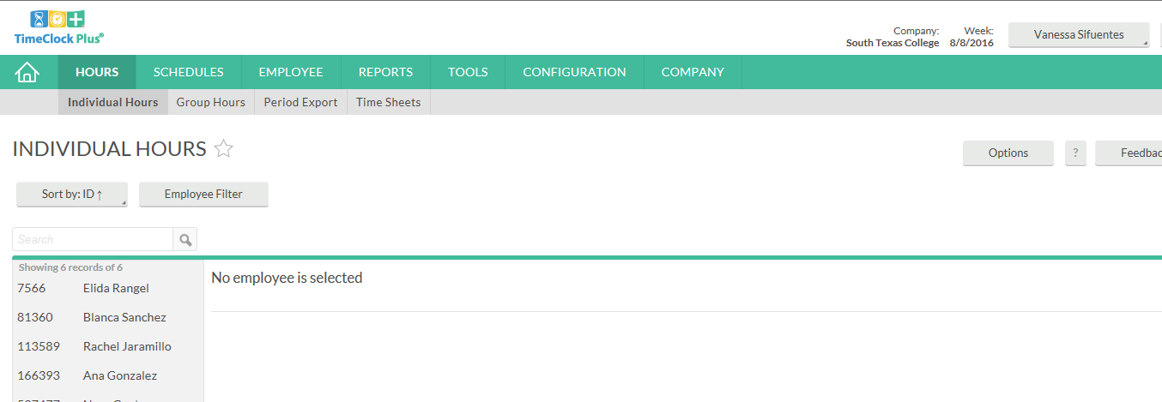
Time Adjustment Request Form
When the employee submits the form to the supervisor, the supervisor will log into system and go to Hours tab, then to Individual Hours. There you will find a list of employees. Select the employee you need to add hours for.

Slide 58
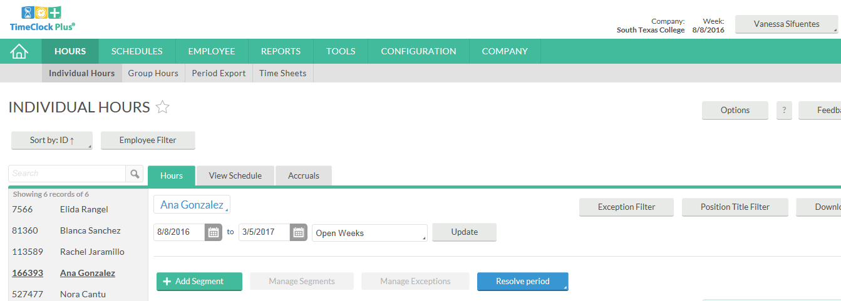
Time Adjustment Request Form
Then click on green button:

Slide 59
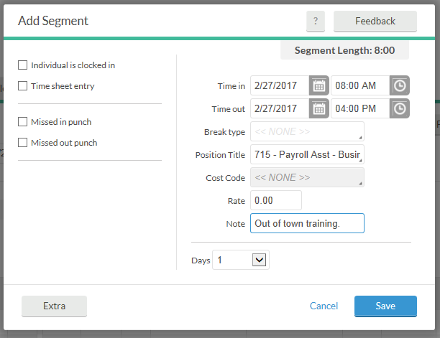
Time Adjustment Request Form
The supervisor will enter the working hours of the training and include a short note.
Then click Save.

Slide 60
Time Adjustment Request Form
The hours are now showing on the employee’s timecard. The employee will have opportunity to confirm that their supervisor entered the correct hours when they review and verify their hours for that day.
Keep in mind, that our payroll record retention is now 10 years.
Keep all originals available for auditing purposes.

Slide 61
Correct/Revise Punch
If an employee forgot to punch in at 7:30 am, but remembered and punched in at 8:00 am, an adjustment needs to be made by the supervisor to reflect the correct time.
The employee will complete the Time Adjustment Request Form and turn in to supervisor for review, approval, and posting.
Keep in mind, this is should be atypical and very limited in occurrence.

Slide 62
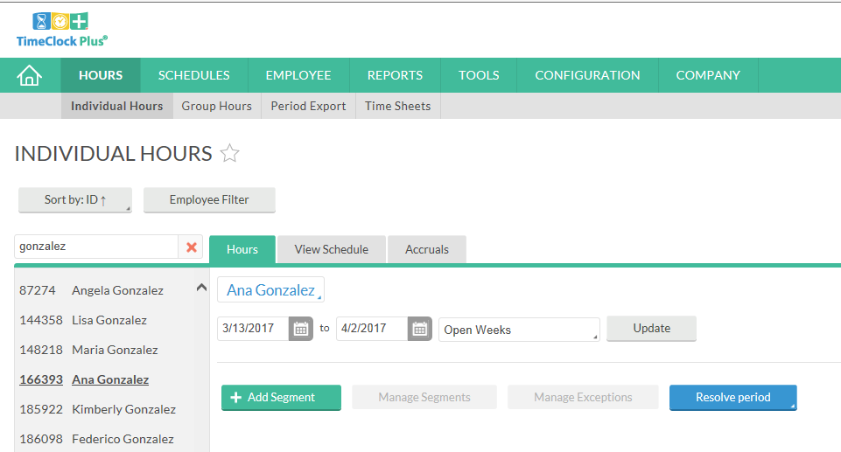
Correct/Revise Punch
When the supervisor receives this form from the employee, they will review, and if approved, input into the system.
Go to Hours, Individual Hours, find the employee, click on the segment that needs correcting.
In this example, the employee came in and started working at 7:30, but forgot to punch in. Then remembered to punch in at 8 am.
The supervisor, if approved, will click on the segment.

Slide 63
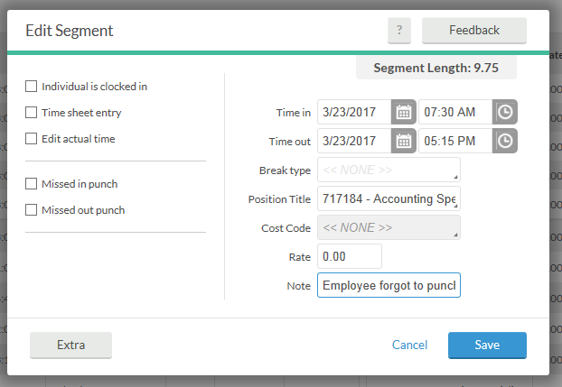
Correct/Revise Punch
An Edit Segment window will open.
Change the time to the correct time, and make a note to document for auditing purposes.
Then click Save.

Slide 64
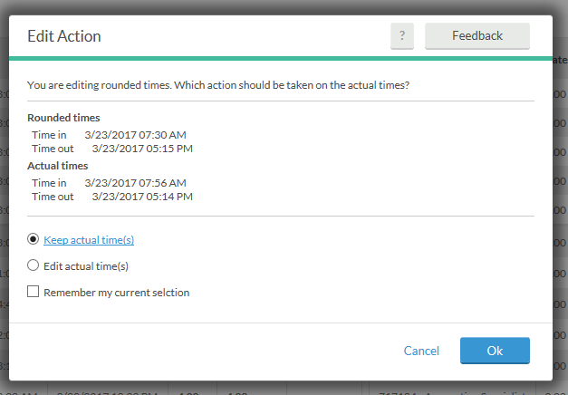
Correct/Revise Punch
Then you’re going to get this window confirming that you want to Keep Actual Time.
Click Ok.
This is going to revise the time, but still keep the actual time for Auditing and tracking purposes.

Slide 65
Correct/Revise Punch
Before:
Now when you go back to Hours Tab, notice that the revision is now reflected.
After:

Slide 66
Verifying Time Using Computer - Employee
Employees should review their timecards on a daily basis. After logging in, click on View, then Hours, then choose the dates you want to review and verify. If correct, then click the column under E and checkmark indicating Employee approval.

Slide 67
Verifying Time Using Computer - Employee
If correct, then click the column under E and checkmark indicating Employee approval.

Slide 68
Verifying Time Using Computer - Employee
When verifying your timecard please be aware that there is no shifts that are conflicting.
Conflicting shift is when a segment shares time with another segment and it will display in orange. Please see example below.
If the pay period has not been locked your supervisor can go ahead and edit the segment with the correct time using reasonable justification (email) from the employee.
If the pay period is locked you will need to submit a leave adjustment request form to fix the leave to the correct time. Original form will need to be submitted to the office of Human Resources-Benefits Specialist.

Slide 69
Verifying Time Using Computer – Employee Certification
Every time you approve your hours, you will receive this notice. It is the same certification as in our previous timekeeping system.
If you agree to this statement, click on Yes.

Slide 70
Verifying Time Using Computer - Supervisor
When your supervisor logs into the system, to review and Verify hours click on Hours, Individual Hours.

Slide 71
Verifying Time Using Computer - Supervisor
There are different ways for this function.
In this example, click on Manage Exceptions and click on Approve column for Manager. Then click Apply.

Slide 72
Review & Verify Timecard Daily
Supervisors and non-exempt employees please get in the practice of reviewing and verifying your timecards on a weekly basis for accurate payroll processing.
In TimeClock Plus, we are able to review and verify hours on a daily/weekly basis rather than waiting for the end of the pay period.
This is an advantage toward accurate payroll processing.
If timecard verification was not done before pay period locking; both non-exempt employee and supervisor will need to print and sign off timecard and have it kept within your department for 10 years for auditing purposes.

Slide 73
Best Practices
Use the TimeClock for punching in and out.
Use the Computer for reviewing and verifying timecards.
Use the Computer for requesting leave.
Review and approve your hours on a daily basis.
Become familiar with the software so that it can be utilized to the best capacity.
Of course, same fraud awareness carries over. Do not share passwords, do use the clock in your assigned area, do not abuse leave, do not abuse working hours, do not overuse the ability to correct/revise punches.
Any reports of suspicion of abuse will be investigated.
Visit website https://finance.southtexascollege.edu/businessoffice/timeclock.html
Presentations and Training Videos

Slide 75
Thank you! Questions contact us @ egomez32@southtexascollege.edu Payroll Specialist
TimeClock Plus

