Slide 1
Helpful Information
Business Office - Payroll Department

Slide 2
Contents
Approving Leave Requests
Approving Miss Punches
Reviewing and Verifying Time Cards
Reviewing Time Card for Discrepancy
Tips and Tricks & Updates
Payroll Forms/Templates
Do’s and Don’ts

Slide 3
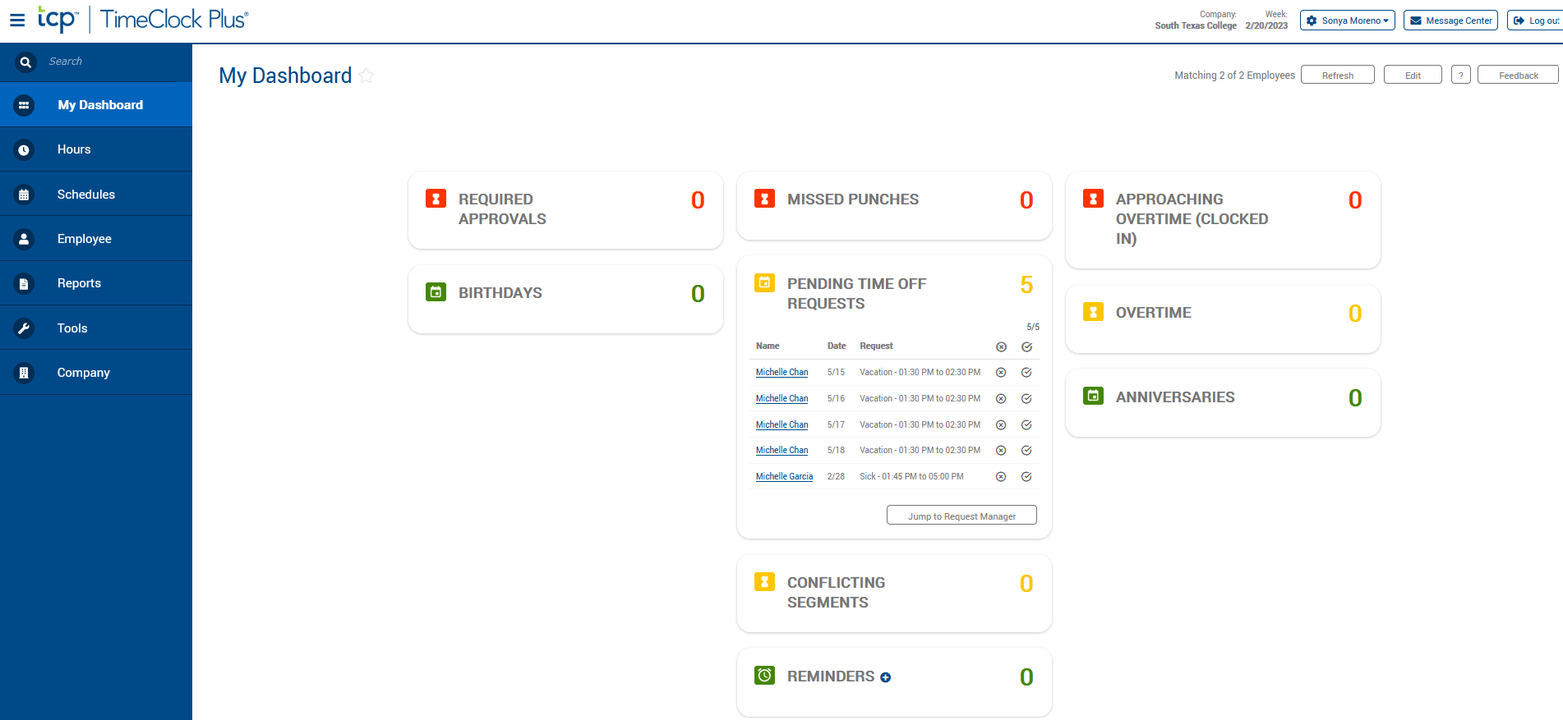
Approving Leave Request using Computer-Supervisor Role
When supervisors log in, they will arrive at “My Dashboard”.
Under Pending Time Off Requests, they will see all pending requests.
Supervisor will click on “Jump to Request Manager”.

Slide 4
Approving Leave Request using Computer-Supervisor Role
If leave request is approved, click on blue Manage button.
Click on Approve Request Level 1.

Slide 5
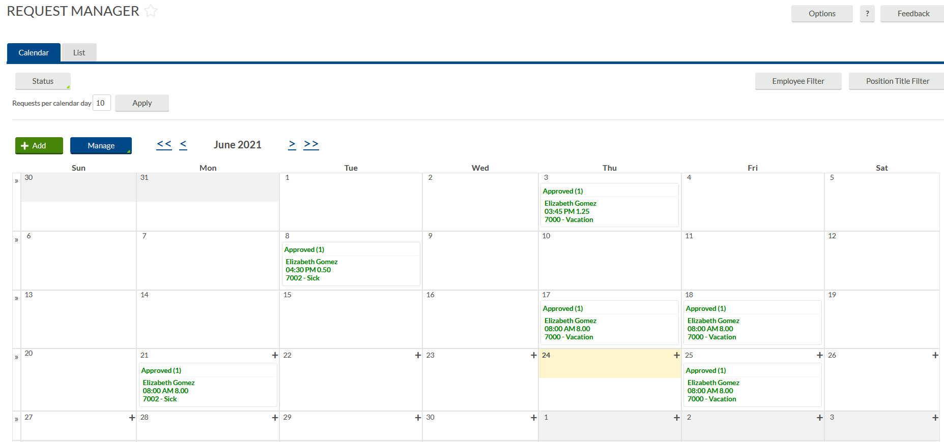
Approving Leave Request using Computer-Supervisor Role
Once approved, the status will change from Pending to Approved.
Employee will get an email notification letting them know that their leave is approved or denied.

Slide 6
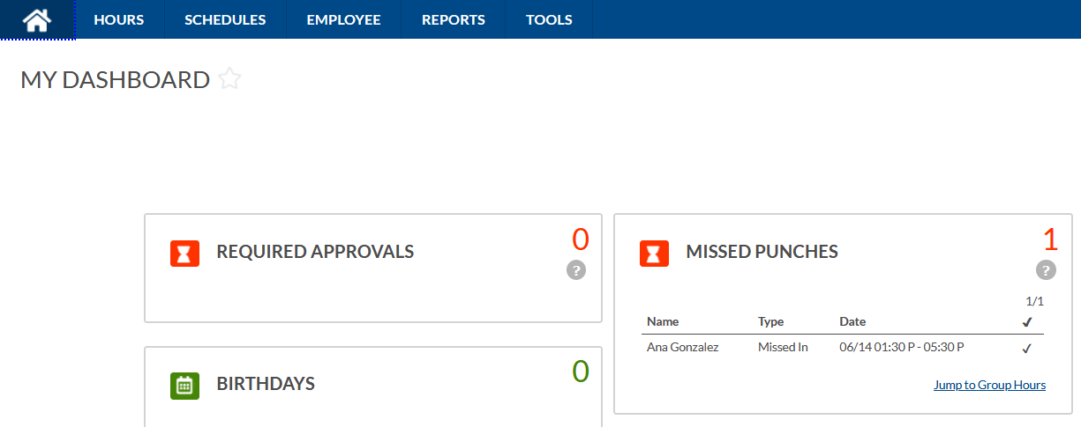
Approving Missed Punches using Computer –
Supervisor Role
When supervisors log in, they will arrive at “My Dashboard”.
Click on Jump to Group Hours
Under MISSED PUNCHES, they will see all revised/missing punches that need review and approval.

Slide 7
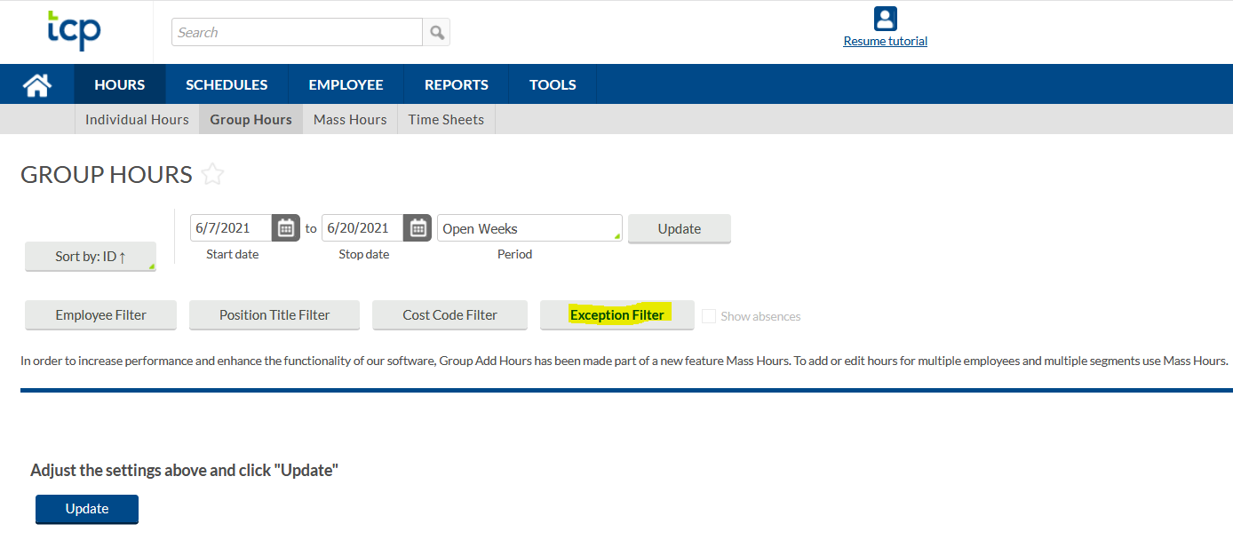
Approving Miss punches using Computer –
Supervisor Role
Click on the Exception Filter
Notes:
Different ways to maneuver around this screen, for this example, we will use the Exception Filter to isolate

Slide 8
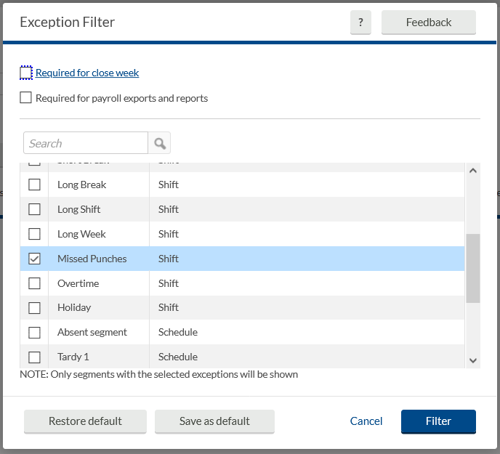
Approving Missed Punches using Computer – Supervisor Role
There are many Exceptions
For this example, we are isolating Missed Punches.
Click Filter

Slide 9
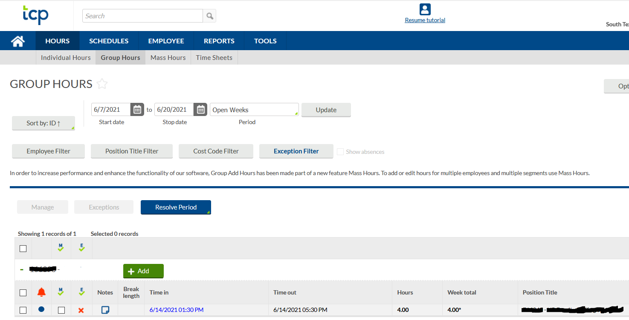
Approving Missed punches using Computer -Supervisor Role
You may Click on Notes for more detail on this occurrence.

Slide 10
Approving Missed Punch using Computer – Supervisor Role
If approved, click on the left box to isolate that activity.
Click on Exceptions, click under Approve column for Missed Punches
Click Apply
If not approved, review with employee and have correct information in the system for approval

Slide 11
Approving Missed Punches using Computer – Supervisor Role
When supervisor returns to Home Page, the Missed Punches have been resolved. Nothing is pending for review and approval.

Slide 12
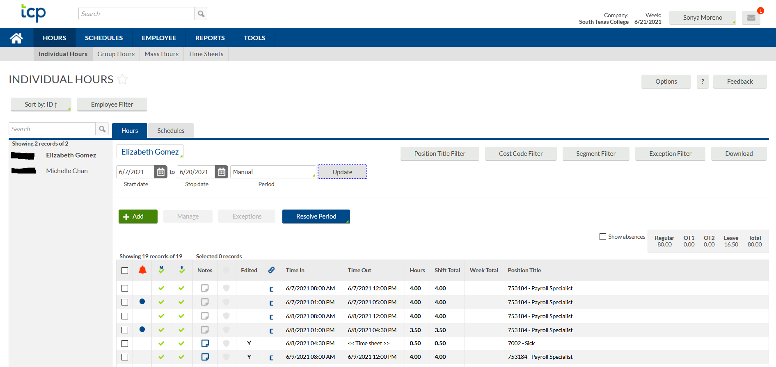
Review & Verify Time Cards - Supervisor Role
Supervisors log into the system, to review and approve hours by clicking on Hours, Individual Hours
All non-exempt employees are required to verify their timecard. (ex. verify your time worked and/or any leave you took).

Slide 13
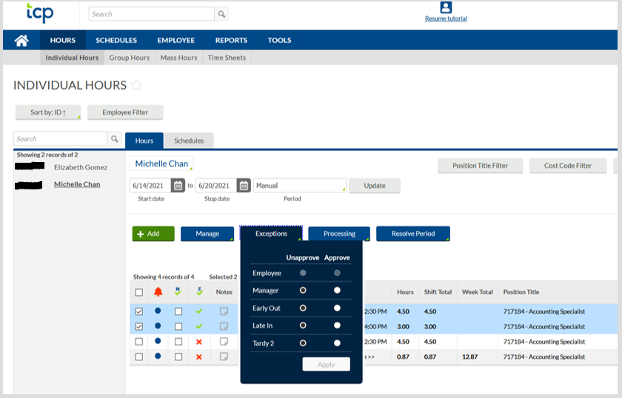
Review & Verify Time Cards - Supervisor Role
There are different ways for this function.
In this example, click on Exceptions and click on Approve column for Manager
Click Apply
Please note if timecard was not verified before pay period locking; timecard will need to be printed & be signed by both employee and supervisor and kept within the department’s record retention files for:
Fiscal Year End + 3 years for all employees.

Slide 14
Reviewing Time Card for Discrepancy
WRONG
Ensure when verifying time card there are no discrepancy's such as:
No Conflicting Shifts
No Long Shifts
Check for Employee not Under Hours
NON ROUNDED PUNCHES
CORRECT

Slide 15
Tips, Tricks & Updates
Tips and Tricks
Verifying employees time cards by using the Resolve Period option.
Set reminders in your calendar/outlook.
Customizing Dashboard.
Be on the look out for the TCP generated reports.
Take advantage of TCP reports.
Updates
Updated payroll record retention.
Time off request can be approved from email and/or TEAMS
Supervisors can access portal off campus.

Slide 16
Tips, Tricks & Updates
Payroll Record Retention
Time Adjustments entered by supervisors and designees will need to be kept in your departments record retention files for auditing purpose for:
FISCAL YEAR END + 3 years for all employees
If TimeCard verification was not done before locking pay period; timecard will need to be printed & both employee and supervisor will need to sign timecard and will need to indicate a justification as to why it was not verified for the following periods:
FISCAL YEAR END + 3 years for all employees

Slide 17
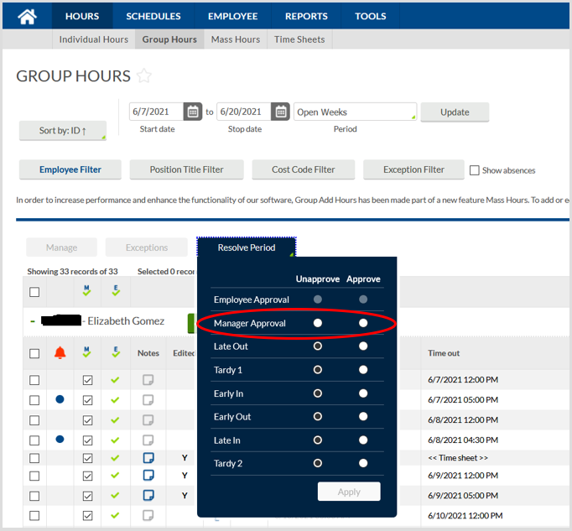
Review & Verify Time Cards (Resolve Period) - Supervisor Role
To verify all your non-exempt employees at once click on:
Hours
Group Hours
Resolve Period
Click Approve on Manager Approval.
This action will approve all employees including those who do not show up on current page.

Slide 18
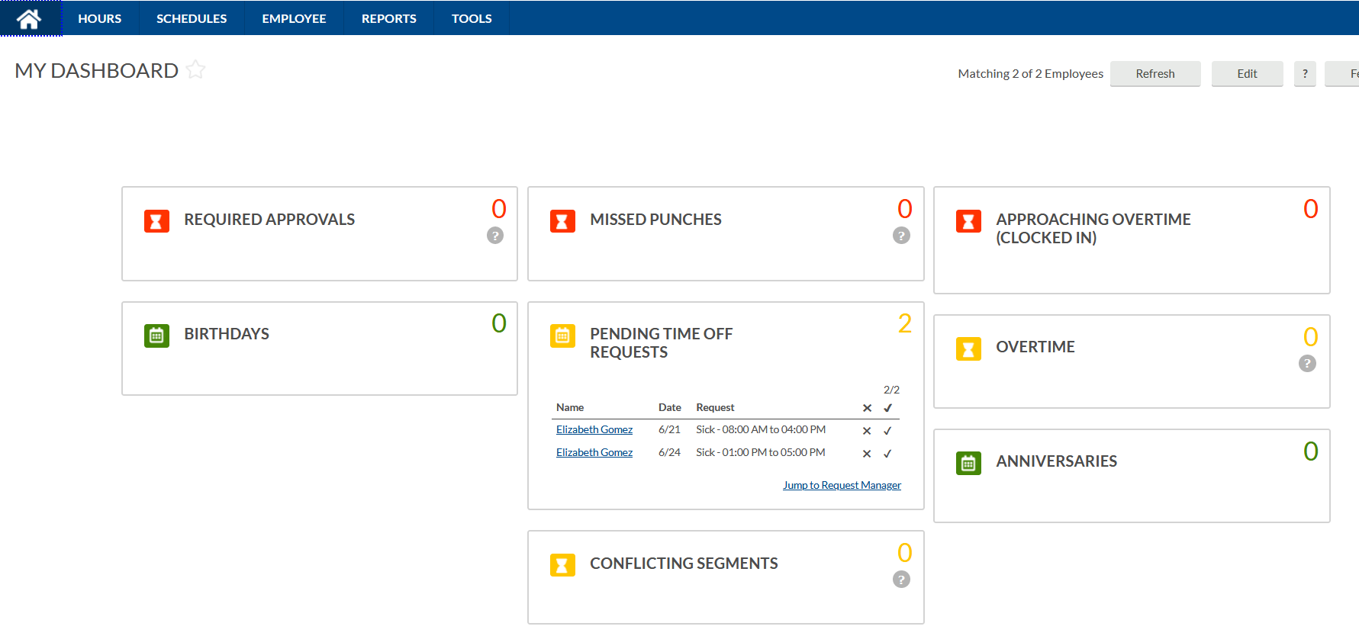
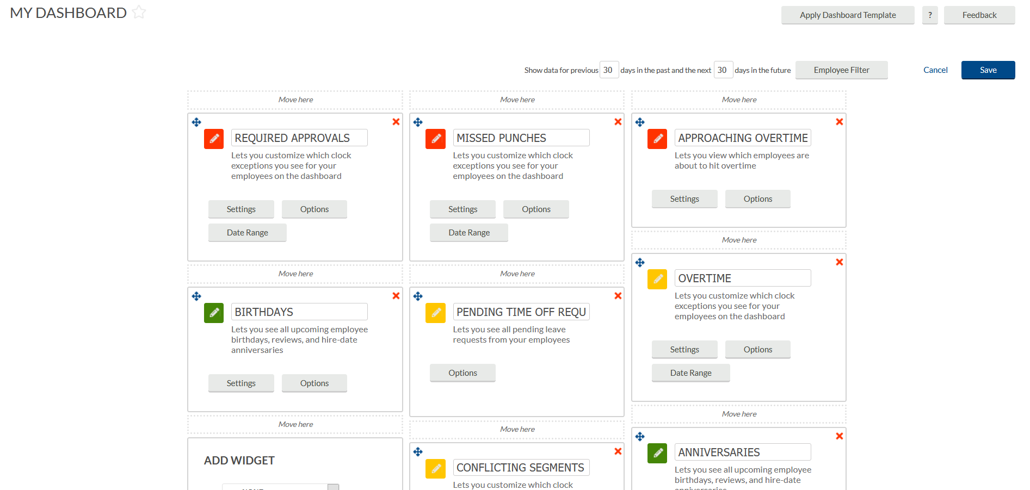
Customizing your Dashboard - Supervisor Role
Supervisor can customize “MY DASHBOARD” by clicking on Edit and adding widgets for convenience processing.

Slide 19
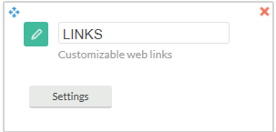
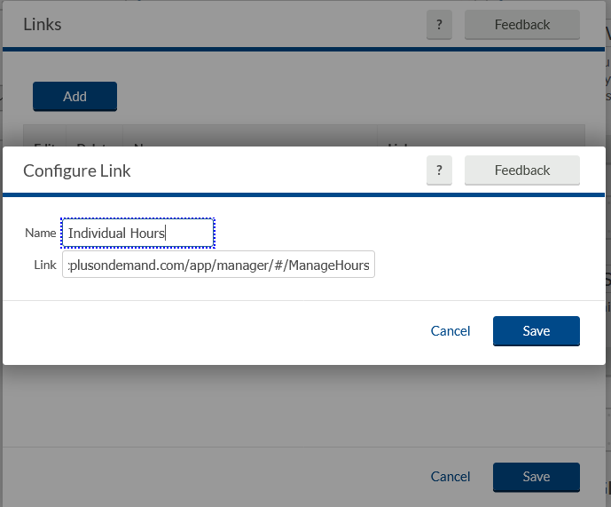
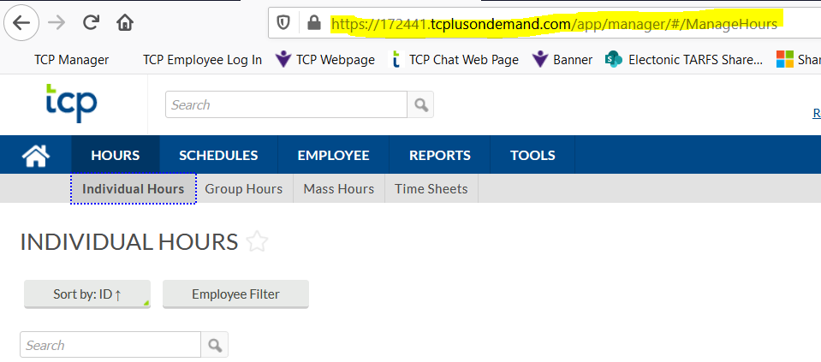
Customizing your Dashboard- Supervisor Role
Click SETTINGS then click ADD
Adding LINKS to Widget
Copy link from Hours - Individual Hours then paste to the Configure Link. You can name Link as you would like it to appear, then click Save

Slide 20
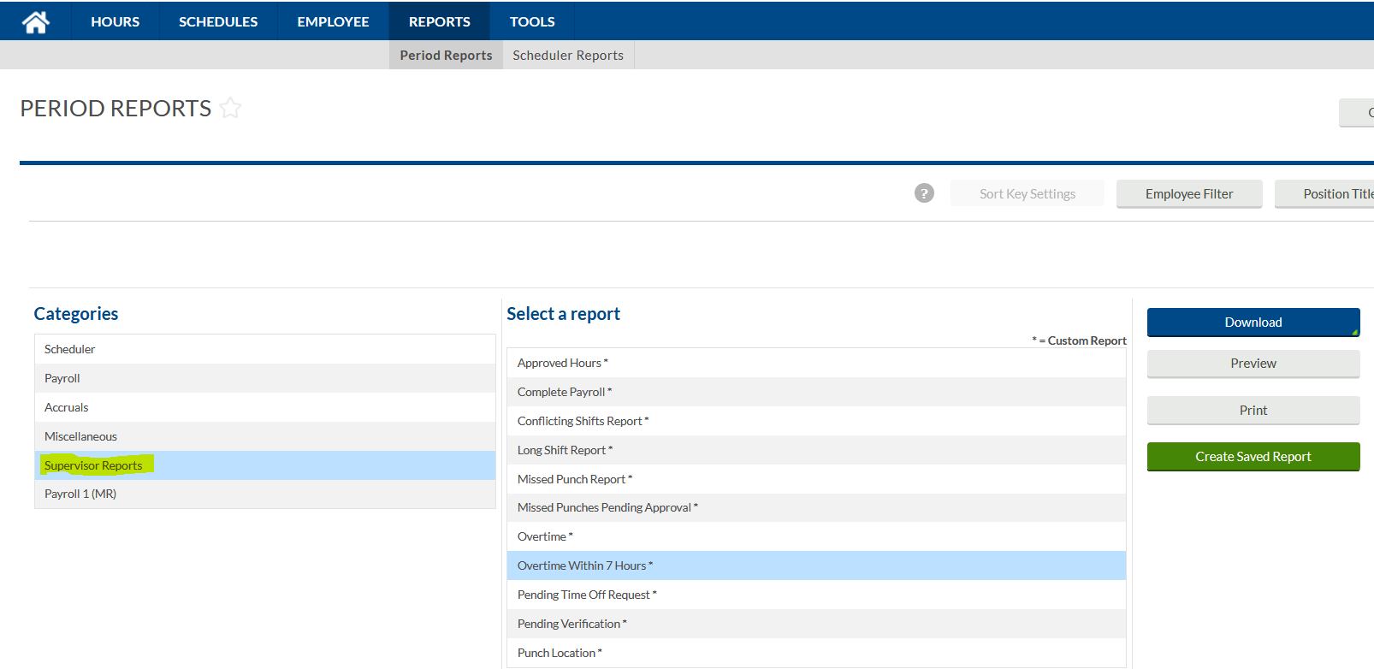
Extract Reports
TimeClock Plus offers different reports for your usage
You can find the reports under:
Reports → Period Reports
Under Categories → Supervisor Reports
TCP is set up to send Automated Report reminders for previous week to Supervisors/Designees on:
Mondays for Punch Location
Tuesdays for Timecard Verification
Wednesdays for Final Timecard Verification
Fridays for Non-Compliant Timecard Verification
Financial Managers (FM’s) are set up to receive a Monthly (on the 15th ) Non-Compliant Timecard Verification for their Departments. The information will only include previous month.

Slide 21
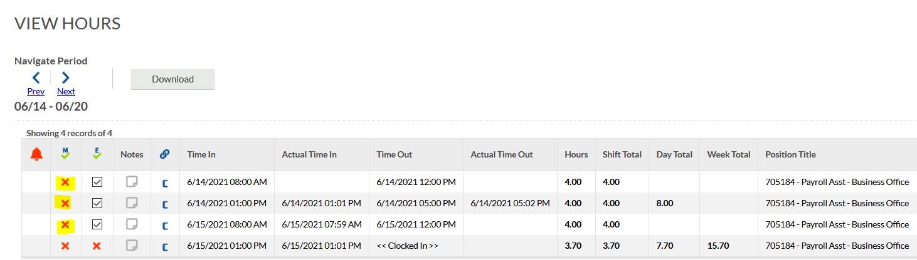
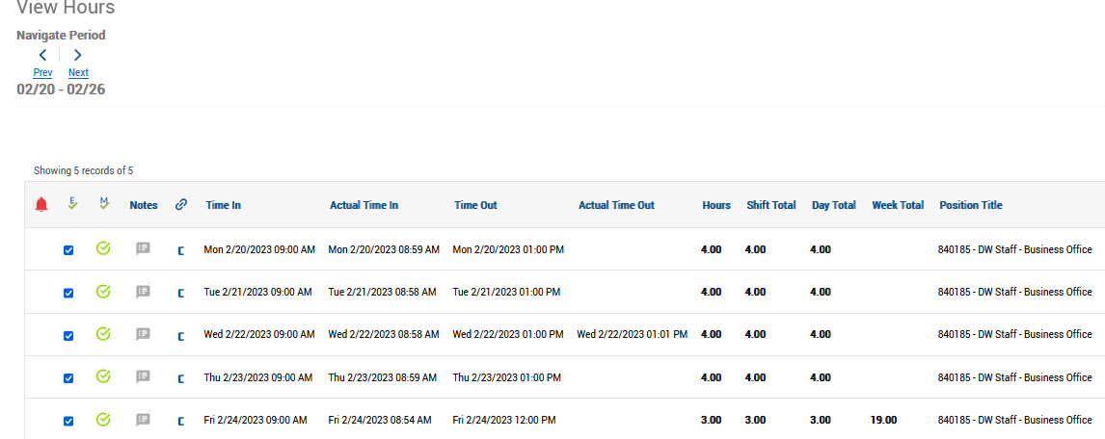
HELPFUL TIPS
Employees can now see if their Supervisor has verified their timecard or not

Slide 22
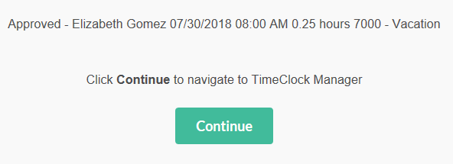
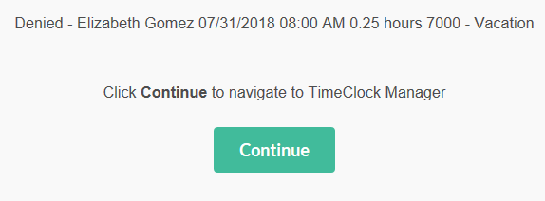
HELPFUL TIPS
TIME-OFF LEAVE REQUESTS CAN BE APPROVED FROM EMAIL AND/OR TEAMS
You may click Approve level 1 to Approve or Deny leave request. The link via email notification is only available to Supervisors for 72 hours. If supervisor does not use the email link to Approve/Deny the leave request within 72 hours of the initial request, the supervisor will need to log into TCP and Approve/Deny the leave request under the Request Manager Calendar.
Once leave request has been Approved or Denied Supervisor will see the message below where you have either Approved or Denied request. You may click Continue to navigate to TCP Manager Portal Login

Slide 23
Payroll Templates
Payroll Templates
TimeClock Plus Access Authorization From (BO-7710)- This form is used to create/remove supervisor and/or designee. As well as adding and removing employees to supervisors/designees.
Time Adjustment Request Form (BO-7700)- This form is needed before making any adjustments to employees time card and to record any travel hours.
Templates to Use for Uploading via DocuSign
Request for Overtime (BO-7721)- Request for employees working overtime on monthly basis.
Annual Overtime Request for (BO-7723)- This form is only used for those employees who work less than 5 hours of overtime each month during a fiscal year.

Slide 24
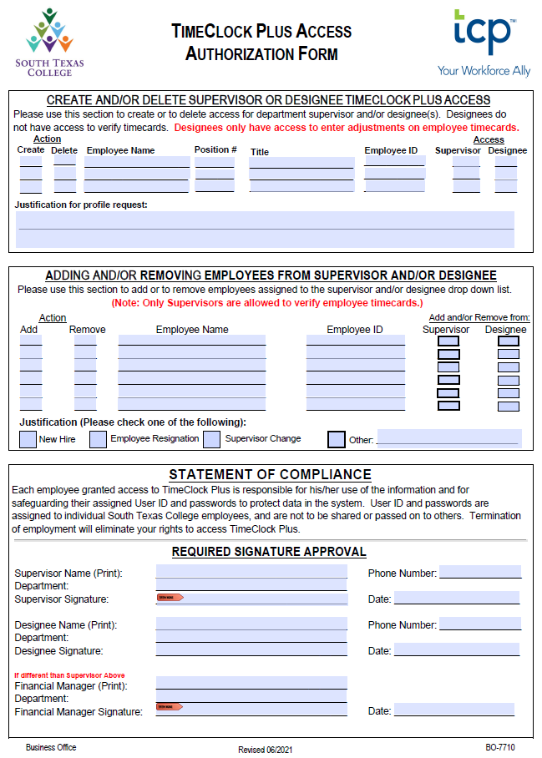
BO-7710 TimeClock Plus-Access Authorization Form
This section is used to create or delete NEW access of a supervisor or designee in TCP.
This section is used to add or remove an employee from your drop down list. Please make sure to indicate from who they will need to be added or removed from.
Statement of compliance section and Required Signature Approval has to be signed by supervisor and/or FM if different.
BO-7710 submission through DocuSign coming soon!!

Slide 25
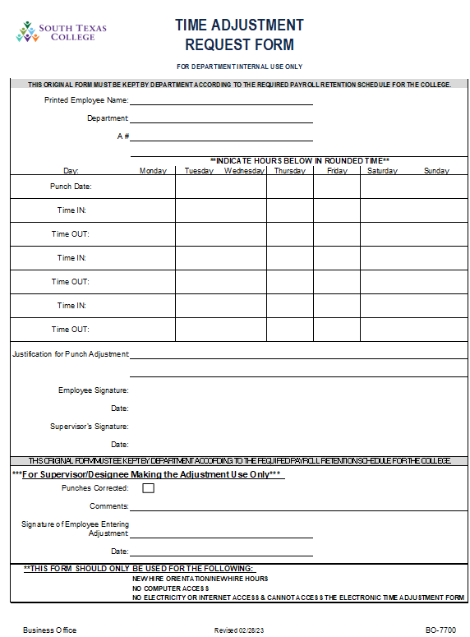
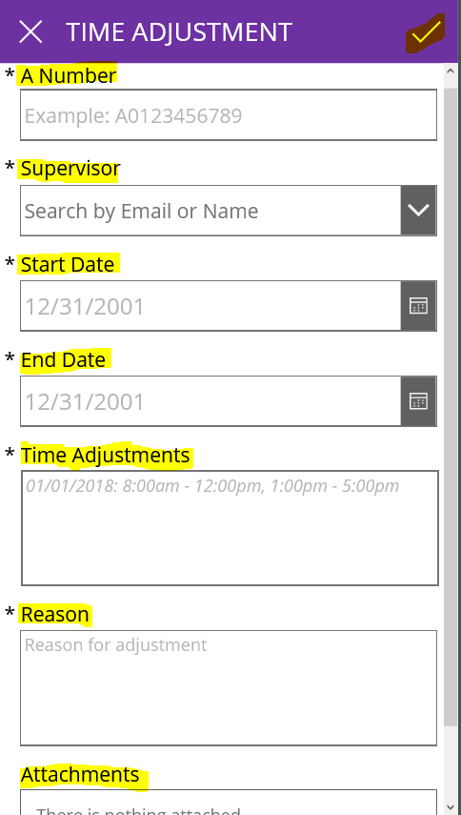
BO-7710 Electronic Time Adjustment Form
When is a TARF needed by the employee?
To edit hours on an employees timecard.
To add conference/travel hours.
To add HR orientation day hours.
Supervisor Note:
If pay period has been locked and you were not able to enter time for employee. Submit ETARF email from Microsoft Flow or original TARF to Business Office-Payroll so hours can be added/adjusted for the employee.
Paper form will only be allowed when employee does not have access to a computer or phone to submit ETARF or no electricity or internet is available.

Slide 26
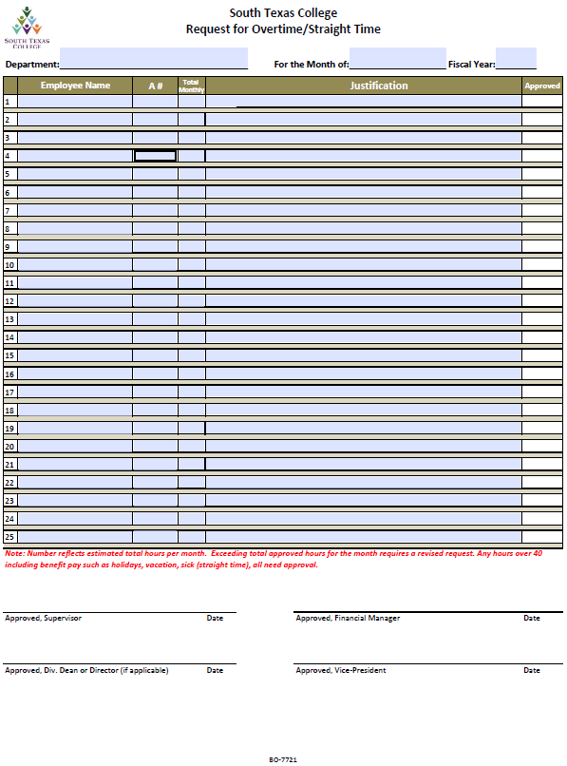
BO-7721 Request for Overtime Memo
Policy 4520 - Requests for overtime work for non-exempt employees may only be authorized by the appropriate supervisor with approval of the President. Exceptions may be granted in emergency situations. All overtime worked must be properly authorized including hours to be worked and an explanation of the reason for the overtime. Employees working unauthorized hours may be subject to disciplinary action.
Supervisors must submit the “Request for Overtime” form (BO-7721) the month prior to the overtime being worked. Regardless of the number of overtime hours anticipated to be worked.
Employees are not required to work all the hours stated on Form BO-7721. The hours are only an estimate.
All non-exempt employees must have prior written approval when working overtime and/or straight time hours.
USE THIS AS TEMPLETE TO SUBMIT VIA DOCUSIGN
https://admin.southtexascollege.edu/president/policies/ch4.html

Slide 27
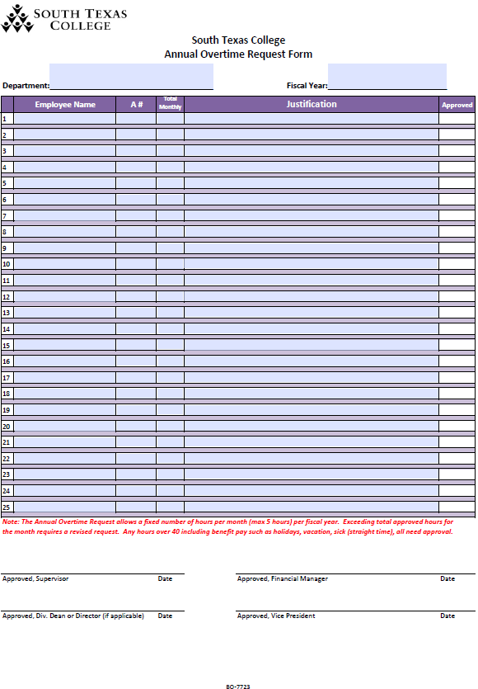
BO-7723 Annual Overtime Request Form
Form BO-7723 Annual Overtime Request is to be used by employees anticipating to work 5 hours or less overtime and/or straight time in each month throughout the Fiscal Year. Any overtime over 5 hours in any month will require a monthly submission of BO-7721.
All procedures applied to Form BO-7721 Request for Overtime apply to BO-7723 with the exception in the amount of hours.
USE THIS AS TEMPLETE TO SUBMIT VIA DOCUSIGN

Slide 28
Do’s and Don'ts
Do’s for Clock In/Out
Don’ts for Clocking In/Out
Do’s
Clock in/out using the time clock in your department’s building or your assigned STC computer when entering or leaving work.
Properly clock in/out at scheduled time to begin/finish work.
Arrive and depart your working assignment according to your schedule.
Use STC Time Adjustment Request Form (BO-7700) for working travel hours.
Review and verify your timecard timely on TCP, before weekly deadline.
Keep all payroll related documentation available in your record retention files for auditing purposes for the following:
Fiscal Year End (FE) + 3 years for all employees
Any forms of abuse are considered acts of fraud. Auditors review exceptions and request justifications.
Don’ts
Don’t share your TimeClock Plus online web access username and password.
Clock in/out through the College’s wireless network utilizing personal equipment.
Abuse working hours.
Clock in/out or authorize another individual to clock you in/out for non-working hours.
Clock in/out in a building you don’t work in to adjust your arrival/departure time.
Clock in, go park your car, and then go back to work.
Clock in/out of another building when going to lunch or returning from lunch.
Clock in and use working time for personal use.
Abuse the 15 minute rounding time setups in TCP.
Overuse the STC Time Adjustment Request Form (BO-7700) to adjust your working hours. Frequent use of this form, which is displayed in your timecard, may cause audit issues.

Slide 29
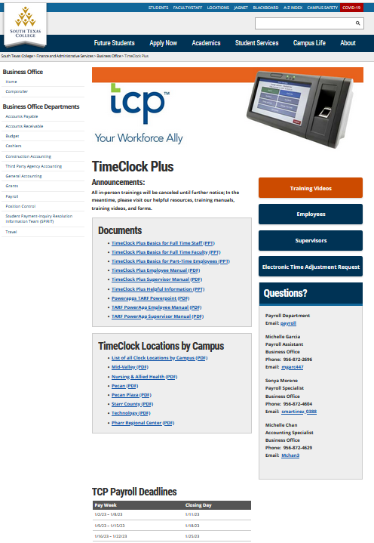
https://finance.southtexascollege.edu/businessoffice/timeclock.html

Slide 30
Thank You!
Questions contact us @
Vanessa Balderrama, Accounting Group Manager Email: vbalderrama@southtexascollege.edu Phone: 956-872-4674
Elida Rangel, Payroll Accountant Email: evaldez_3158@southtexascollege.edu Phone: 956-872-4641
Sonya Moreno, Payroll Specialist
Email: smartinez_0388@southtexascollege.edu
Phone: 956-872-4604
Michelle Chan, Accounting Specialist
Email: mchan3@southtexascollege.edu
Phone: 956-872-4629
Michelle Garcia, TCP Admin, Payroll Assistant
Email: mgarc447@southtexascollege.edu
Phone: 956-872-2696
Blanca Sanchez, Accounting Assistant Monthly Payroll Processing Email: bsanchez_2699@southtexascollege.edu Phone: 956-872-4613
Rachel Jaramillo, Accounting Assistant Semi-Monthly Payroll Processing Email: rjaramillo_8214@southtexascollege.edu Phone: 956-872-4606
Payroll Department
payroll@southtexascollege.edu

