Slide 1
Part-Time Employees

Slide 2
Contents
Clocking in and out operations – using the Timeclock
Missed punches – using the Timeclock
Messages – using the Timeclock
Approving Time – using the Timeclock
Clocking in and out operations – using the computer (webclock)
Missed punches – using the computer (webclock)
Electronic Time Adjustment Request Form (TARF)
Verifying Time – using computer (webclock)
Best Practices

Slide 3
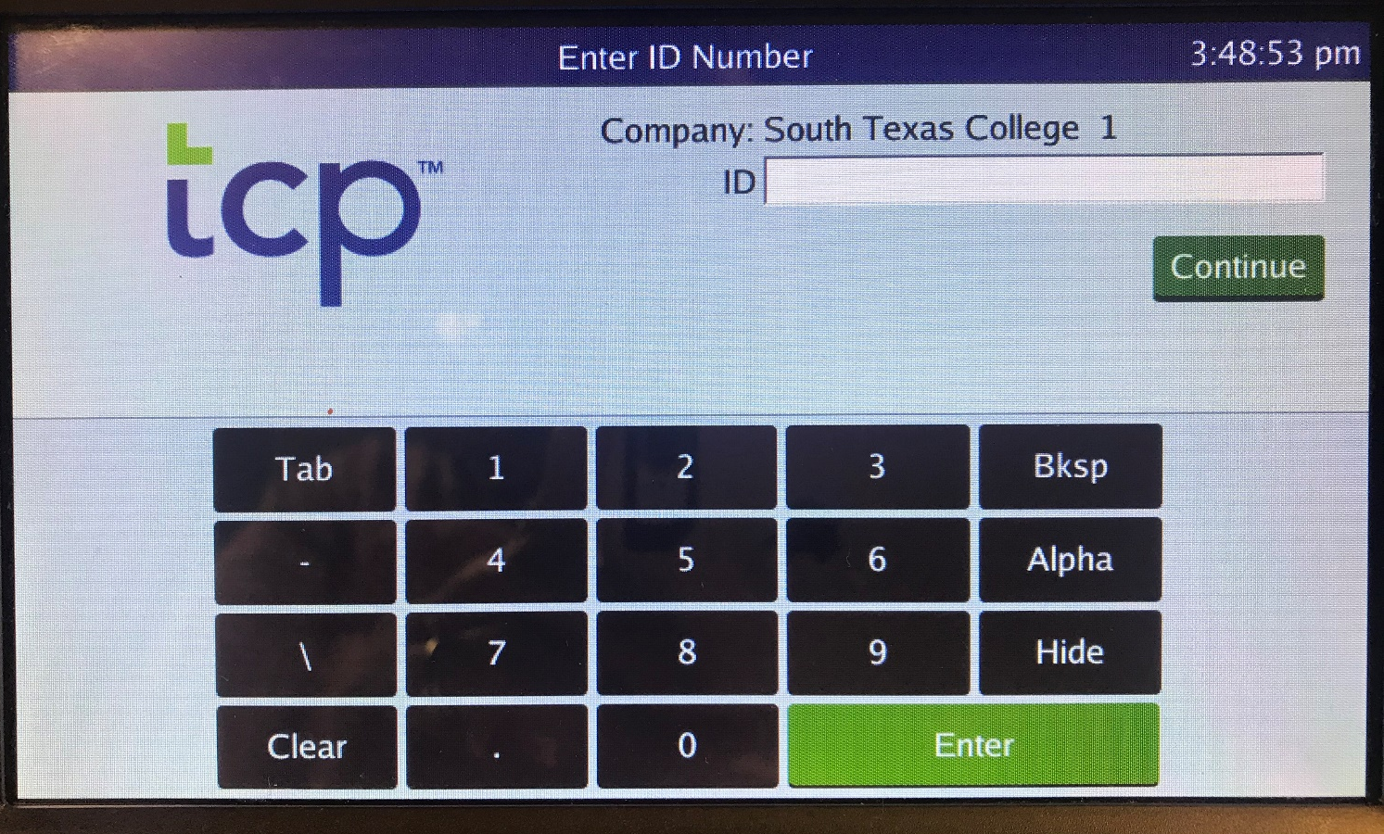
Clocking in and Clocking Out Operations
Using the touchscreen keypad, enter your Employee A#, not including the leading zeros.
Press

Slide 4
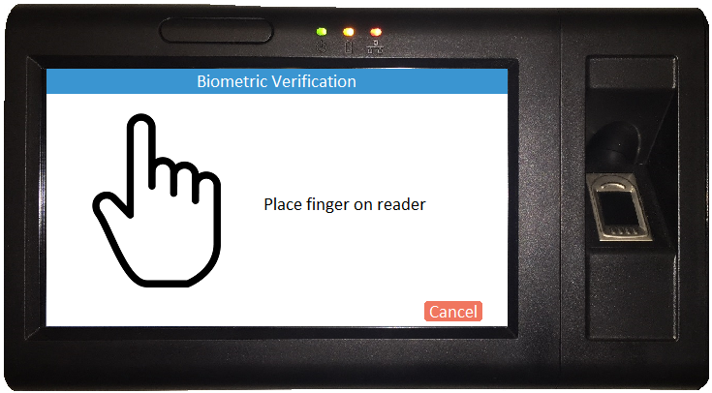
Clocking in and Clocking Out Operations
Place your finger on the fingerprint scanner.

Slide 5
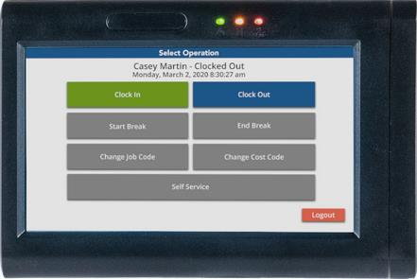
Clocking in and Clocking Out Operations
To Clock In:
Select
To Clock Out:
Select
Only use the Clock In and Clock Out options.
Do not clock out for breaks.
DO NOT USE Logout tab on bottom right corner for Clocking Out.
This will completely log you out of the system.

Slide 6
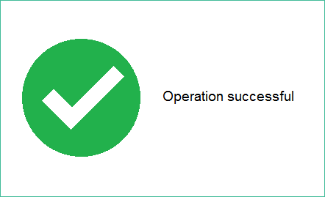
Clocking in and Clocking Out(Biometric Reader)
When you see this screen, you have successfully clocked in/out.

Slide 7
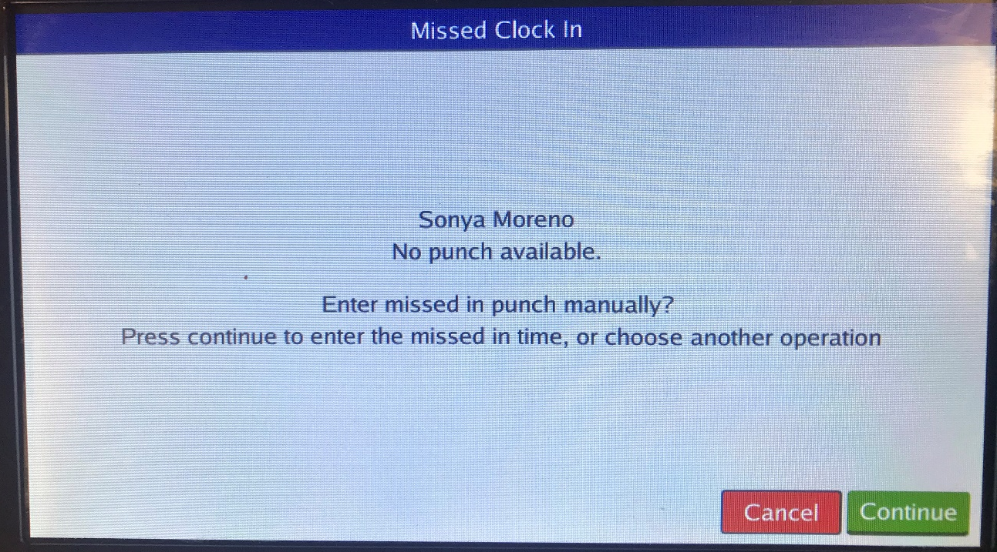
Missed Punch – Enter Record
System is letting you know that there is a missed punch
Press
Notes:
Now what happens if you’re trying to punch in but you didn’t punch out? The system will ask you if you missed a missed a punch and if you want to punch out manually, correct the punch. Press continue.

Slide 8
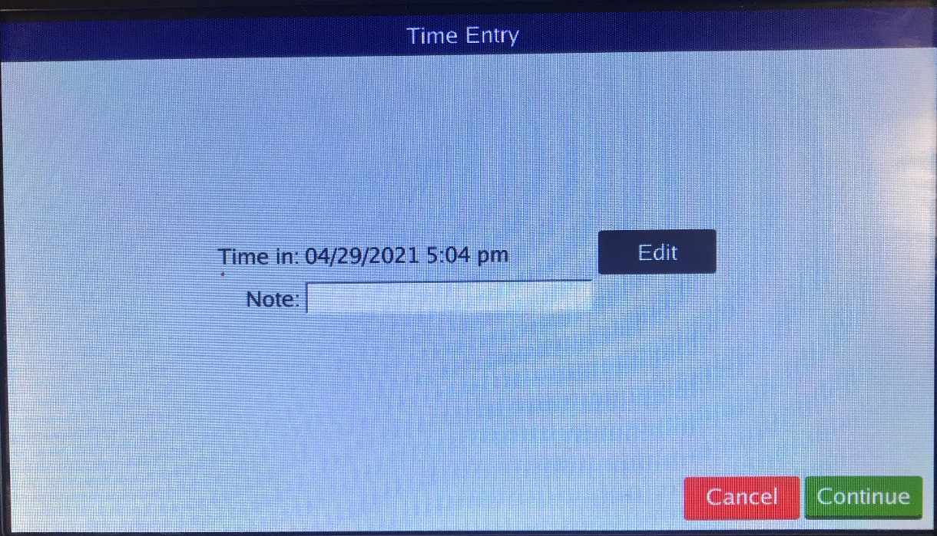
Missed Punch – Enter Record
This screen will allow you to correct the missing punch
Press
Notes:
Now what happens if you’re trying to punch in but you didn’t punch out? The system will ask you if you missed a missed a punch and if you want to punch out manually, correct the punch. Press edit.

Slide 9
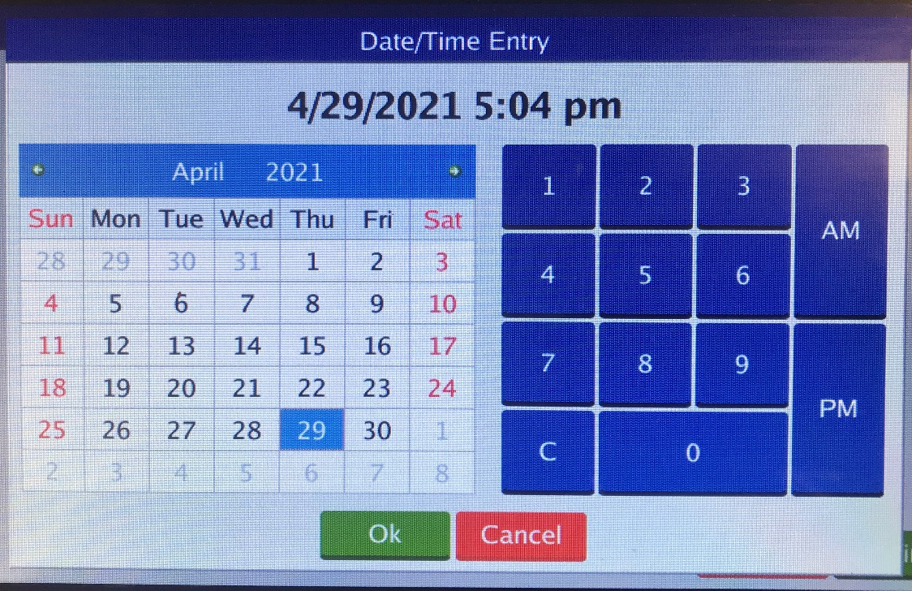
Missed Punch – Enter Record
Enter the correct date and time for your missed punch.
Press

Slide 10
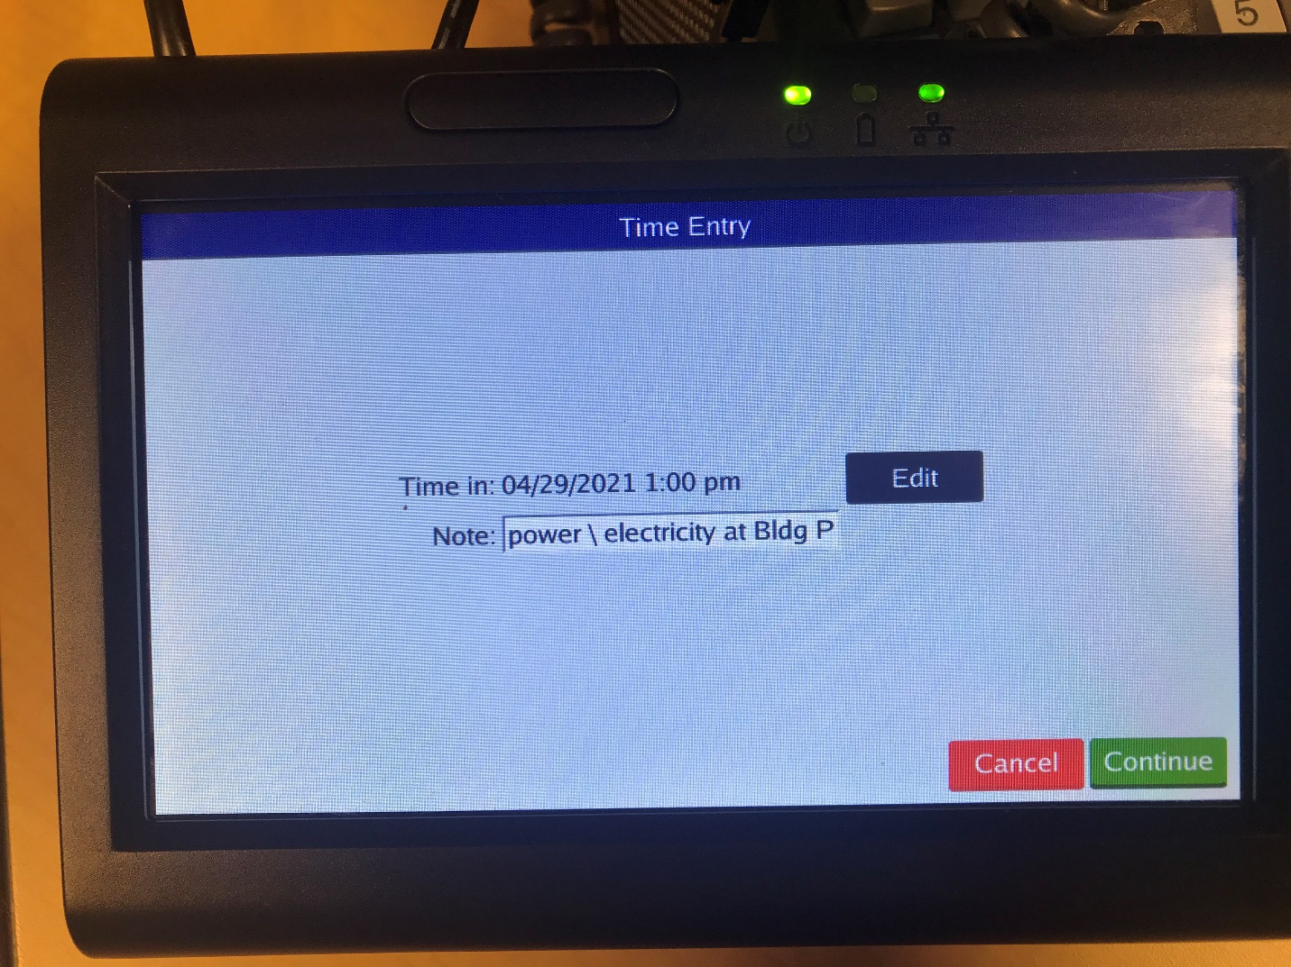
Missed Punch – Enter Record
Enter an explanation of the missed punch.
Click Continue

Slide 11
Missed Punch – Enter Record
The correct IN and OUT punches for the day should be displayed.
Press

Slide 12
Missed Punch-Enter Record
When you see this screen, you have successfully clocked in/out.

Slide 13
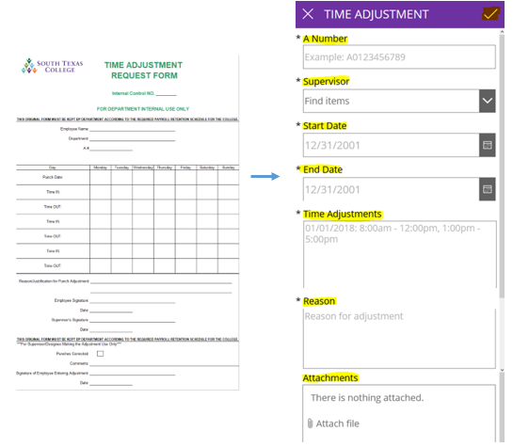
Correct/Revise Punch-Enter Record
If you need to correct a segment or missing clock in or out, you must submit an electronic time adjustment (southtexascollege.edu/go/tarf). If no electricity or internet is available a paper TARF will be accepted.
The electronic TARF is only to be used when you need to submit hours worked in a full segment, such as when working outside of STC premises or traveling for conferences, etc.
Supervisor must make corrections in TCP.

Slide 14
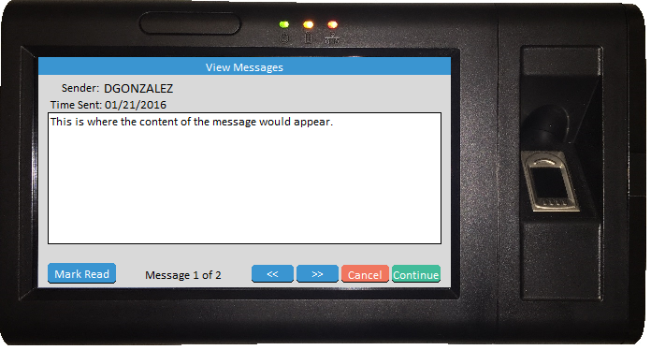
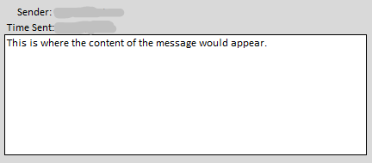
Employee Message
The buttons are used to scroll through the messages but will only appear if there are multiple messages available to view.
The button alerts the sender that you have viewed the message. Upon marking a message as read, it will immediately advance to the next message. The sender may not require the alert in which case the button may not appear.
You must press to finish clocking in or out.
Notes:
Timeclock plus has the ability for supervisors to send messages to their employees. If you receive a message upon logging into the system, read message, click Mark Read, and continue.

Slide 15
Verifying Time
Log into the clock. This will take you to the “Select Operation” screen.
From the “Select Operation” screen, press
Do not use any function outside of punching in/out/resolving missed punch, on the clock during the hours of:
7:30 – 8:30 am and 4:30-5:30 pm.
This is to avoid delaying others during the hours of peak timeclock use.

Slide 16
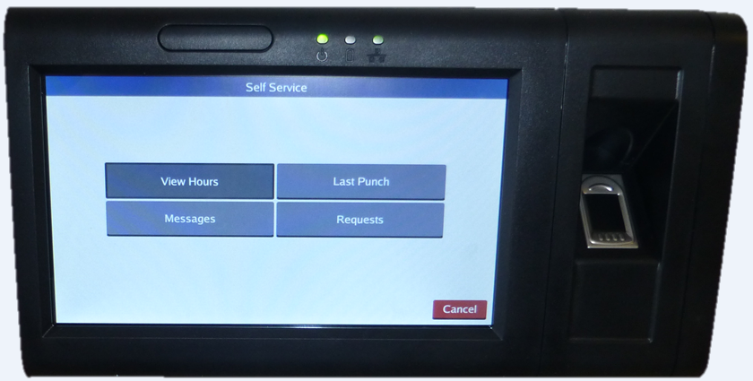
Verifying Time
On the “Self Service” screen, press Hours

Slide 17
Verifying Time
Examine the time information.
If everything is correct, press the Checkbox in the Aprv column next to the segment. Once you have verified your time click

Slide 18
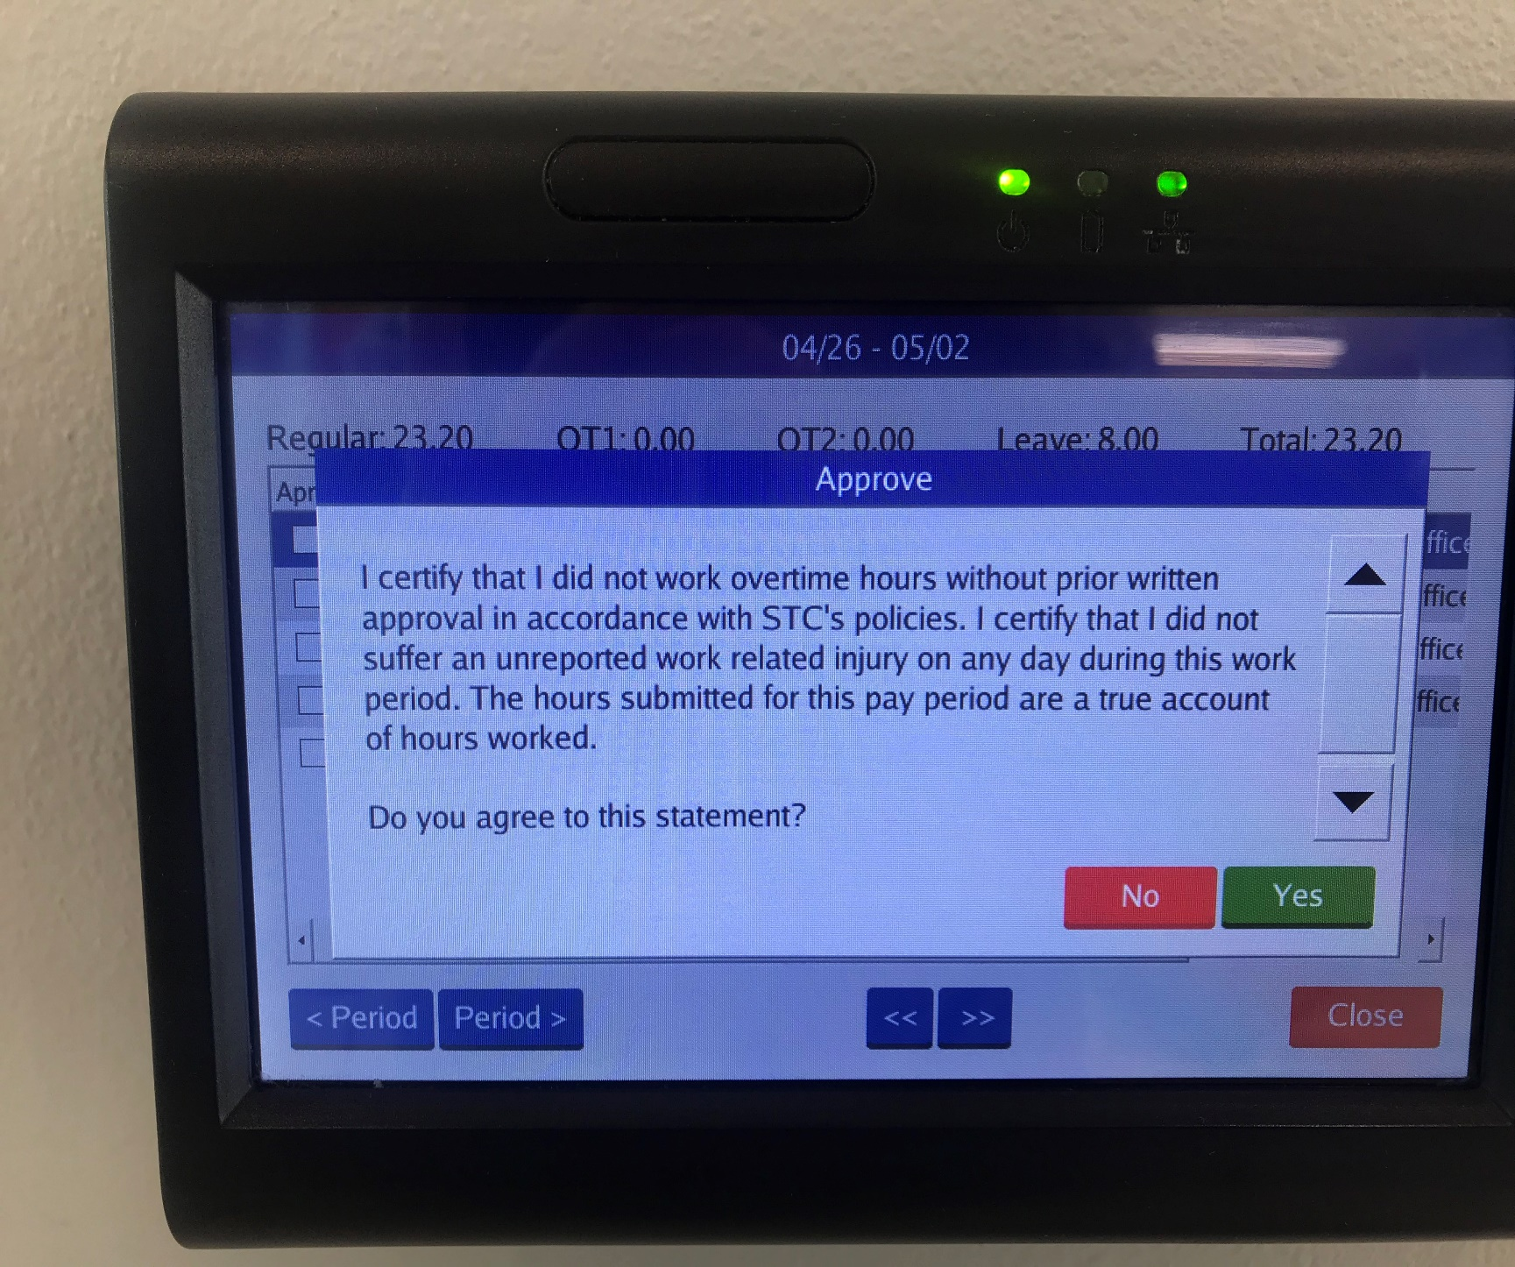
Verifying Time-Certification
Each time you approve your hours, you will receive this notice. It is to certify that you did not work overtime hours without prior written approval and that you did not suffer an unreported work related injury on any day during this work period.
If you agree to this statement, click on Yes.

Slide 19
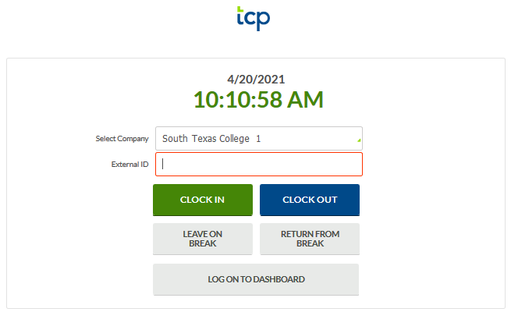
Clock in and Out using Computer
Go to TimeClock Plus link. Login using your computer credentials. Click CLOCK IN or CLOCK OUT.
https://172441.tcplusondemand.com/app/webclock/#/EmployeeLogOn/172441/1

Slide 20
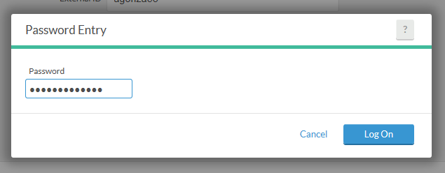
Clock in and Out using Computer
Enter your Password. Same password as computer credentials. Click Log On.

Slide 21
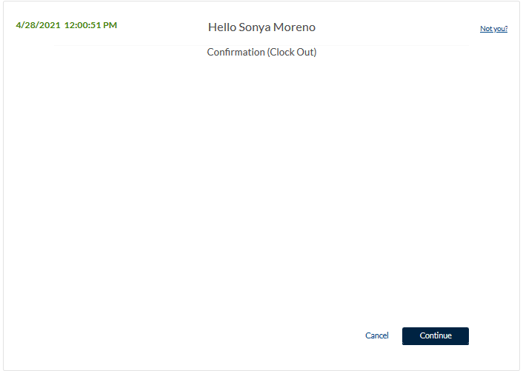
Clock in and Out using Computer
This is confirming that you are clocking in or out.
Click on Continue.

Slide 22
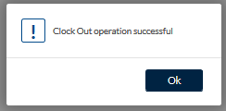
Clock in and Out using Computer
You will see the message indicating that the clock operation was successful.
Click on Ok.

Slide 23
Correcting/Missing punches using Computer
If you get this message, this means you missed a punch and you cannot perform any other actions until it is corrected.
Click Continue.

Slide 24
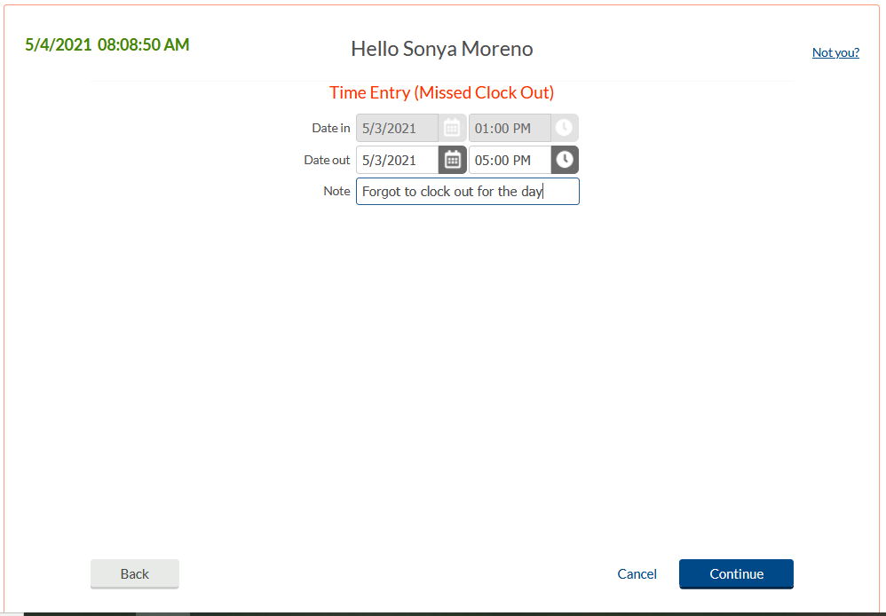
Correcting/Missing punches using Computer
Verify or enter date and time of missed punch. Enter a Note, this is required.

Slide 25
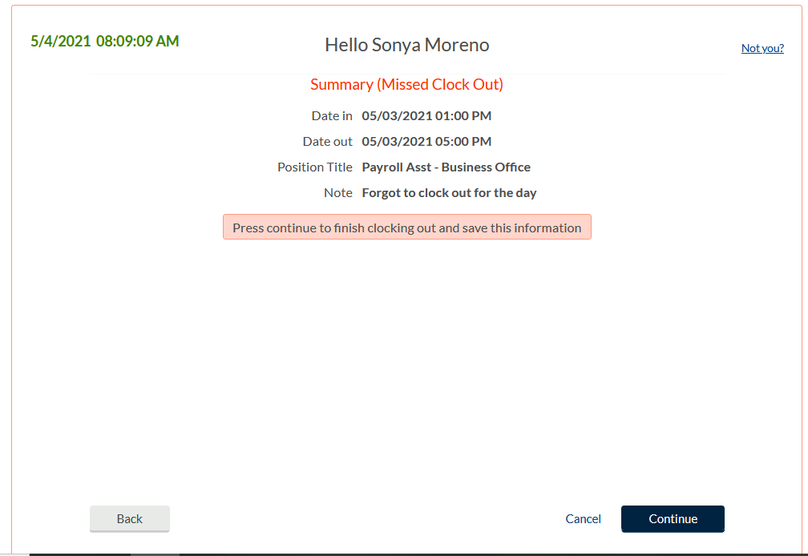
Correcting/Missing punches using Computer
Summary screen.
Verify date, time, and action.
If correct, click Continue.

Slide 26
Correcting/Missing punches using Computer
You should get Clock operation successful message which means you were able to both correct the missing out punch and clock yourself in with this operation.

Slide 27
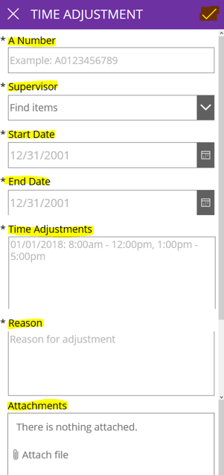
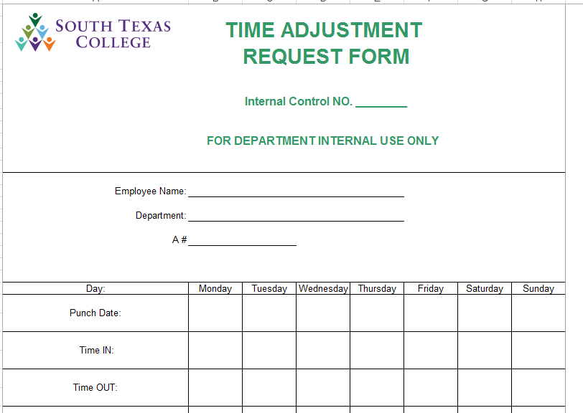
Electronic Time Adjustment Request - PowerApps
This electronic TARF is only to be used when you need to submit hours worked in a full segment, such as when working outside of STC premises or traveling for conferences, etc.
The electronic TARF is the preferred method for submitting time adjustments, unless there is no electricity or internet.
southtexascollege.edu/go/tarf

Slide 28
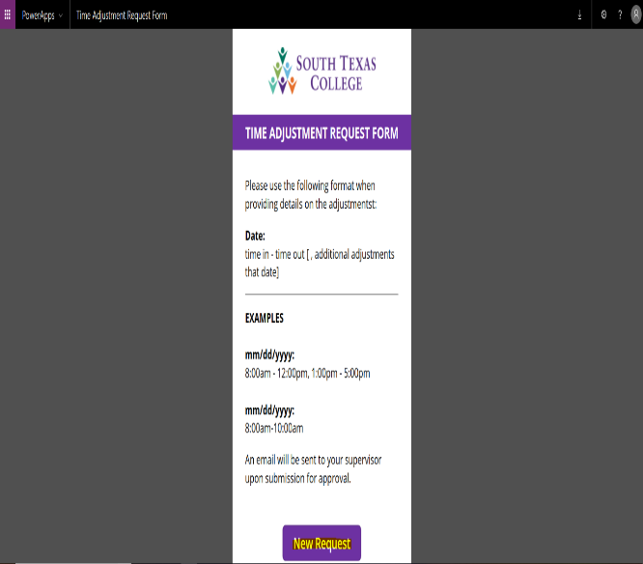
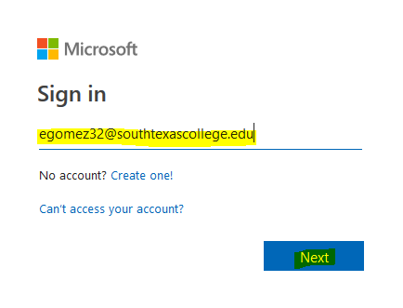
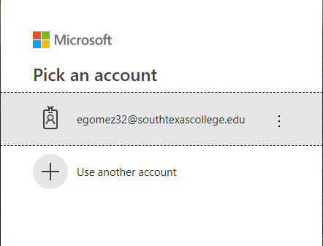
Time Adjustment Request Form
Log In to: www.southtexascollege.edu/go/tarf
Using your same credentials as Jagnet and then click Next or select your account.
When you see the PowerApps Time Adjustment Request Form, click on New Request.
Enter the Required Fields: Enter your A#, Supervisor Name, Start Date (the day or days you need the adjustment for), End Date, Time Adjustment (times you need in your timecard to be fixed or added), Reason (justification of why time adjustment is needed). Attachments are optional but you can use this section to upload any conference schedule that you may have attended. Once information is complete, click submit. Your supervisor will receive an e-mail notification to process your request in TimeClock Plus.

Slide 29
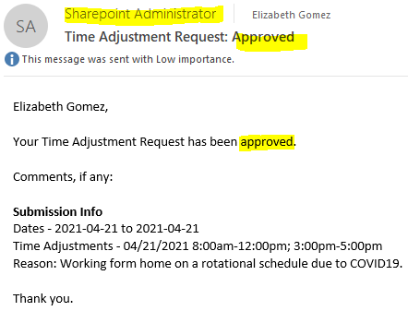
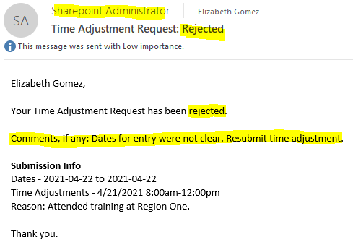
Time Adjustment Request Form
Confirmation Email
You will receive an email confirmation from Sharepoint Administrator notifying you that your time adjustment has been either approved or rejected by your supervisor. Please see below examples of Approved and Rejected.
If your time adjustment request is approved, it is your responsibility to ensure it is posted in TimeClock Plus before verifying your timecard.
If your time adjustment request is rejected, check the comments if provided in the email you received from SharePoint Administrator or inquire with your supervisor the reason why it was rejected. If correction is needed, you will need to submit a new electronic TARF.

Slide 30
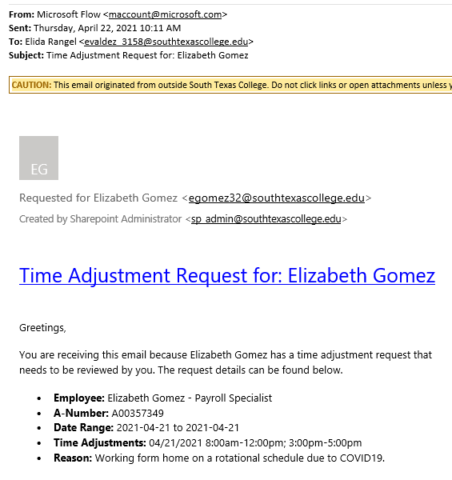
Time Adjustment Request – Adding / Correcting Hours
Supervisor will receive request from the employee via email, the email will be delivered by Microsoft Flow, supervisor will review, and if approved, supervisor will need to enter into TimeClock Plus.
*REMINDER Payroll Record Retention: FE (fiscal year end) + 3 for all employees.

Slide 31
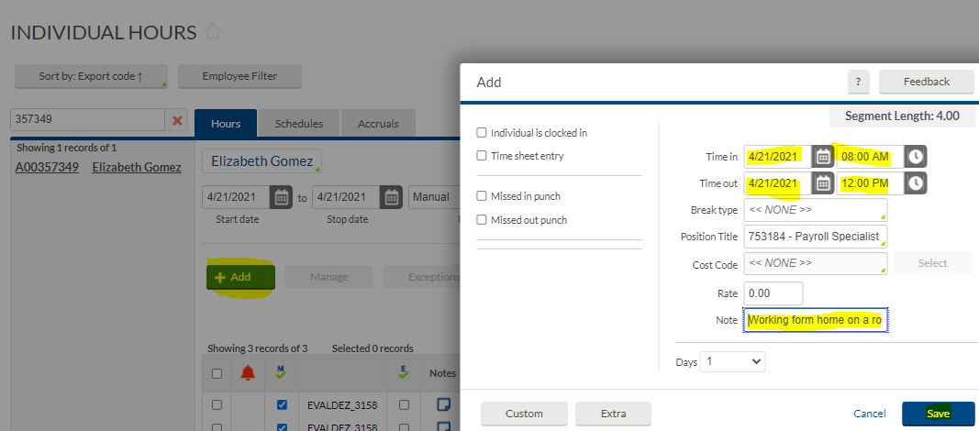
Time Adjustment Request – Adding / Correcting Hours
Go to Hours, Individual Hours, find the employee, click on the segment that needs adding/correcting.
Then click on green +Add button:
The supervisor will enter the working hours of the working hours and include the note provided by the employee.
Then click Save.

Slide 32
Time Adjustment Request – Adding / Correcting Hours
The hours are now showing on the employee’s timecard. The employee will have opportunity to confirm that their supervisor entered the correct hours when they review and verify their hours for that day.
.

Slide 33
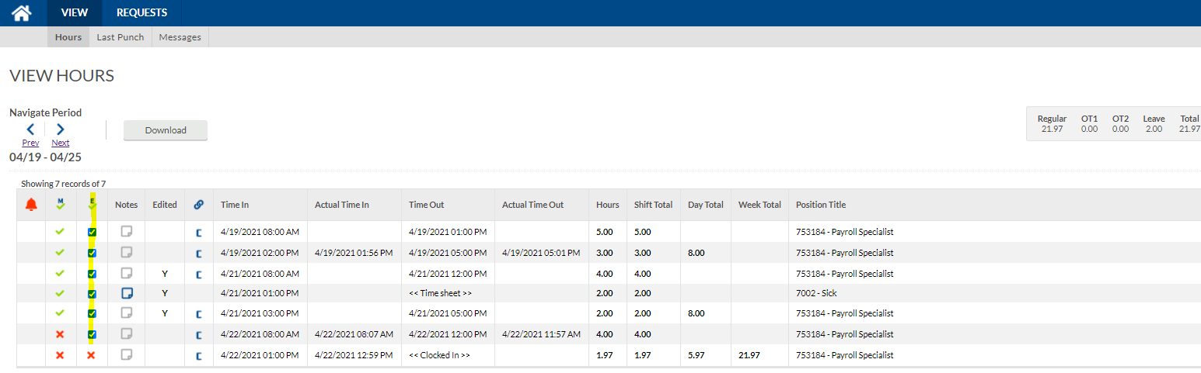
Verifying Time Using Computer - Employee
Employees should review their timecards on a daily basis. After logging in, click on View, then Hours, then choose the dates you want to review and verify. If correct, then click the column under E and checkmark indicating Employee approval.

Slide 34
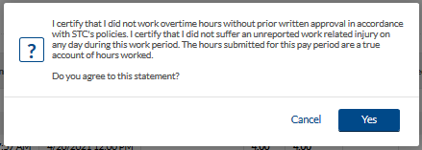
Verifying Time Using Computer – Employee Certification
Every time you approve your hours, you will receive this notice.
If you agree to this statement, click on Yes.

Slide 35
Review & Verify Timecard Daily
Supervisors and non-exempt employees please get in the practice of reviewing and verifying your timecards on a weekly basis for accurate payroll processing.
In TimeClock Plus, we are able to review and verify hours on a daily/weekly basis rather than waiting for the end of the pay period.
This is an advantage toward accurate payroll processing.
If timecard verification was not done before pay period locking; both non-exempt employee and supervisor will need to print and sign off timecard and have it kept within your department for 4 years for non-grant funded employees and 10 years for grant funded employees.

Slide 36
Best Practices
Use the TimeClock for punching in and out.
Use the Computer for reviewing and verifying timecards.
Review and approve your hours on a daily basis.
Become familiar with the software so that it can be utilized to the best capacity.
Of course, same fraud awareness carries over. Do not share passwords, do use the clock in your assigned area, do not abuse working hours, do not overuse the ability to correct/revise punches.
Any reports of suspicious abuse will be investigated.
Visit website https://finance.southtexascollege.edu/businessoffice/timeclock.html
Presentations and Training Videos

Slide 37
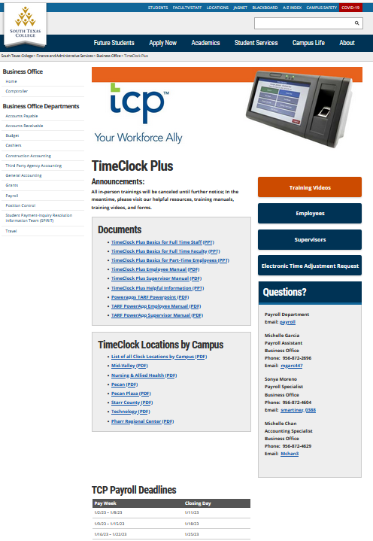

Slide 38
Thank you!
Questions? Please contact
Michelle Garcia, TCP Admin, Payroll Assistant
Email: mgarc447@southtexascollege.edu
or payroll@southtexascollege.edu

