Slide 1
Full Time Employees

Slide 2
Contents
Clocking in and out operations – using the Timeclock
Missed punches – using the Timeclock
Messages – using the Timeclock
Requesting Leave – using the Timeclock
Verifying Time – using the Timeclock
Clocking in and out operations – using the computer (webclock)
Missed punches – using the computer (webclock)
Requesting/approving leave using the computer (webclock)
Exempt Employees Only
Electronic Time Adjustment Request Form (TARF & E-TARF)
Verifying Time – using computer (webclock)
Best Practices

Slide 3
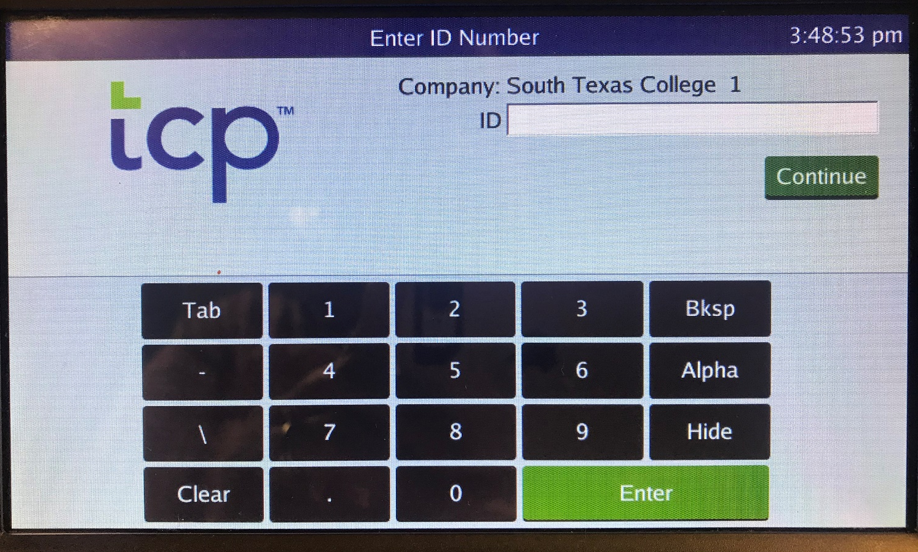
Clocking in and Clocking Out Operations
Using the touchscreen keypad, enter your Employee A#, not including the leading zeros.
Press

Slide 4
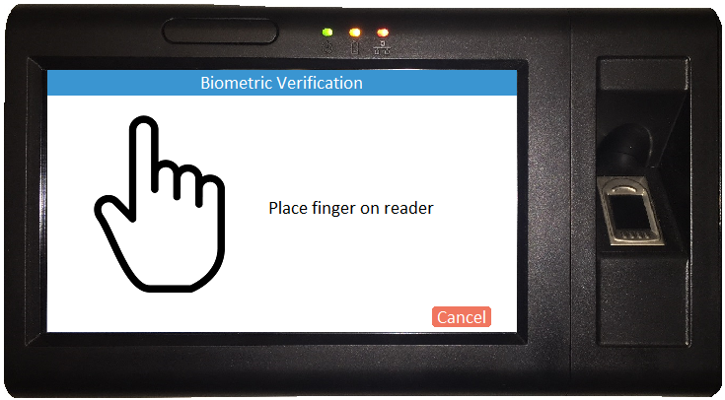
Clocking in and Clocking Out Operations
Place your finger on the fingerprint scanner.

Slide 5
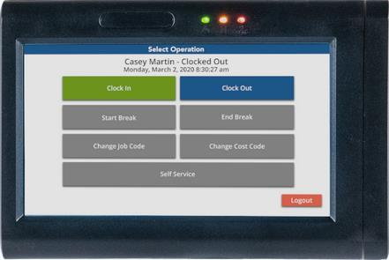
Clocking in and Clocking Out Operations
To Clock In:
Select
To Clock Out:
Select
Only use the Clock In and Clock Out options.
Do not clock out for breaks.
DO NOT USE Logout tab on bottom right corner for Clocking Out.
This will completely log you out of the system.

Slide 6
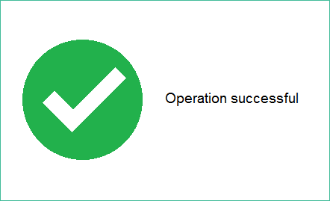
Clocking in and Clocking Out(Biometric Reader)
When you see this screen, you have successfully clocked in/out.

Slide 7
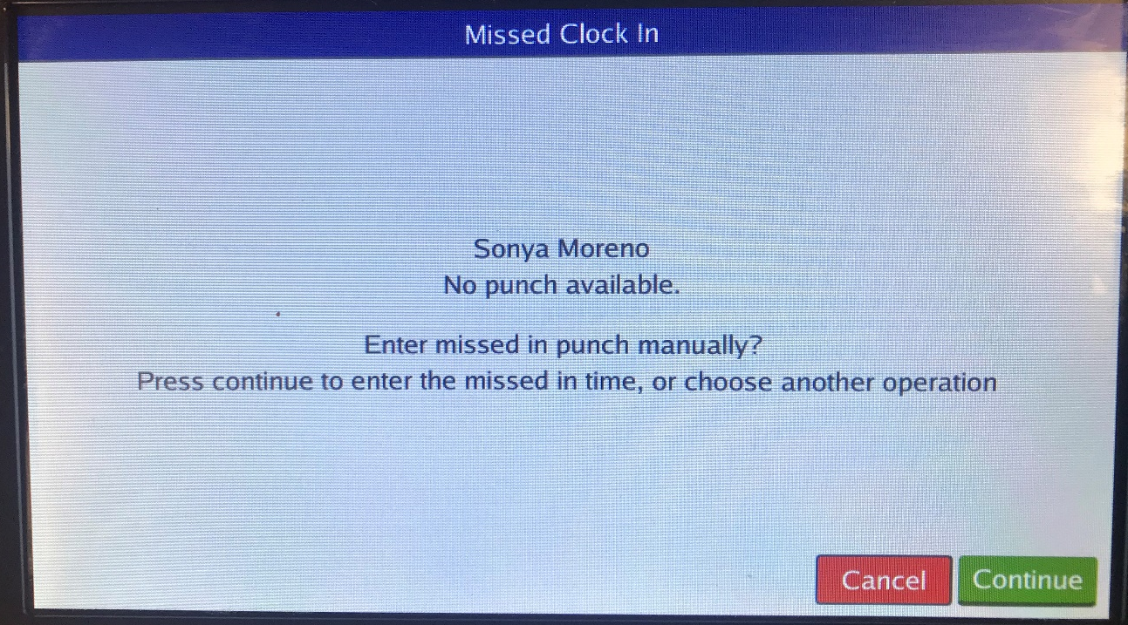
Missed Punch – Enter Record
System is letting you know that there is a missed punch
Press
Notes:
Now what happens if you’re trying to punch in but you didn’t punch out? The system will ask you if you missed a missed a punch and if you want to punch out manually, correct the punch. Press continue.

Slide 8
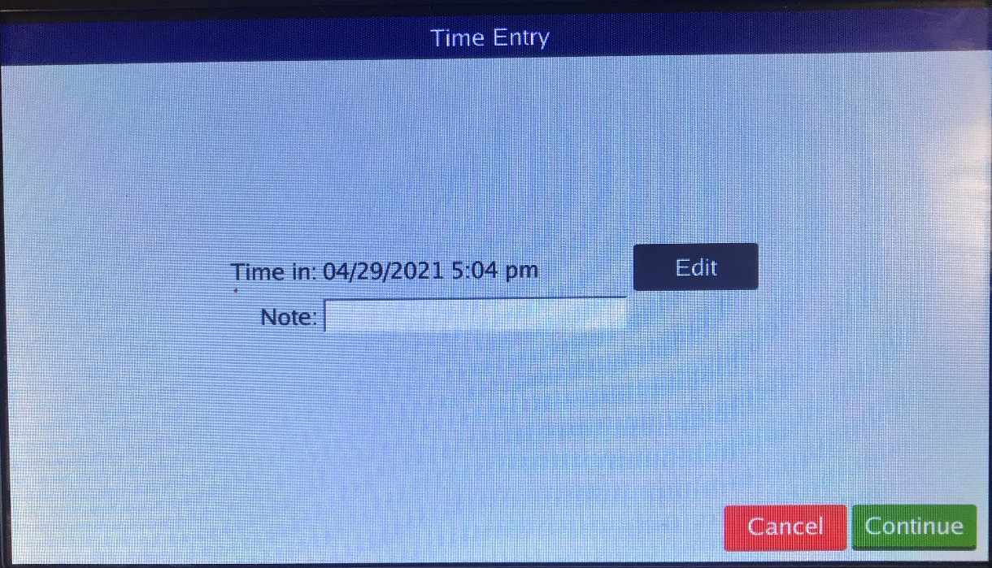
Missed Punch – Enter Record
This screen will allow you to correct the missing punch
Press
Notes:
Now what happens if you’re trying to punch in but you didn’t punch out? The system will ask you if you missed a missed a punch and if you want to punch out manually, correct the punch. Press edit.

Slide 9
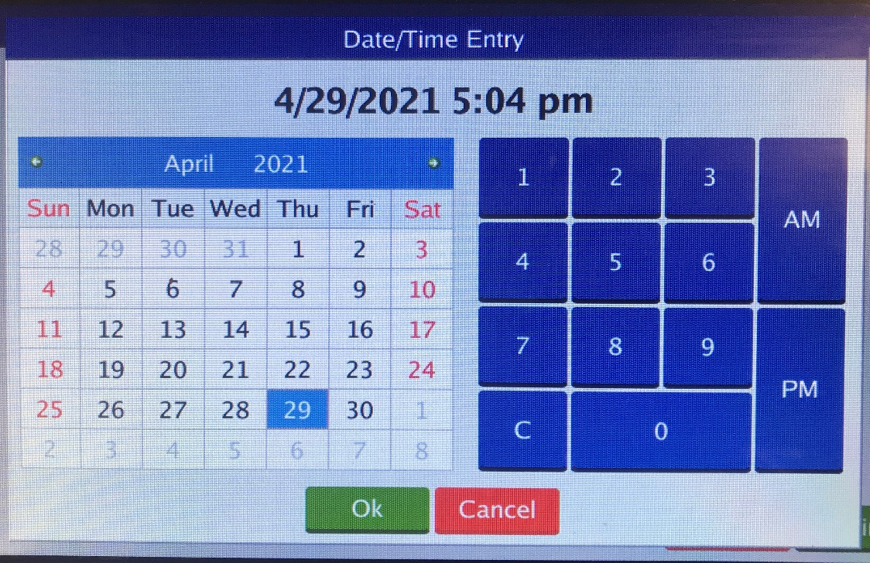
Missed Punch – Enter Record
Enter the correct date and time for your missed punch.
Press

Slide 10
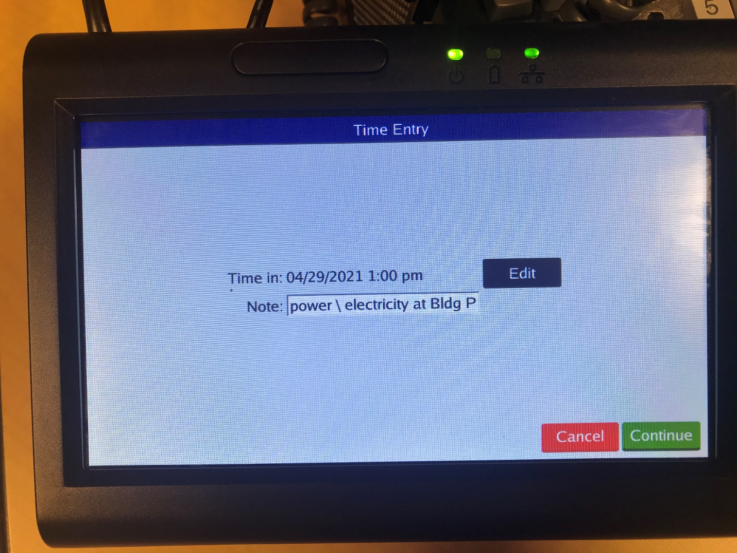
Missed Punch – Enter Record
Enter an explanation of the missed punch.
Click Continue

Slide 11
Missed Punch – Enter Record
The correct IN and OUT punches for the day should be displayed.
Press

Slide 12
Missed Punch-Enter Record
When you see this screen, you have successfully clocked in/out.

Slide 13
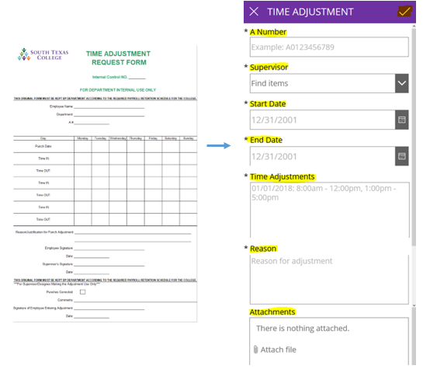
Correct/Revise Punch-Enter Record
If you need to correct a segment or missing clock in or out, you must submit an electronic time adjustment (southtexascollege.edu/go/tarf). If no electricity or internet is available a paper TARF will be accepted.
The electronic TARF is only to be used when you need to submit hours worked in a full segment, such as when working outside of STC premises or traveling for conferences, etc.
Supervisor must make corrections in TCP. These are stand alone applications and do not communicate with each other.

Slide 14
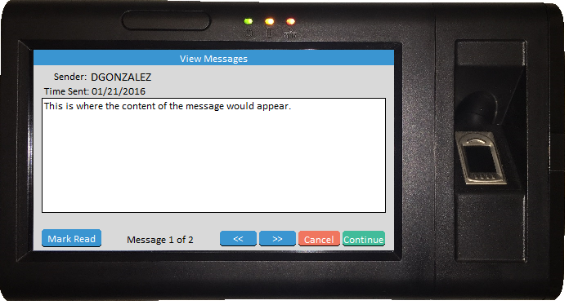
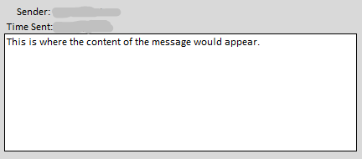
Employee Message
The buttons are used to scroll through the messages but will only appear if there are multiple messages available to view.
The button alerts the sender that you have viewed the message. Upon marking a message as read, it will immediately advance to the next message. The sender may not require the alert in which case the button may not appear.
You must press to finish clocking in or out.
Notes:
Timeclock plus has the ability for supervisors to send messages to their employees. If you receive a message upon logging into the system, read message, click Mark Read, and continue.

Slide 15
Requesting Leave
From the “Select Operation” screen, press
Do not use any function outside of punching in/out/resolving missed punch, on the clock during the hours of:
7:45 – 8:15 am and 4:45-5:15 pm.
This is to avoid delaying others using the clock during these hours designated as peak timeclock use.

Slide 16
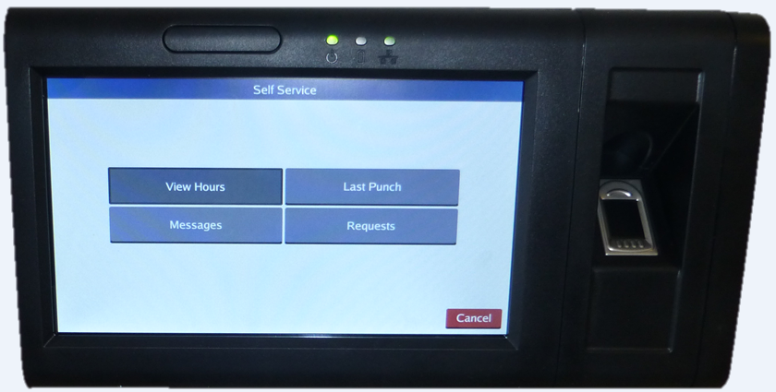
Requesting Leave
Click on Requests.

Slide 17
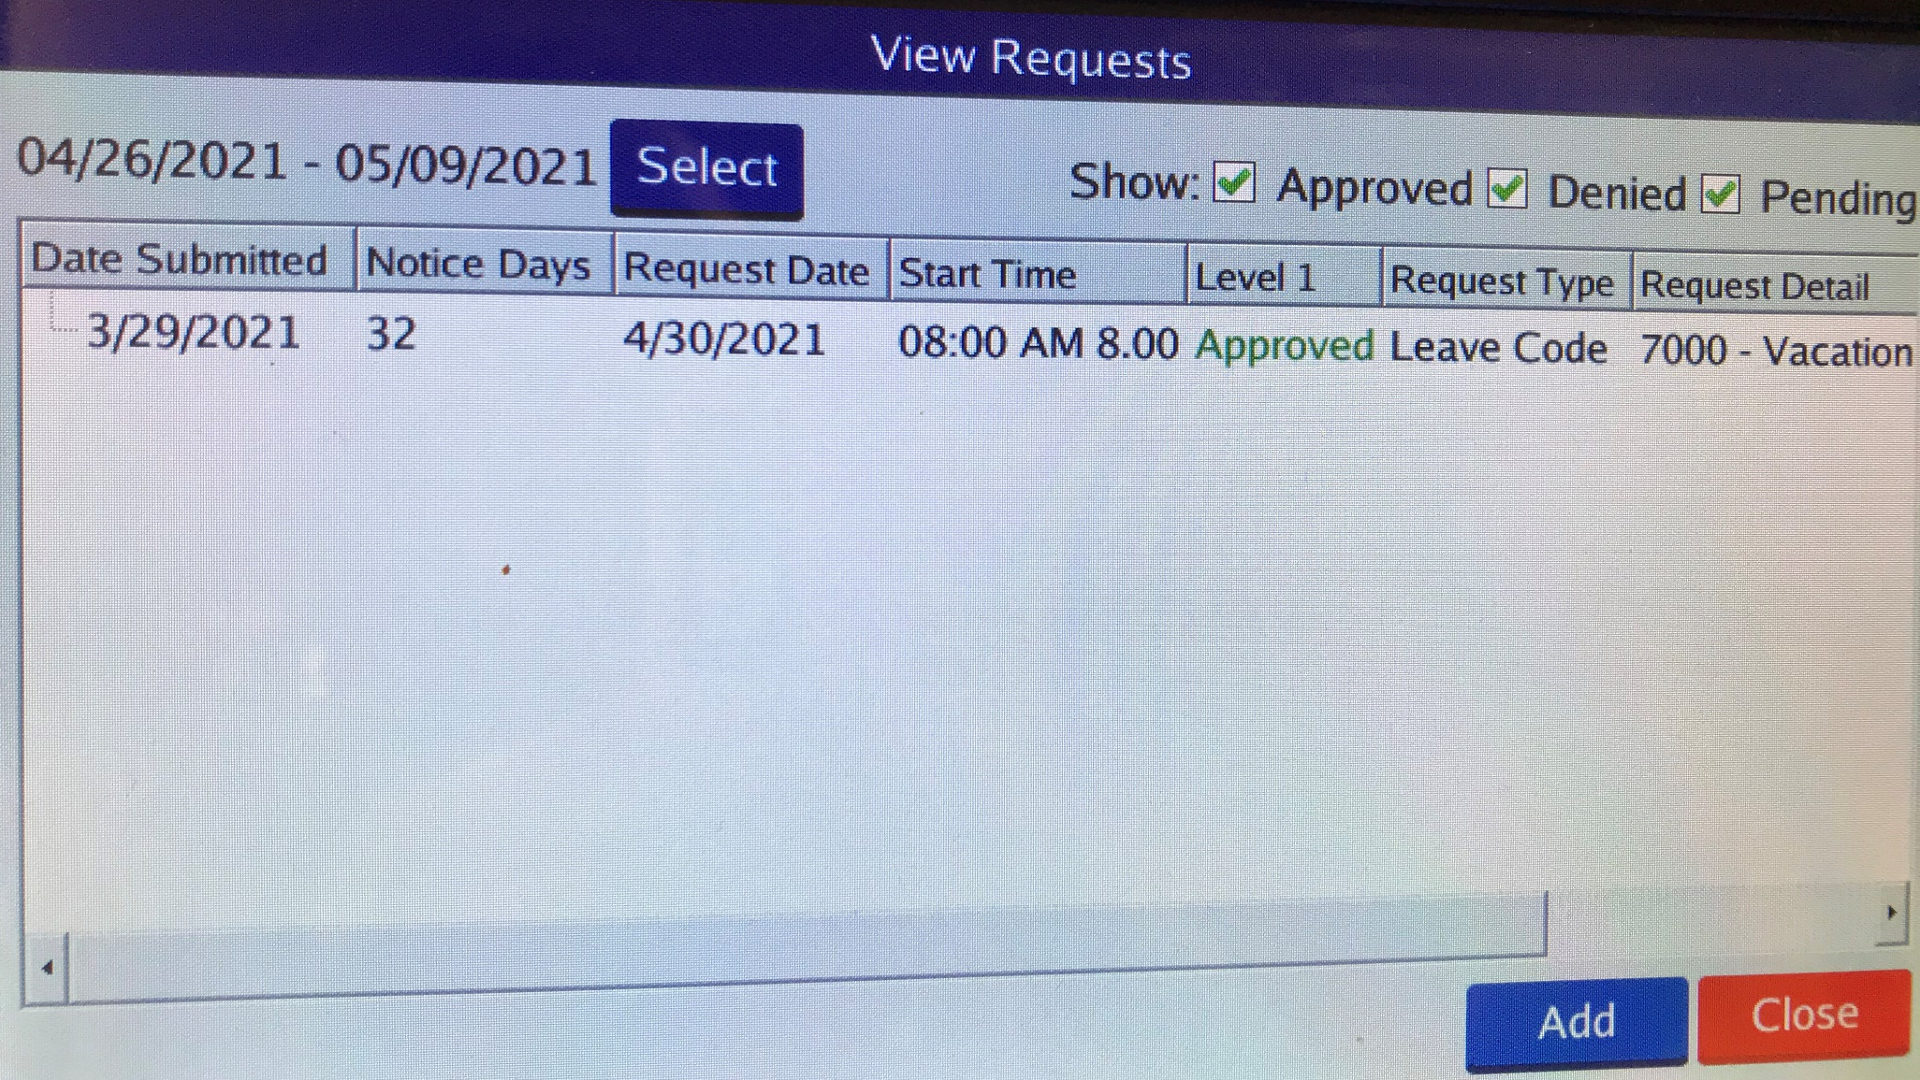
Requesting Leave
Click on Add button.

Slide 18
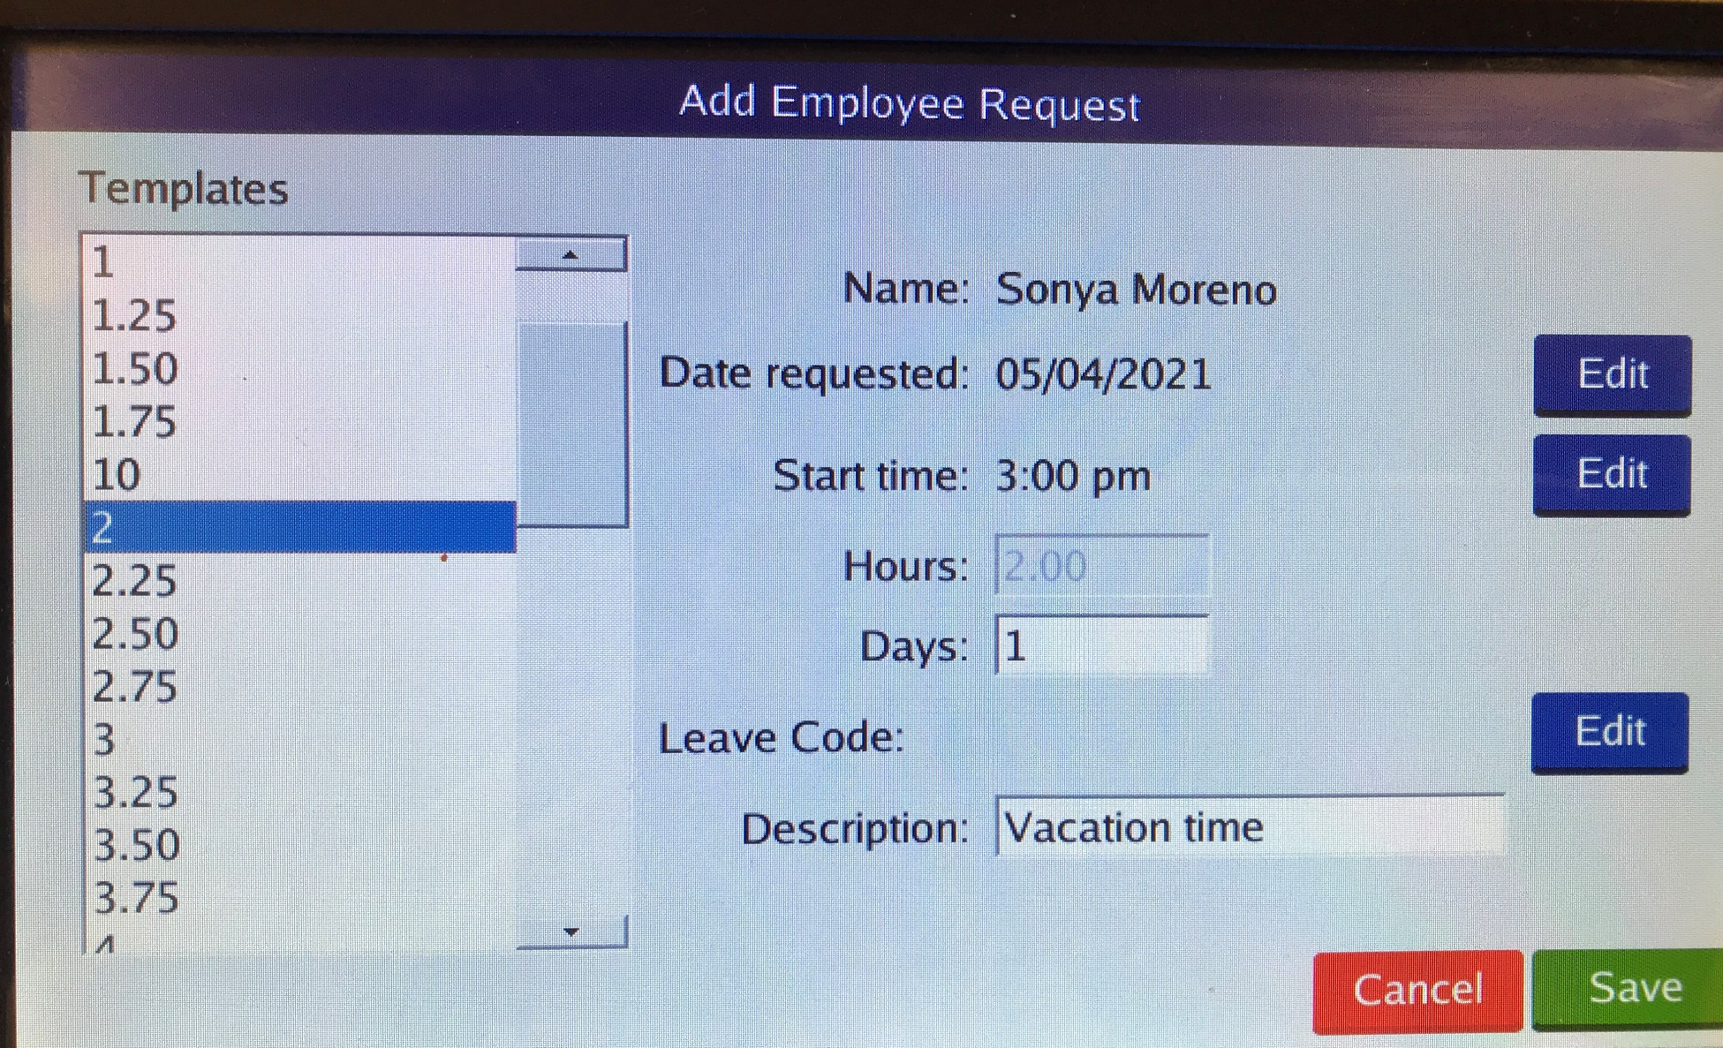
Requesting Leave
Using Edit button, enter date for leave requested, start time, and number of hours, or days.
Enter brief description, ex. Vacation day.
Then for Leave code line, click on blue Edit button.

Slide 19
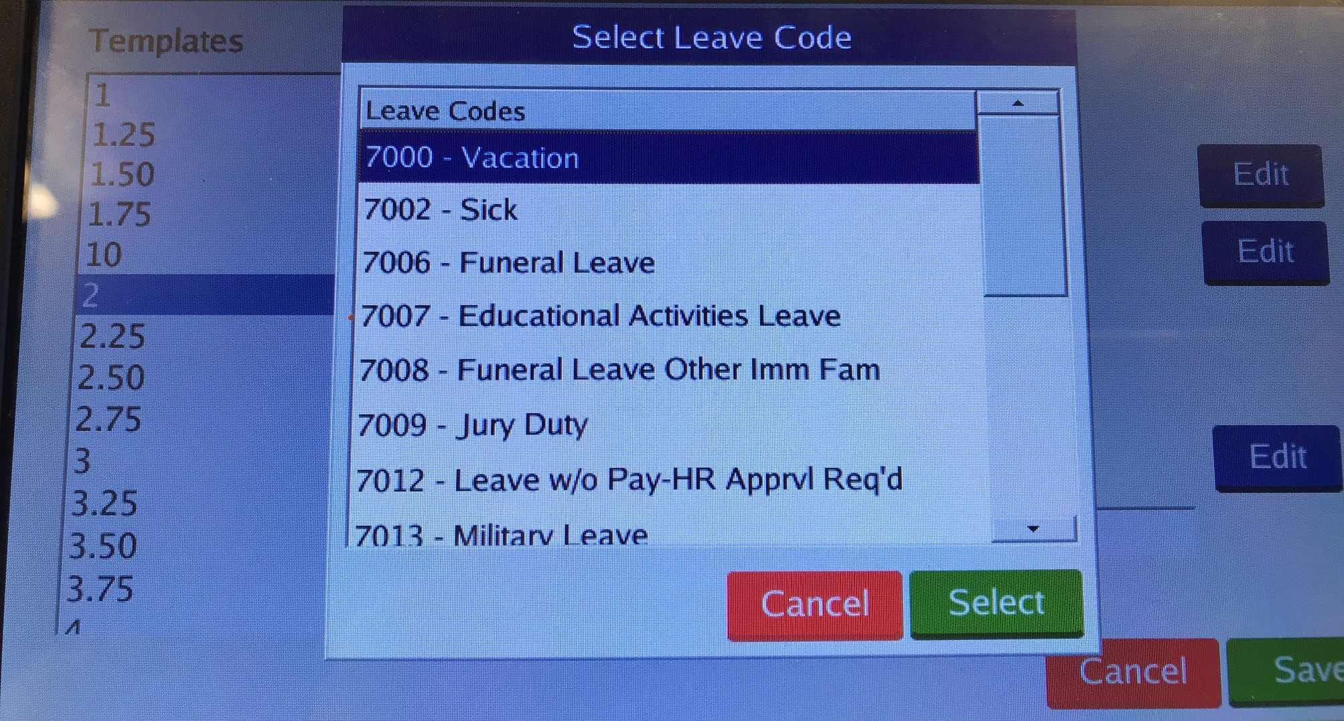
Requesting Leave
Choose the Leave you are requesting. Be sure to choose the correct one, as you are responsible for your leave requests.
Then click Select.
Then click save on next screen, Employee Request screen.

Slide 20
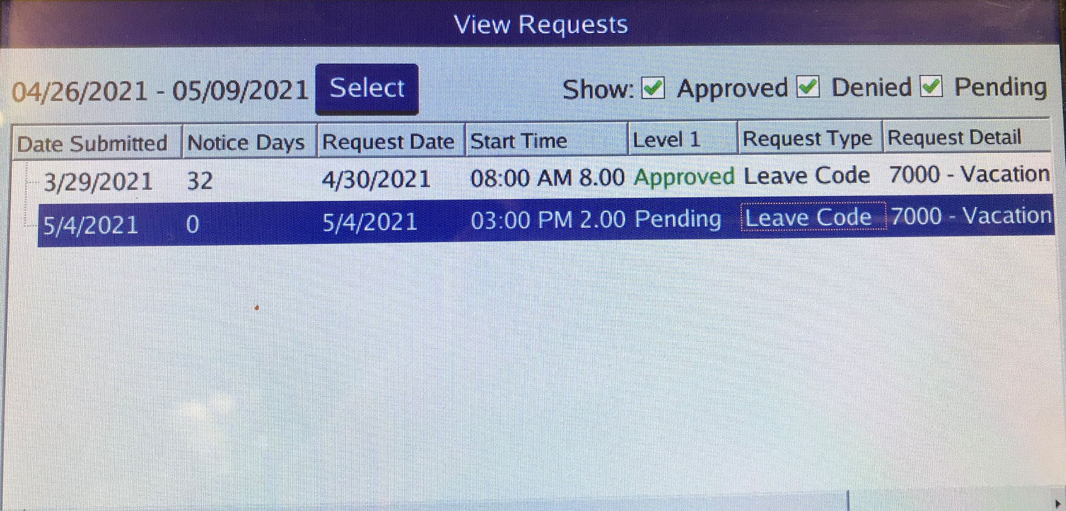
Requesting Leave
You should receive this message indicating this request has been submitted to your supervisor for review and approval.
In the View Requests screen you the request has been populated and will show as Pending until Supervisor approves.

Slide 21
Verifying Time
Log into the clock. This will take you to the “Select Operation” screen.
From the “Select Operation” screen, press

Slide 22
Verifying Time
On the “Self Service” screen, press Hours

Slide 23
Verifying Time
Examine the time information.
If everything is correct, press the Checkbox in the Aprv column next to the segment. Once you have verified your time click

Slide 24
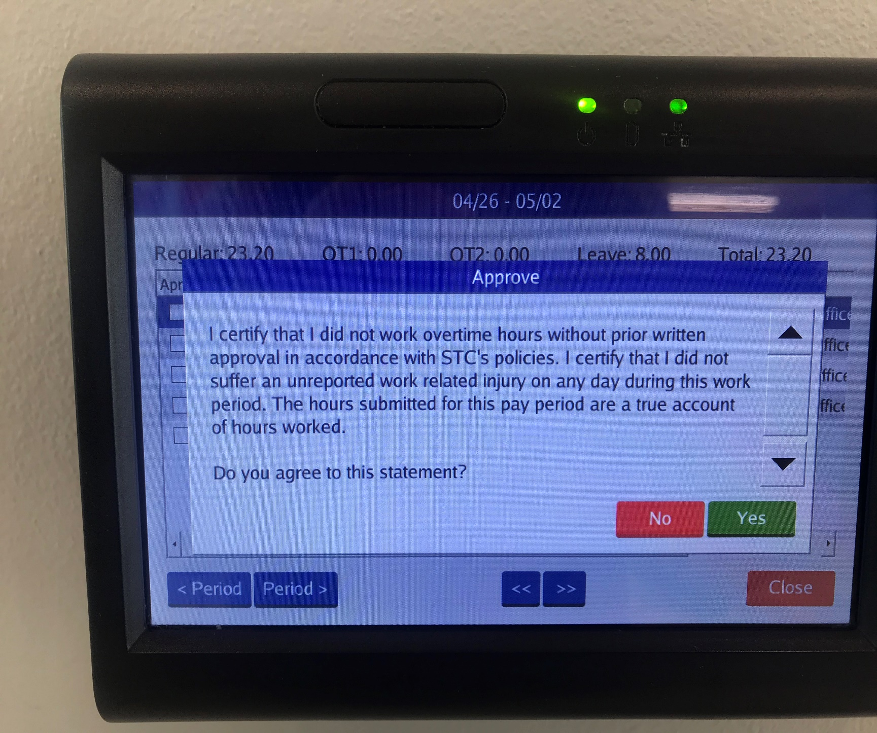
Verifying Time-Certification
Each time you approve your hours, you will receive this notice. It is to certify that you did not work overtime hours without prior written approval and that you did not suffer an unreported work related injury on any day during this work period.
If you agree to this statement, click on Yes.

Slide 25
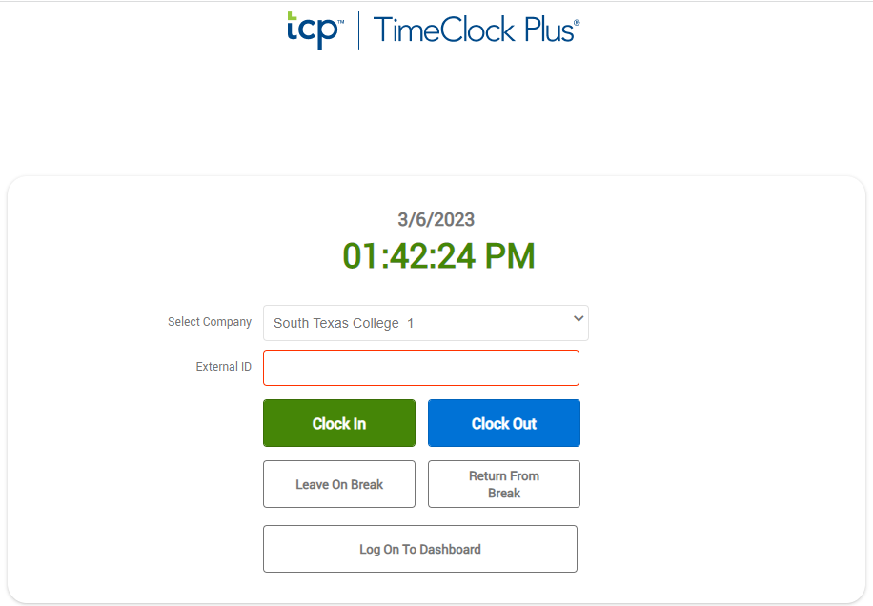
Clock in and Out using Computer
Go to TimeClock Plus link. Login using your computer credentials. Click CLOCK IN or CLOCK OUT.
https://172441.tcplusondemand.com/app/webclock/#/EmployeeLogOn/172441/1

Slide 26
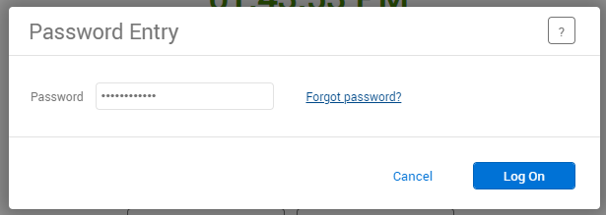
Clock in and Out using Computer
Enter your Password. Same password as computer credentials. Click Log On.

Slide 27
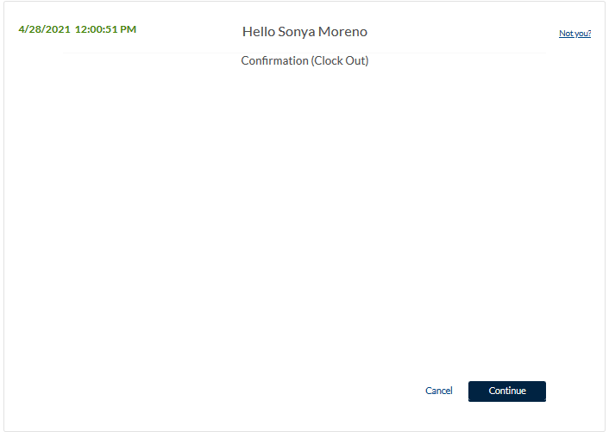
Clock in and Out using Computer
This is confirming that you are clocking in or out.
Click on Continue.

Slide 28
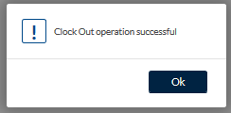
Clock in and Out using Computer
You will see the message indicating that the clock operation was successful.
Click on Ok.

Slide 29
Correcting/Missing punches using Computer
If you get this message, this means you missed a punch and you cannot perform any other actions until it is corrected.
Click Continue.

Slide 30
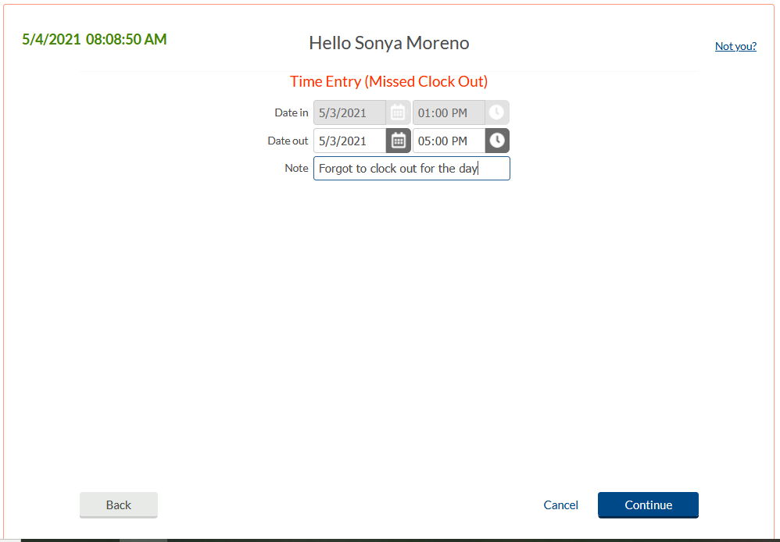
Correcting/Missing punches using Computer
Verify or enter date and time of missed punch. Enter a Note, this is required.

Slide 31
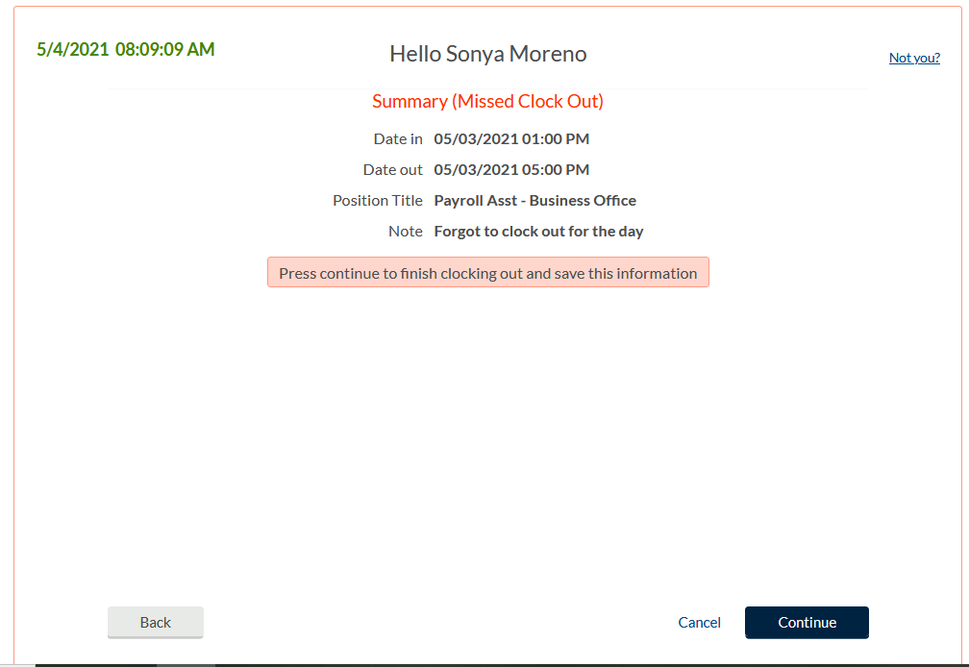
Correcting/Missing punches using Computer
Summary screen.
Verify date, time, and action.
If correct, click Continue.

Slide 32
Correcting/Missing punches using Computer
You should get Clock operation successful message which means you were able to both correct the missing out punch and clock yourself in with this operation.

Slide 33
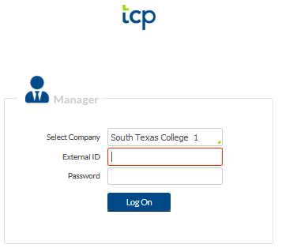
Correcting/Missing punches using Computer Supervisor Role
Supervisor will need to log in and view leave requests pending approval.
Supervisors use a different log in than employees use, for viewing employee information.
Supervisors will log in using same credentials as computer credentials.
https://172441.tcplusondemand.com/app/manager/#/ManagerLogOn/172441

Slide 34
Correcting/Missing punches using Computer Supervisor Role
Upon supervisor log in, you will be directed to “My Dashboard”.
Under MISSED PUNCHES, supervisor will see all revised/missing punches that require review and approval.
Click on Jump to Group Hours.

Slide 35
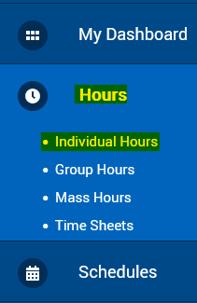
Correcting/Missing punches using Computer Supervisor Role
Click on the Exception Filter
Notes:
Different ways to maneuver around this screen, for this example, we will use the Exception Filter to isolate

Slide 36
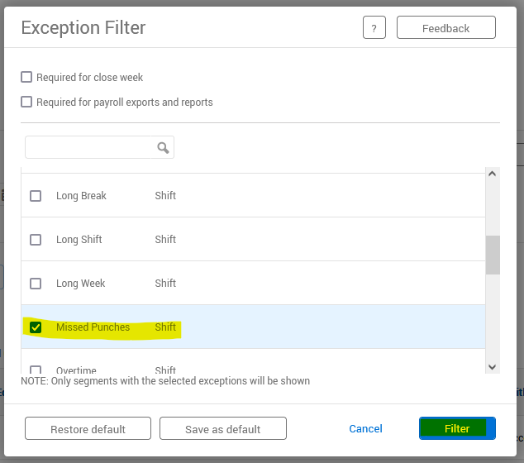
Correcting/Missing punches using Computer Supervisor Role
There are many Exceptions for filtering.
For this example, we are isolating Missed Punches.
Click Filter.

Slide 37
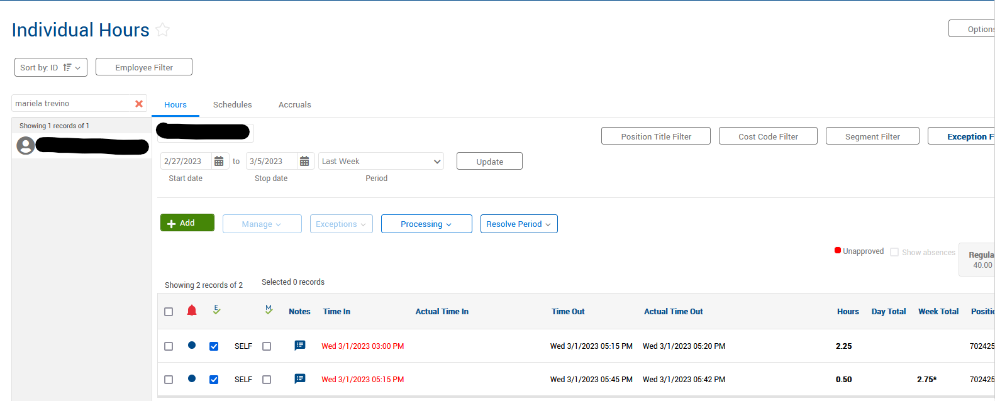
Correcting/Missing punches using Computer Supervisor Role
The punch that was just added by employee is showing.

Slide 38
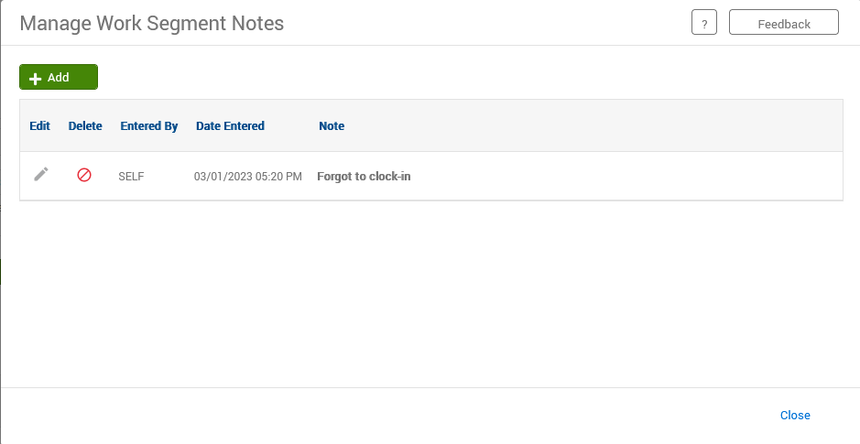
Correcting/Missing punches using Computer Supervisor Role
Click on Notes for more detail on this occurrence.

Slide 39
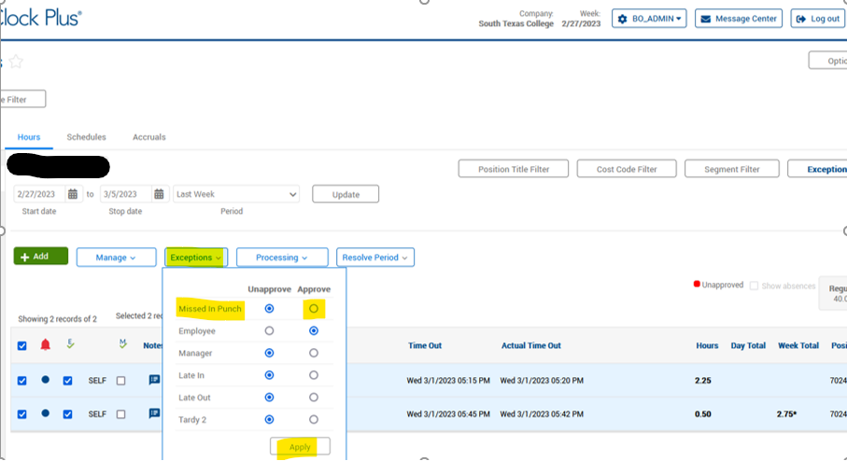
Correcting/Missing punches using Computer Supervisor Role
If approved, click on the left box to isolate that activity. Click on Exceptions, click under Approve column for Missed Punches.
Then click Apply.
If not approved, review with employee and have employee correct the information in the system for approval.

Slide 40
Correcting/Missing punches using Computer Supervisor Role
When supervisor returns to Home Page, the Missed Punches have been resolved. Nothing pending for review and approval.

Slide 41
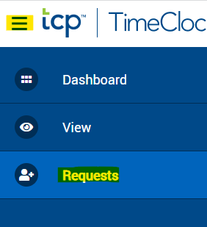
Request Leave using Computer-Employee
Click on Requests, calendar will appear. You can either double click the day you want to request leave for or click on green +Add.

Slide 42
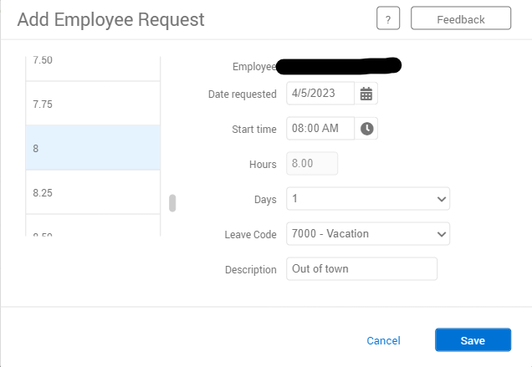
Request Leave using Computer-Employee
Enter date of requested leave, start time (typically 8 am if full day), number of hours for leave, (typically 8 if full day), number of days, then choose a leave code from drop down. Enter a brief description.
Be sure to choose the correct leave code, as you are responsible for your leave requests.

Slide 43
Request Future Leave-Employee
Example: In month of February, an employee wants to request Vacation Leave for June. However, they haven’t accrued enough leave as of February to request the amount of vacation they want to take in June. Since TCP is linked to Banner, employees are unable to request leave based on future leave earnings.
The employee will notify the supervisor that they are requesting leave in June, the supervisor will input into TCP and have those days locked for them as vacation.

Slide 44
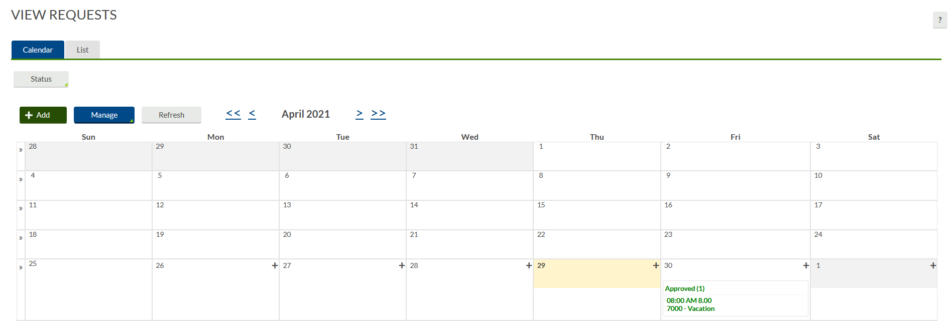
Exempt Employees ONLY
If you are an EXEMPT employee and if you are out of the office for a PARTIAL DAY- (Less than 8 hours)
Report the absence using the Exempt-Paid Leave code
Select the REQUEST Tab

Slide 45
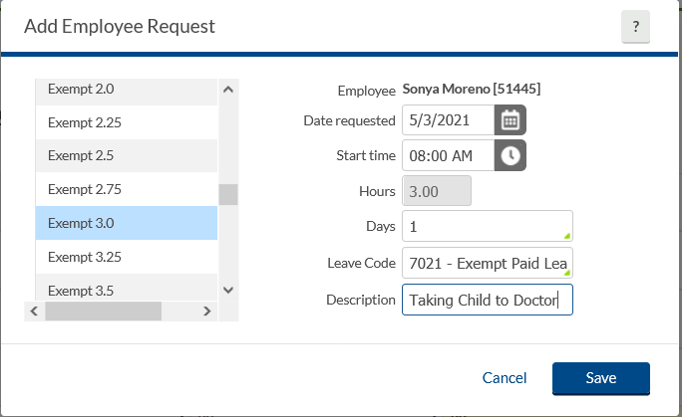
Exempt Employees ONLY
Click on the day you want to request partial leave, enter the start time and the number of hours and use the leave code: EXEMPT-Paid Leave and enter a brief description and save.
**Keep in mind this will not be reduced from your leave, this is just for reporting purposes.**

Slide 46
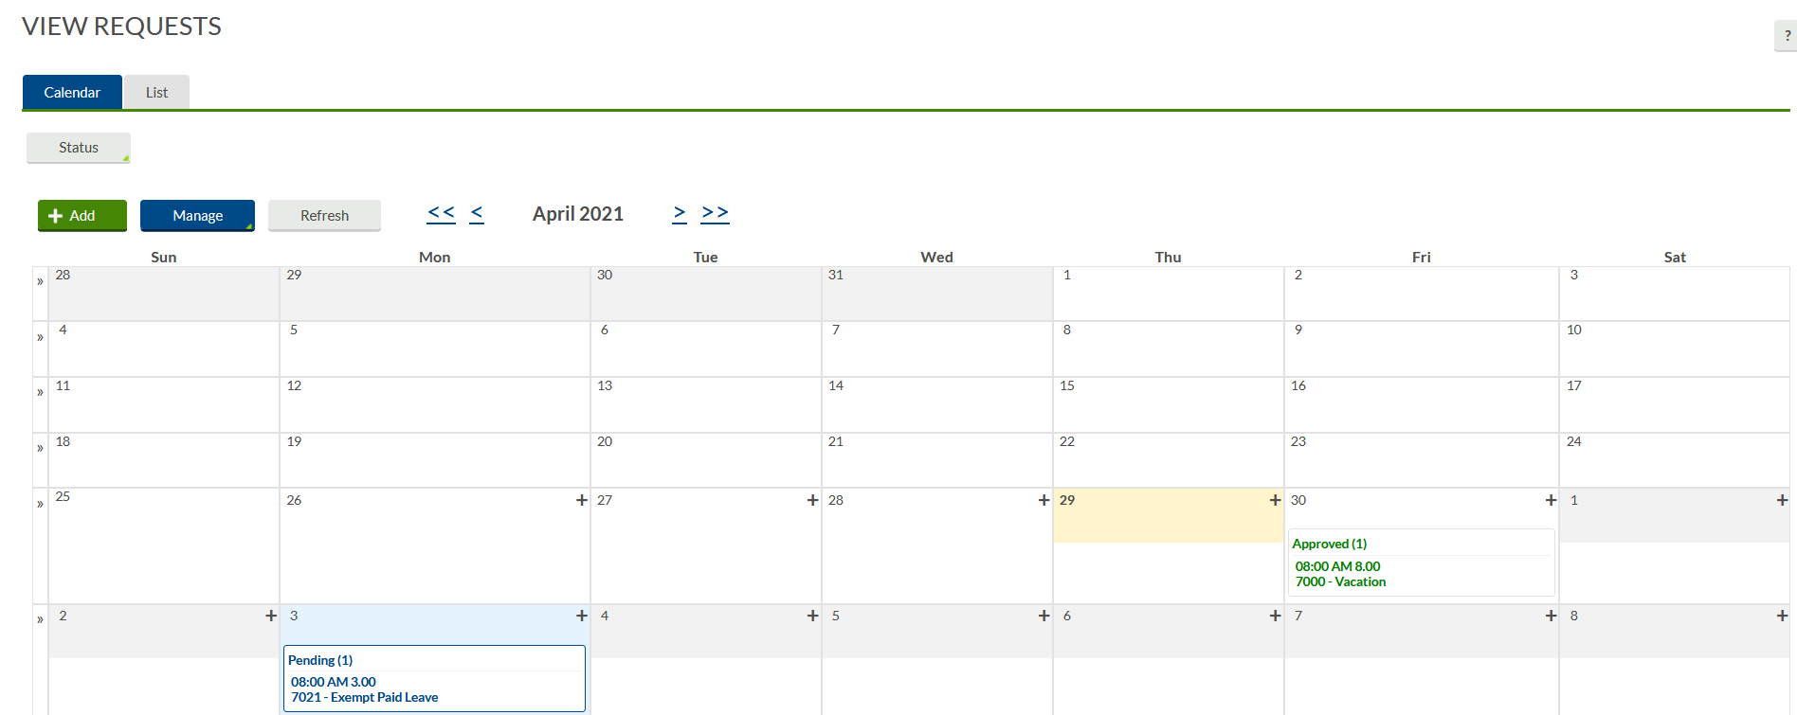
Exempt Employees ONLY
Your absence request is now reflecting in your timecard and will be forwarded to your supervisor for approval.

Slide 47
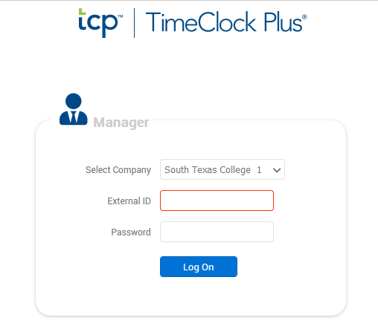
Request Leave using Computer
Supervisor Role
Supervisor will log in and view leave requests pending approval.
**Remember to log into the supervisor link to review your employees requests.**

Slide 48
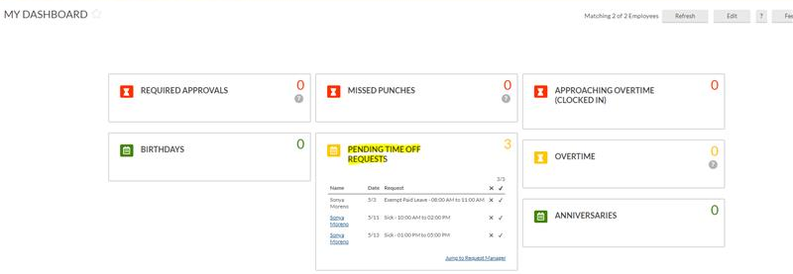
Request Leave using Computer-Supervisor Role
When supervisors log in, they will arrive at “My Dashboard”.
Under Pending Time Off Requests, they will see all pending requests. Then they will go to Request Manager.

Slide 49
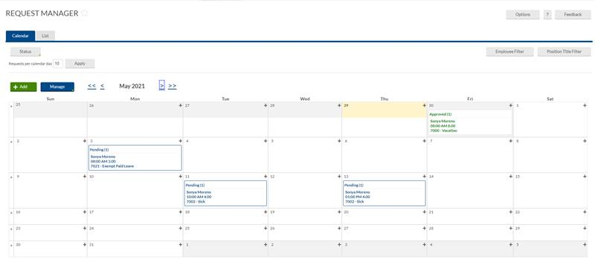
Request Leave using Computer-Supervisor Role

Slide 50
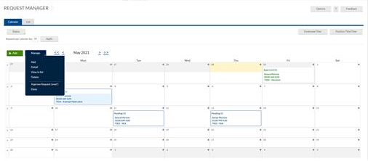
Request Leave using Computer
If leave request is approved, click on blue Manage button. Then click on Approve Request.

Slide 51
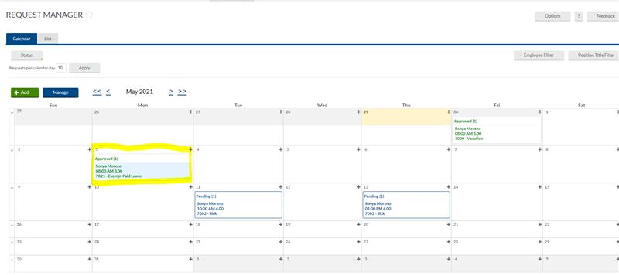
Request Leave using Computer
Once approved, the status will change from Pending to Approved.

Slide 52
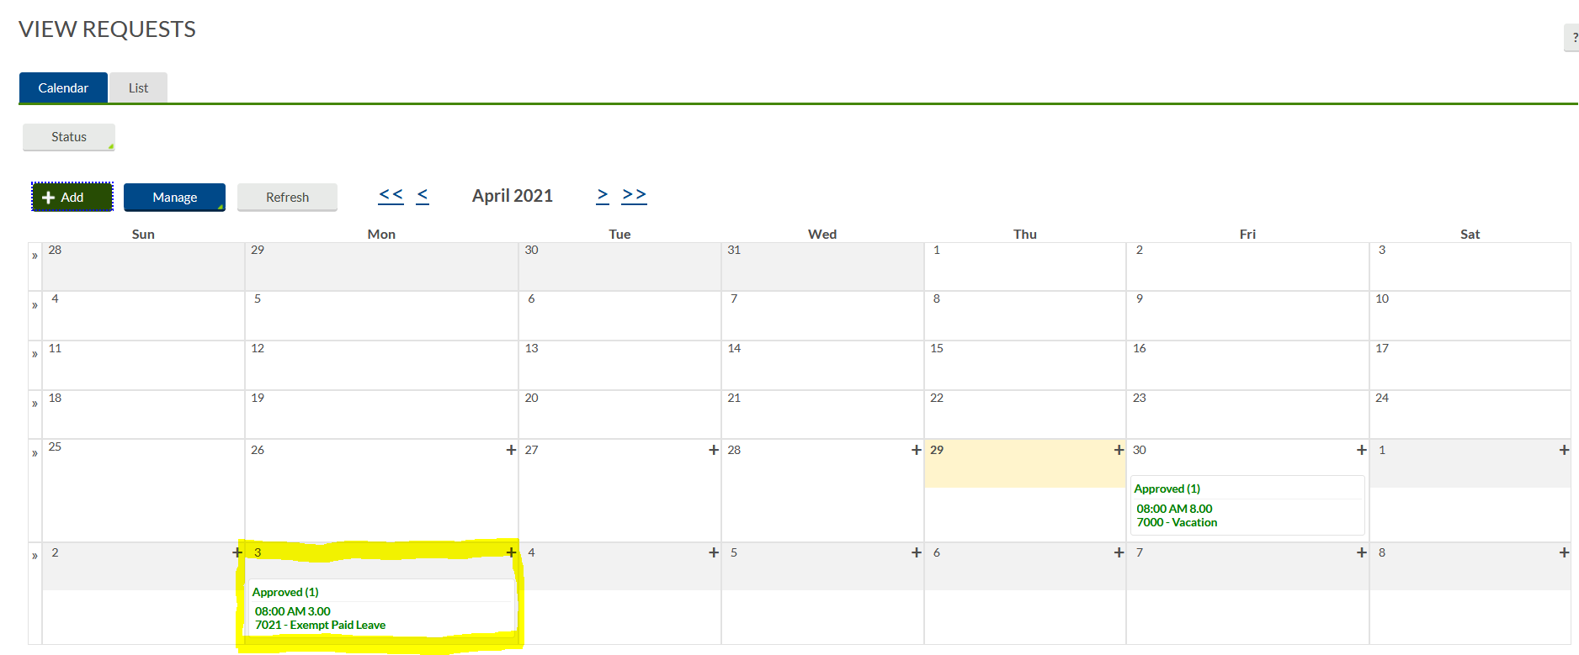
Request Leave using Computer
Now when the employee logs in and views requests, they will see that the request has been updated from Pending to Approved.

Slide 53
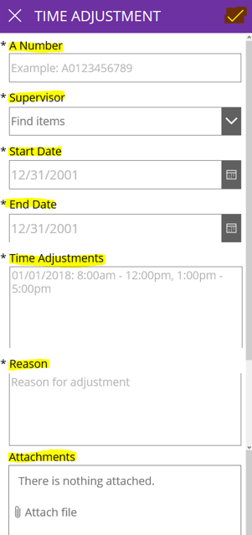
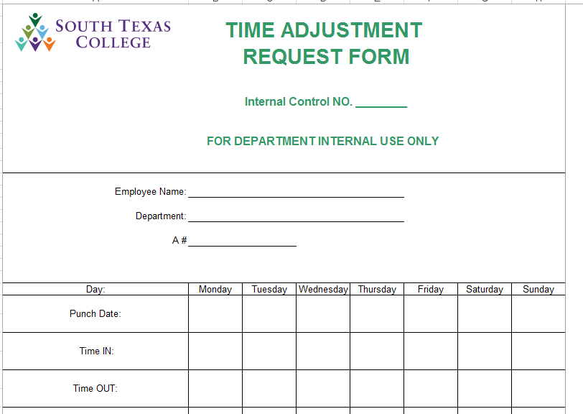
Electronic Time Adjustment Request - PowerApps
The electronic TARF is only to be used when you need to submit hours worked in a full segment, such as when working outside of STC premises or traveling for conferences, etc.
The electronic TARF is the preferred method for submitting time adjustments, unless there is no electricity or internet.
southtexascollege.edu/go/tarf

Slide 54
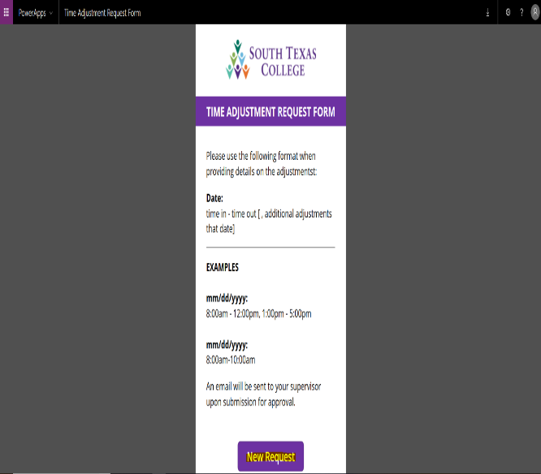
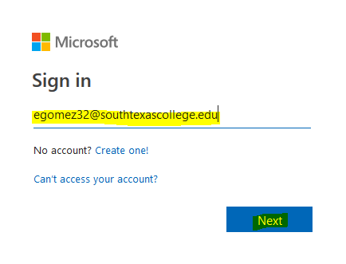
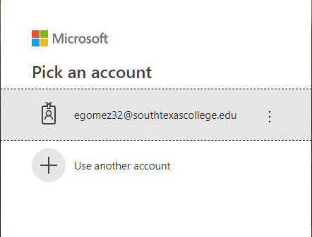
Time Adjustment Request Form
Log In to: www.southtexascollege.edu/go/tarf
Using your same credentials as Jagnet and then click Next or select your account.
When you see the PowerApps Time Adjustment Request Form, click on New Request.
Enter the Required Fields: Enter your A#, Supervisor Name, Start Date (the day or days you need the adjustment for), End Date, Time Adjustment (The time you need in your timecard to be fixed or added), Reason (justification of why time adjustment is needed). Attachments are optional but you can use this section to upload any conference schedule that you may have attended. Once information is complete, click submit. Your supervisor will receive an e-mail notification to process your request in TimeClock Plus.

Slide 55
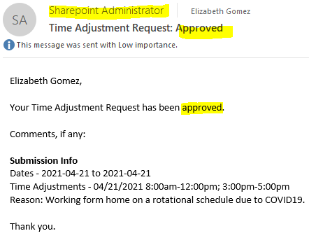
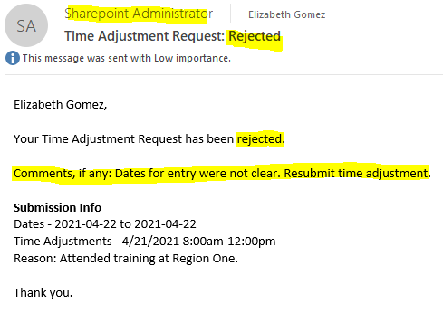
Time Adjustment Request Form
Confirmation Email
You will receive an email confirmation from Sharepoint Administrator notifying you that your time adjustment has been either approved or rejected by your supervisor. Please see below examples of Approved and Rejected.
If your time adjustment request is approved, it is your responsibility to ensure it is posted in TimeClock Plus before verifying your timecard.
If your time adjustment request is rejected, check the comments if provided in the email you received from SharePoint Administrator or inquire with your supervisor the reason why it was rejected. If correction is needed, you will need to submit a new electronic TARF.

Slide 56
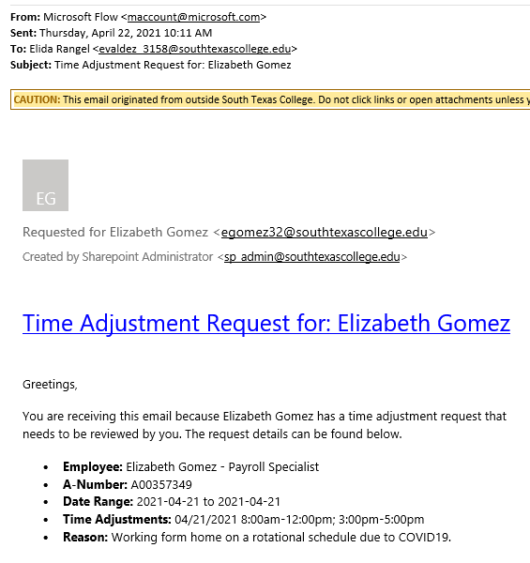
Time Adjustment Request – Adding / Correcting Hours
Supervisor will receive request from the employee via email, the email will be delivered by Microsoft Flow, supervisor will review, and if approved, supervisor will need to enter into TimeClock Plus.
*REMINDER Payroll Record Retention: FE (fiscal year end) + 3 years for all employees.

Slide 57
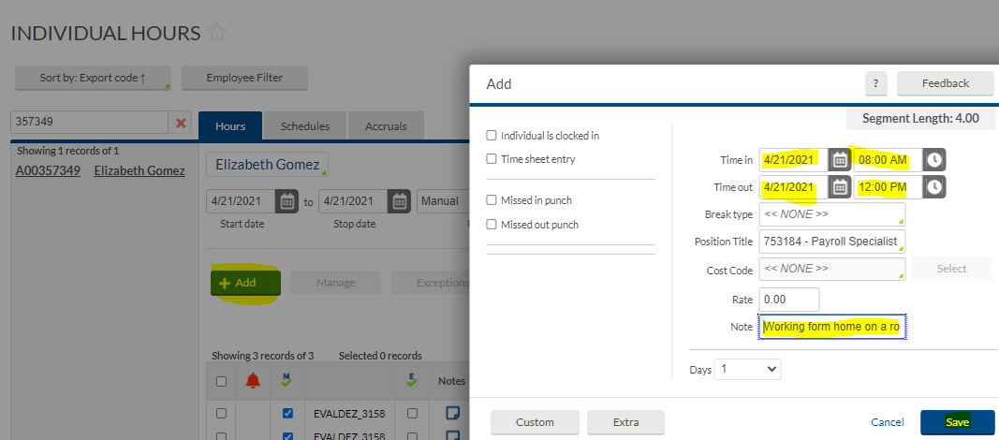
Time Adjustment Request – Adding / Correcting Hours
Go to Hours, Individual Hours, find the employee, click on the segment that needs adding/correcting.
Then click on green +Add button:
The supervisor will enter the working hours of the working hours and include the note provided by the employee.
Then click Save.

Slide 58
Time Adjustment Request – Adding / Correcting Hours
The hours are now showing on the employee’s timecard. The employee will have opportunity to confirm that their supervisor entered the correct hours when they review and verify their hours for that day.
.

Slide 59
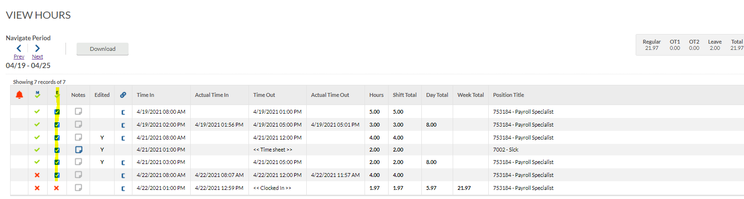
Verifying Time Using Computer - Employee
Employees should review their timecards on a daily basis. After logging in, click on View, then Hours, then choose the dates you want to review and verify. If correct, then click the column under E and checkmark indicating Employee approval.

Slide 60
Verifying Time Using Computer - Employee
When verifying your timecard please be aware that there are no shifts that are conflicting.
Conflicting shift is when a segment shares time with another segment and it will display in orange. Please see example below.
If the pay period has not been locked your supervisor can go ahead and edit the segment with the correct time using reasonable justification (email) from the employee.
If the pay period is locked you will need to submit an Leave Adjustment Request Form (LARF) to fix the leave to the correct time. Original form will need to be submitted to the office of Human Resources-Benefits Specialist.

Slide 61
Verifying Time Using Computer – Employee Certification
Every time you approve your hours, you will receive this notice.
If you agree to this statement, click on Yes.

Slide 62
Verifying Time Using Computer - Supervisor
When your supervisor logs into the system, to review and Verify hours click on Hours, Individual Hours.

Slide 63
Verifying Time Using Computer - Supervisor
There are different ways for this function.
In this example, click on Manage Exceptions, click on Approve column for Manager, then Apply.

Slide 64
Review & Verify Timecard Daily
Supervisors and non-exempt employees please get in the practice of reviewing and verifying your timecards on a weekly basis for accurate payroll processing.
In TimeClock Plus, we are able to review and verify hours on a daily/weekly basis rather than waiting for the end of the pay period.
This is an advantage toward accurate payroll processing.
If timecard verification was not done before pay period locking; both non-exempt employee and supervisor will need to print and sign timecard and provide justification on timecard of why it was not verified.
Signed/approved timecard will need to be kept within your departments’ record retention files for FE (fiscal year end) + 3 years for all employees.

Slide 65
Best Practices
Use the TimeClock for punching in and out.
Use the Computer for reviewing and verifying timecards.
Use the Computer for requesting leave.
Review and approve your hours on a daily basis.
Become familiar with the software so that it can be utilized to the best capacity.
Of course, same fraud awareness carries over. Do not share passwords, do use the clock in your assigned area, do not abuse leave, do not abuse working hours, do not overuse the ability to correct/revise punches.
Any reports of suspicious abuse will be investigated.
Visit website https://finance.southtexascollege.edu/businessoffice/timeclock.html
Presentations and Training Videos

Slide 67
Thank you!
Questions? Please contact
Michelle Garcia, TCP Admin, Payroll Assistant
Email: mgarc447@southtexascollege.edu
or payroll@southtexascollege.edu

