Slide 1
Full Time Faculty

Slide 2
Contents
Log into Computer (webclock)
Requesting Leave - using the computer (webclock)
Reviewing Time Using – using the computer (webclock)
Verifying Time – using the computer (webclock)
Best Practices

Slide 3
All Full Time Faculty will use Time Clock Plus Timekeeping system for submitting leave requests.
Faculty & Exempt Employees are no longer required to verify timecards.
No paper forms will be used for submitting leave requests for Sick, Vacation, Funeral, and Educational Activities.
For FMLA, Military Leave, and other extended leaves will still require documentation be submitted to HR.

Slide 4
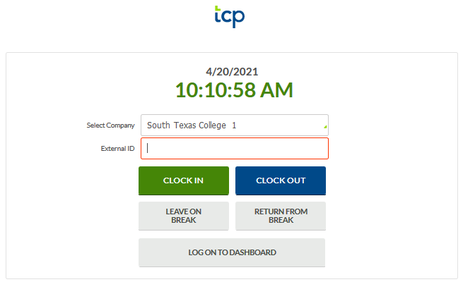
Log into Computer (Webclock)
Go to TimeClock link.
Log in using your computer credentials.
Click on:

Slide 5
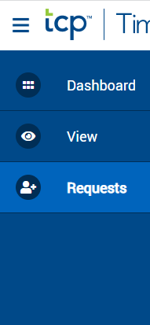
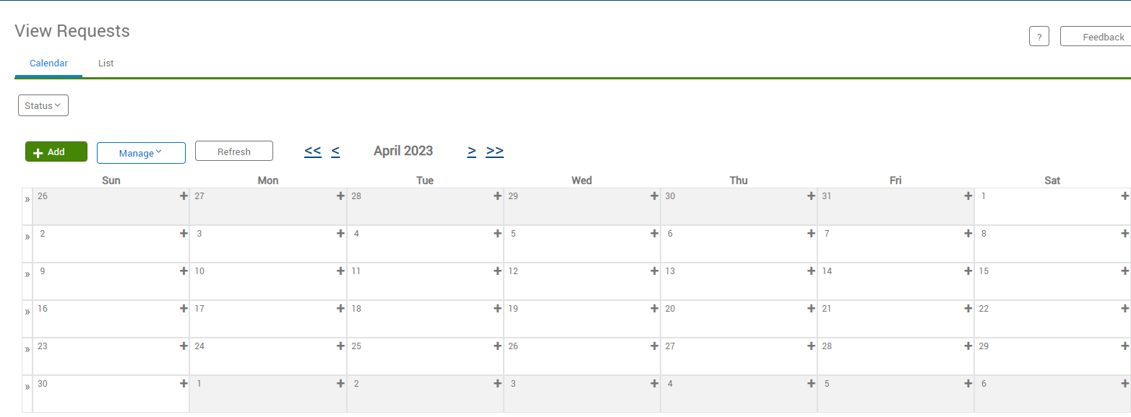
Request Leave using Computer
Click on Requests, calendar will appear. You can either double click the day you want to request leave for or click on green +Add.

Slide 6
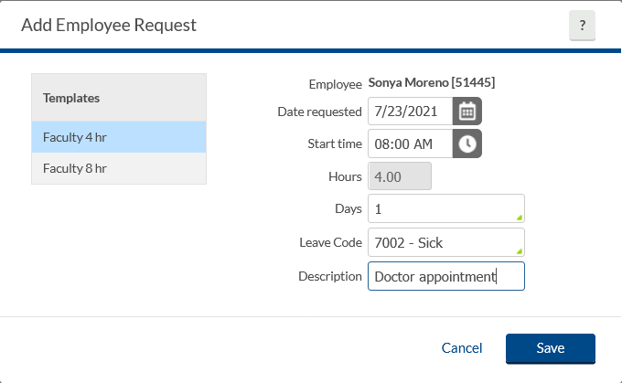
Request Leave using Computer
Enter date of requested leave, start time (typically 8 am if full day), number of hours for leave, (typically 8 if full day), number of days, and the choose a leave code from drop down. Enter a brief description.
Be sure to choose the correct time increment in 4 or 8 hours, as you are responsible for your leave requests.

Slide 7
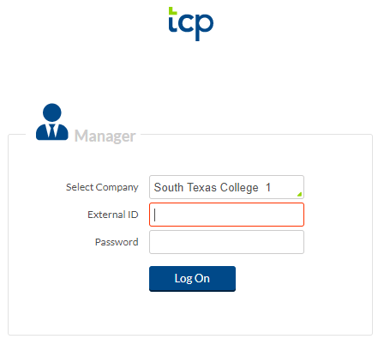
Request Leave using Computer-Supervisor Role
Supervisor will log in and view leave requests pending approval.
**Remember to log into the supervisor link to review your employees requests.**

Slide 8
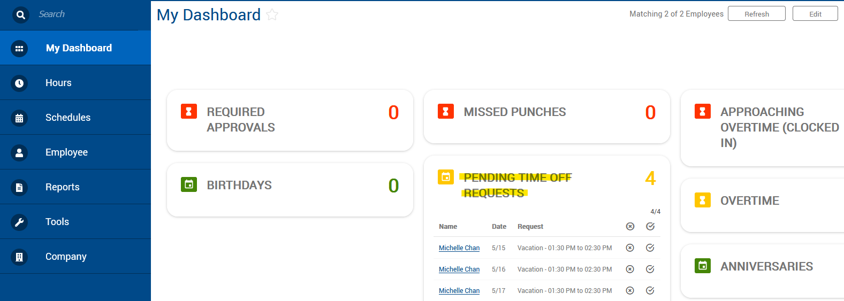
Request Leave using Computer-Supervisor Role
After logging in, they will arrive at “My Dashboard”.
Under Pending Time Off Requests, they will see all pending requests.
Then they will go to Request Manager, or you may click on Jump to Request Manager

Slide 9
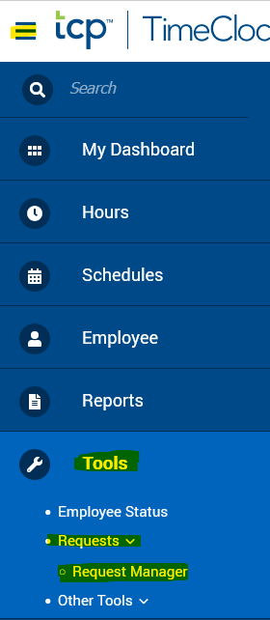
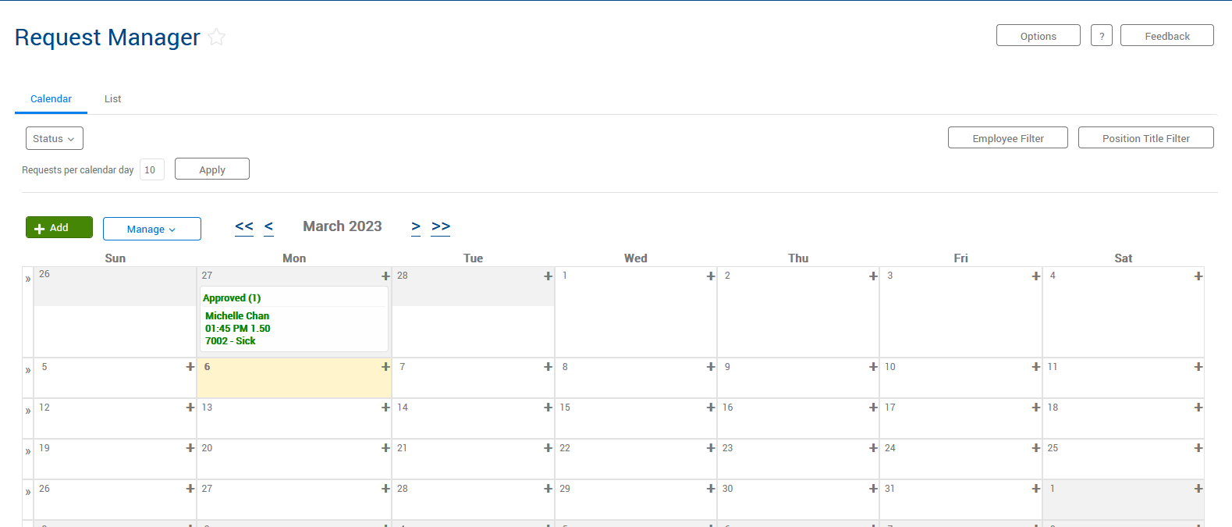
Request Leave using Computer-Supervisor Role

Slide 10
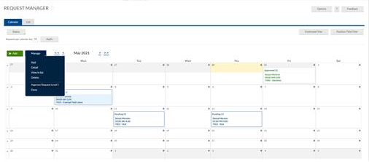
Request Leave using Computer-Supervisor Role
When supervisors log in, they will arrive at “My Dashboard”.
Under Pending Time Off Requests, they will see all pending requests. Then they will go to Request Manager.

Slide 11
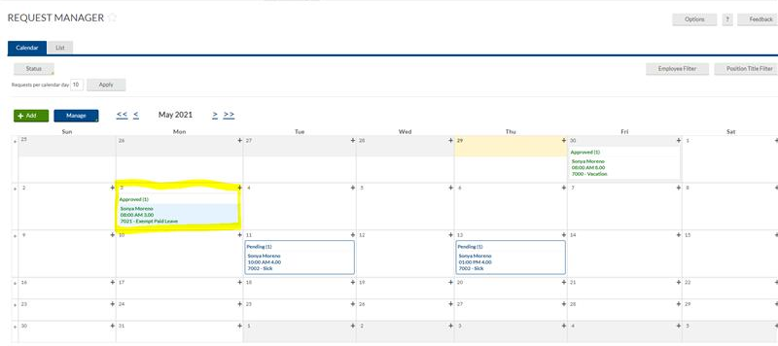
Request Leave using Computer- Supervisor Role
Once approved, the status will change from Pending to Approved.

Slide 12
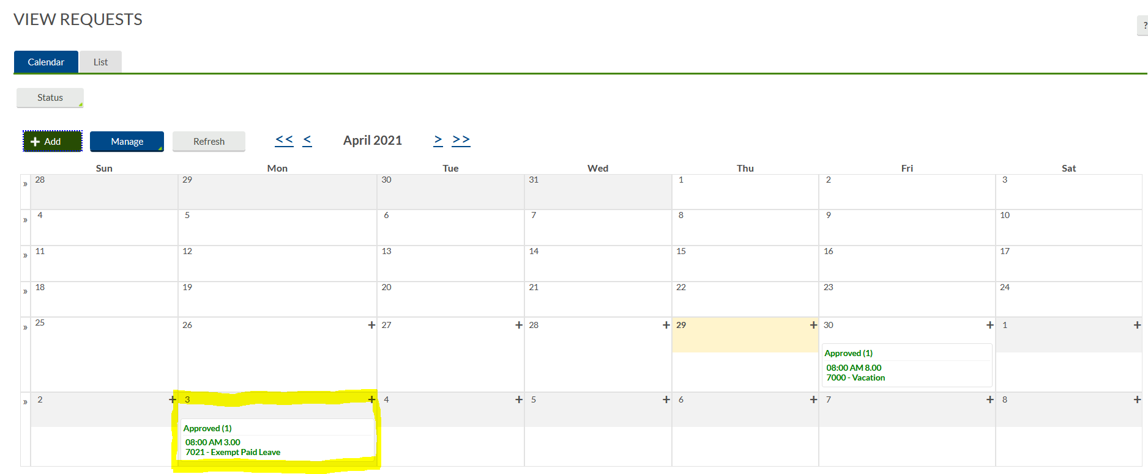
Request Leave using Computer-Employee
Now when the employee logs in and views requests, they will see that the request has been updated from Pending to Approved.

Slide 13
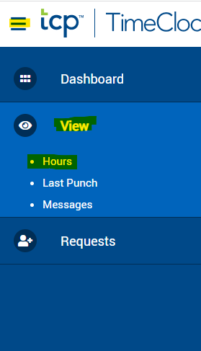
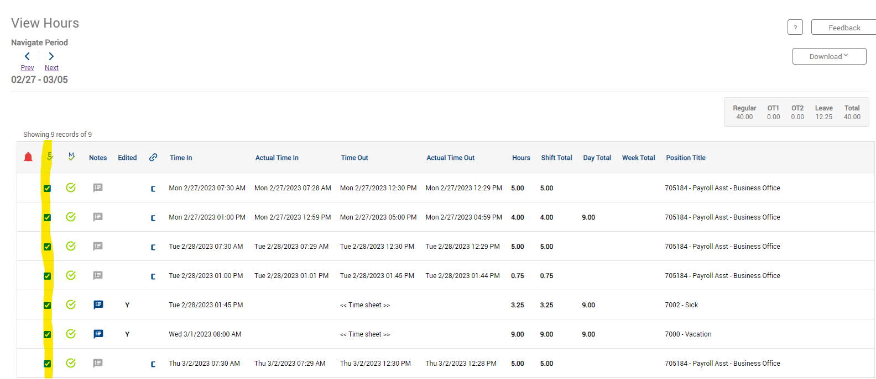
Reviewing Time Using Computer - Employee
Employee should review their timecard when leave has been approved to ensure hours are correct.

Slide 14
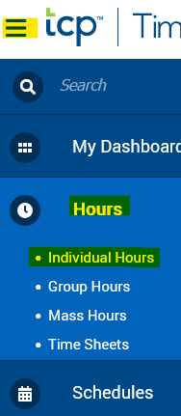
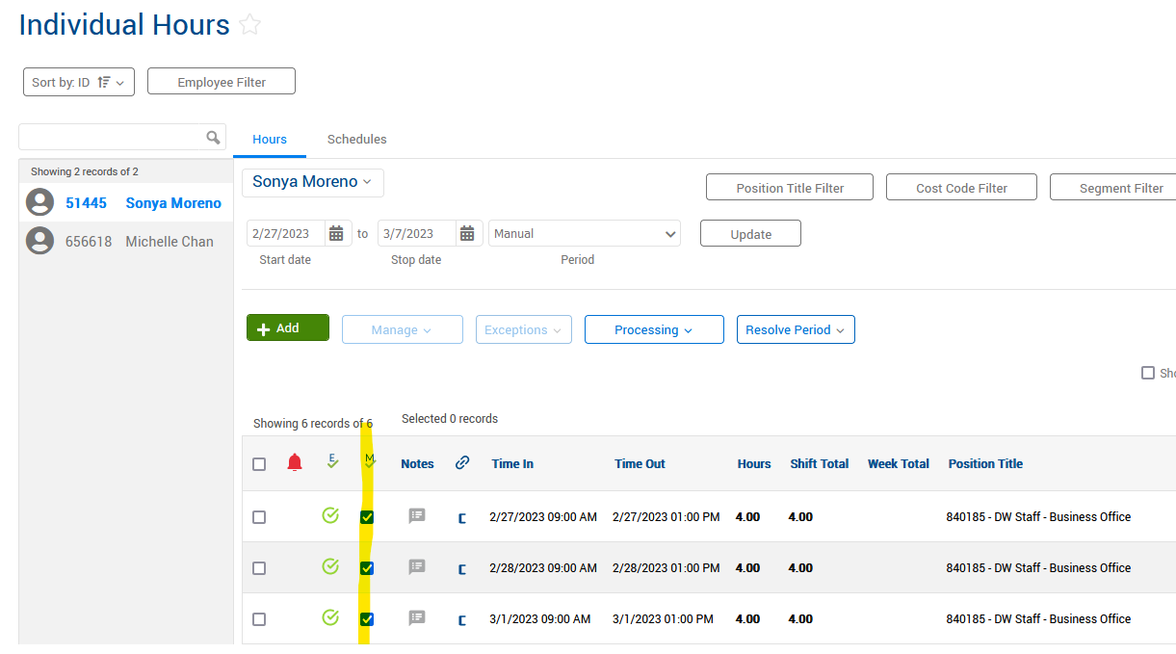
Verifying Timecards Using Computer – Supervisor Role
*For supervisor that have non-exempt employees (i.e. work studies, direct wage, classified, and professional non-exempt). You will continue to verify employees timecards.

Slide 15
Verifying Timecards Using Computer – Supervisor role
To verify non-exempt employees timecards you will go to hours, then individual hours.
There are different ways for this function.
In this example, you will click on an employee, once reviewed you will click on the
, and this should verify the week.

Slide 16
Best Practices
Use the Computer for requesting leave.
Use the Computer for reviewing and verifying timecards.
Faculty please review your absences when requesting leave for accurate payroll processing.
Become familiar with the software so that it can be utilized to the best capacity.
Of course, same fraud awareness carries over. Do not share passwords, clock-in in your assigned area, do not abuse leave, do not abuse working hours, do not overuse the ability to correct/revise punches.
Any reports of suspicious activity and abuse will be investigated.
Please visit our website where we provide training videos, presentations, and Handbooks:
https://finance.southtexascollege.edu/businessoffice/timeclock.html

Slide 17
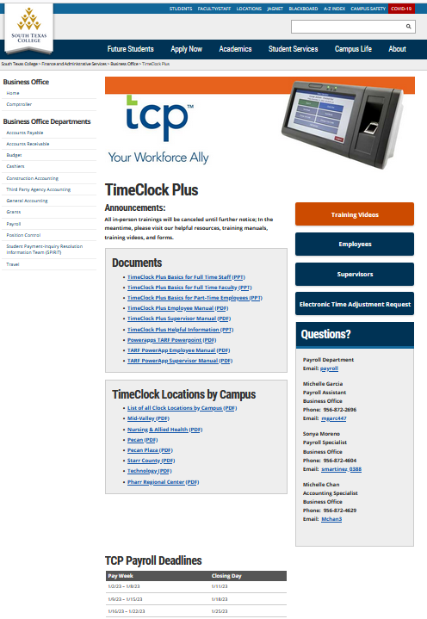

Slide 18
Thank you!
Questions? Please contact
Michelle Garcia, TCP Admin, Payroll Assistant
Email: mgarc447@southtexascollege.edu
or payroll@southtexascollege.edu

